Slide 1
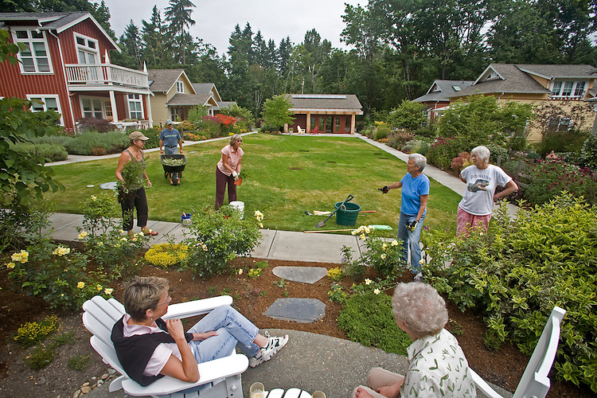
Senior Housing Residential Development Overlay District Bylaw
Planning Board Zoning Hearing
October 1, 2018

Slide 2

AGENDA
Update since 9/10 Hearing
Hinkley process
Bylaw Overview
Comments

Slide 3
Summary of changes
Definitions added for “basement” and “public amenity”
Floor area caps added to townhouses and multifamily
Clarified use authorization for single and two family uses
Reduced side yard setbacks for lots in bi/ie zone

Slide 4
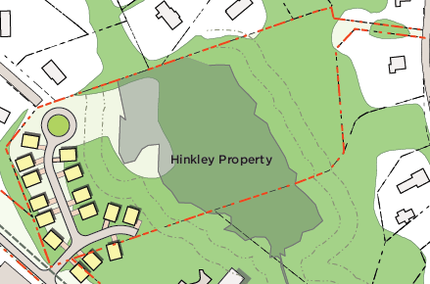
Hinkley property Concept Plan
The Town acquired the Hinkley property for $1.1m in 2001
Currently zoned rt/Ie
Adjacent to the Senior Center
Roughly 4 developable acres
Site requires extension of ice house road and the installation of sewer and public water service mains (Cost estimates for Hinkley and lot 3 were $1.8M Actual costs for Hinkley only would be lower)

Slide 5

Hinkley redevelopment process
ZONING
RFP
DISPOSITION
PERMITTING
CONSTRUCTION
Authorizes the Construction of Senior Housing
Establishes Sales Prices
Unit Design
Affordability
Regulatory Agreement between Town and Developer
Public Process to Review Project Design
Certificate of Occupancy if All Conditions Met

Slide 6
Senior Housing Bylaw Goal
The purpose of this Bylaw is to provide diverse and appropriate housing opportunities to meet the needs of people as they age and/or become disabled. Housing developed under this article should be located near services and encourage housing types, floor plans, and levels of affordability that are appropriate to serve these population groups. The housing should be designed in such a way as to promote cohesive neighborhoods, consistent in character with traditional New England architecture, and shall utilize best practices with respect to minimizing environmental impacts.

Slide 7
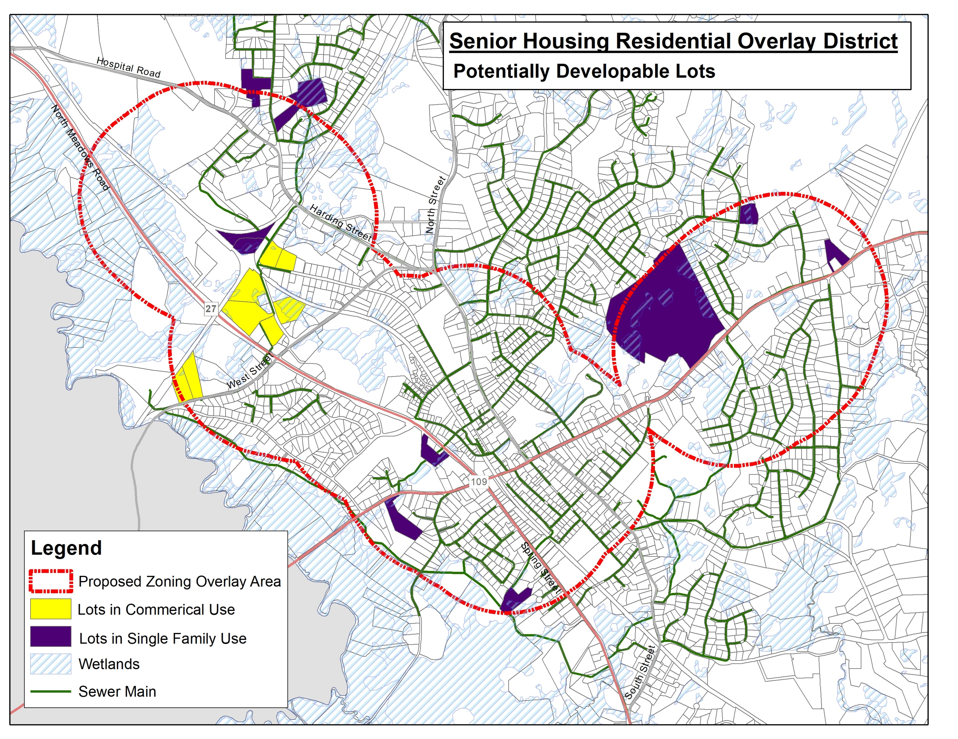
Applicability
Lots located in the rs, rt, bi, or ie Zoning districts that:
Are at least 3 developable acres in size; and
Have at least 150’ of frontage on a public street, or have an access easement from a lot in municipal use; and
Are served by public sewer and water; and
Are located within a 2,000’ radius of a public amenity.

Slide 8
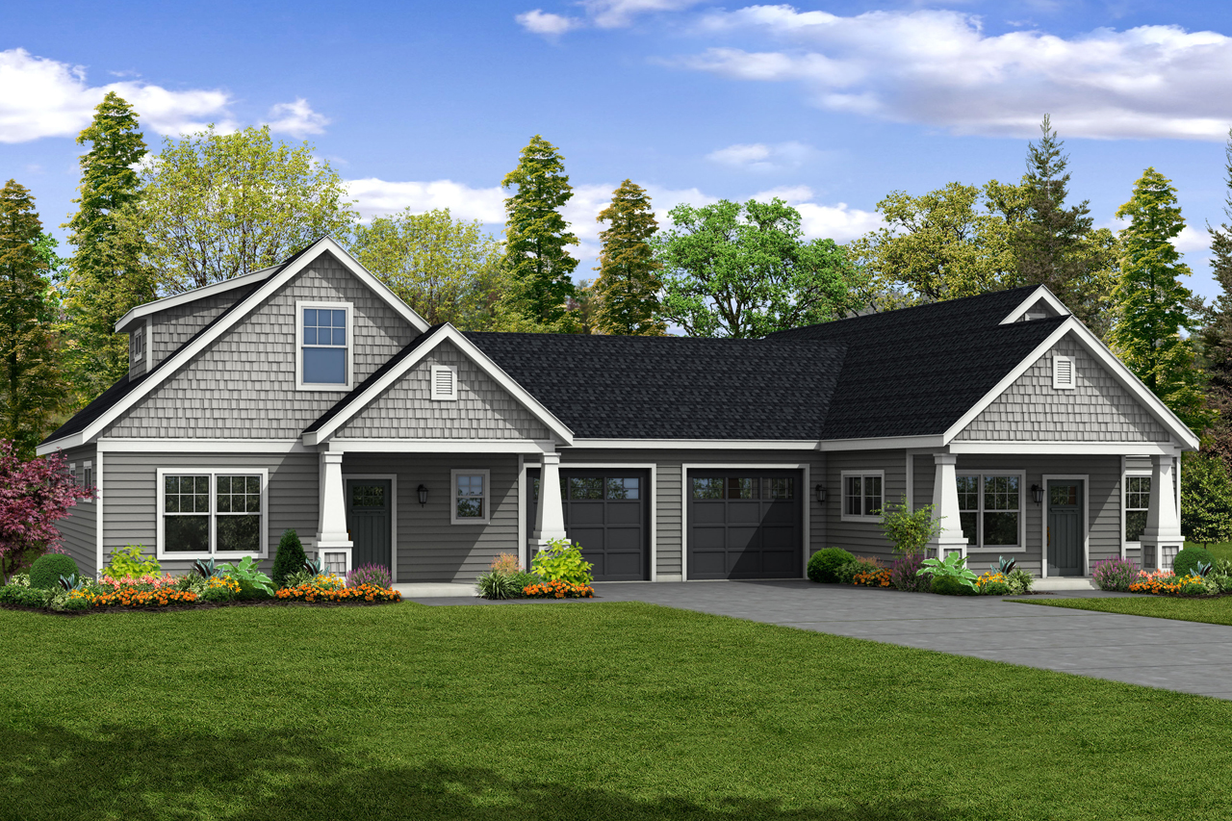
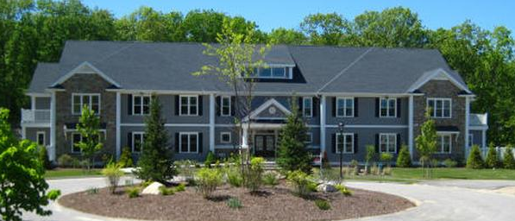
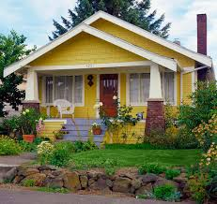
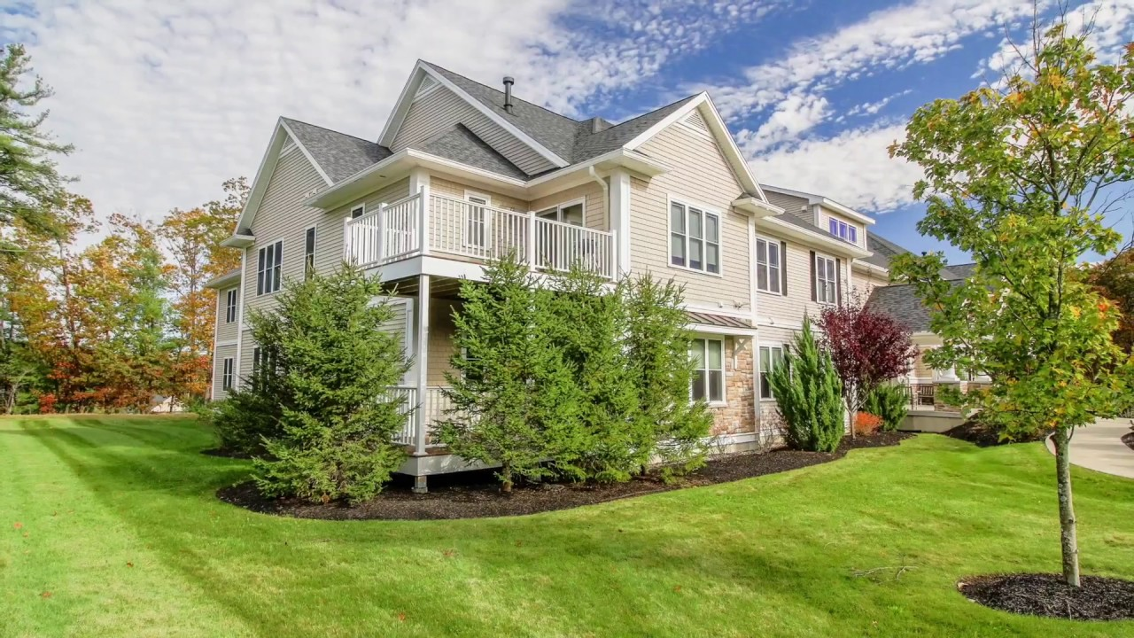
What could be built?
SINGLE FAMILY COTTAGE homes - 1,600 s.f. MAX WITH attached parking
Duplexes – SEPARATED BY WALLS OR FLOORS
Townhouses - Maximum 6 townhouses in a SINGLE row
Apartment buildings - maximum 24 units, 4 stories tall

Slide 9
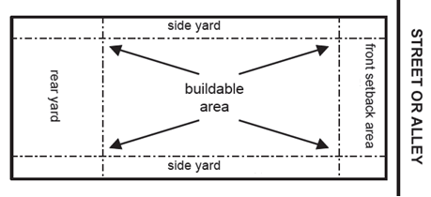
How close can it be to anyone else?
Note: If a senior housing residential development is located adjacent to any single family homes, an additional 25’ must be added to the required setback to reduce impacts on neighboring properties.
 | RT | RS | BI/IE
Cottage & Two-Family Dwellings (Front/Rear Yard) | 20’ | 30’ | 15’
Cottage & Two-Family Dwellings (Side Yard) | 10’ | 10’ | 7.5’
Townhouse Dwellings (All) | 20’ | 35’ | 15’
Multifamily Dwellings (All) | 30’ | 35’ | 20’
Note: TOWNHOUSE BUILDINGS MUST BE SEPARATED BY AT LEAST 15’ AND MULTIFAMILY BUILDINGS MUST BE SEPARATED BY AT LEAST 30’.

Slide 10
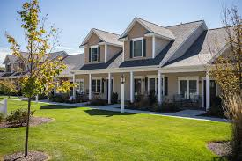
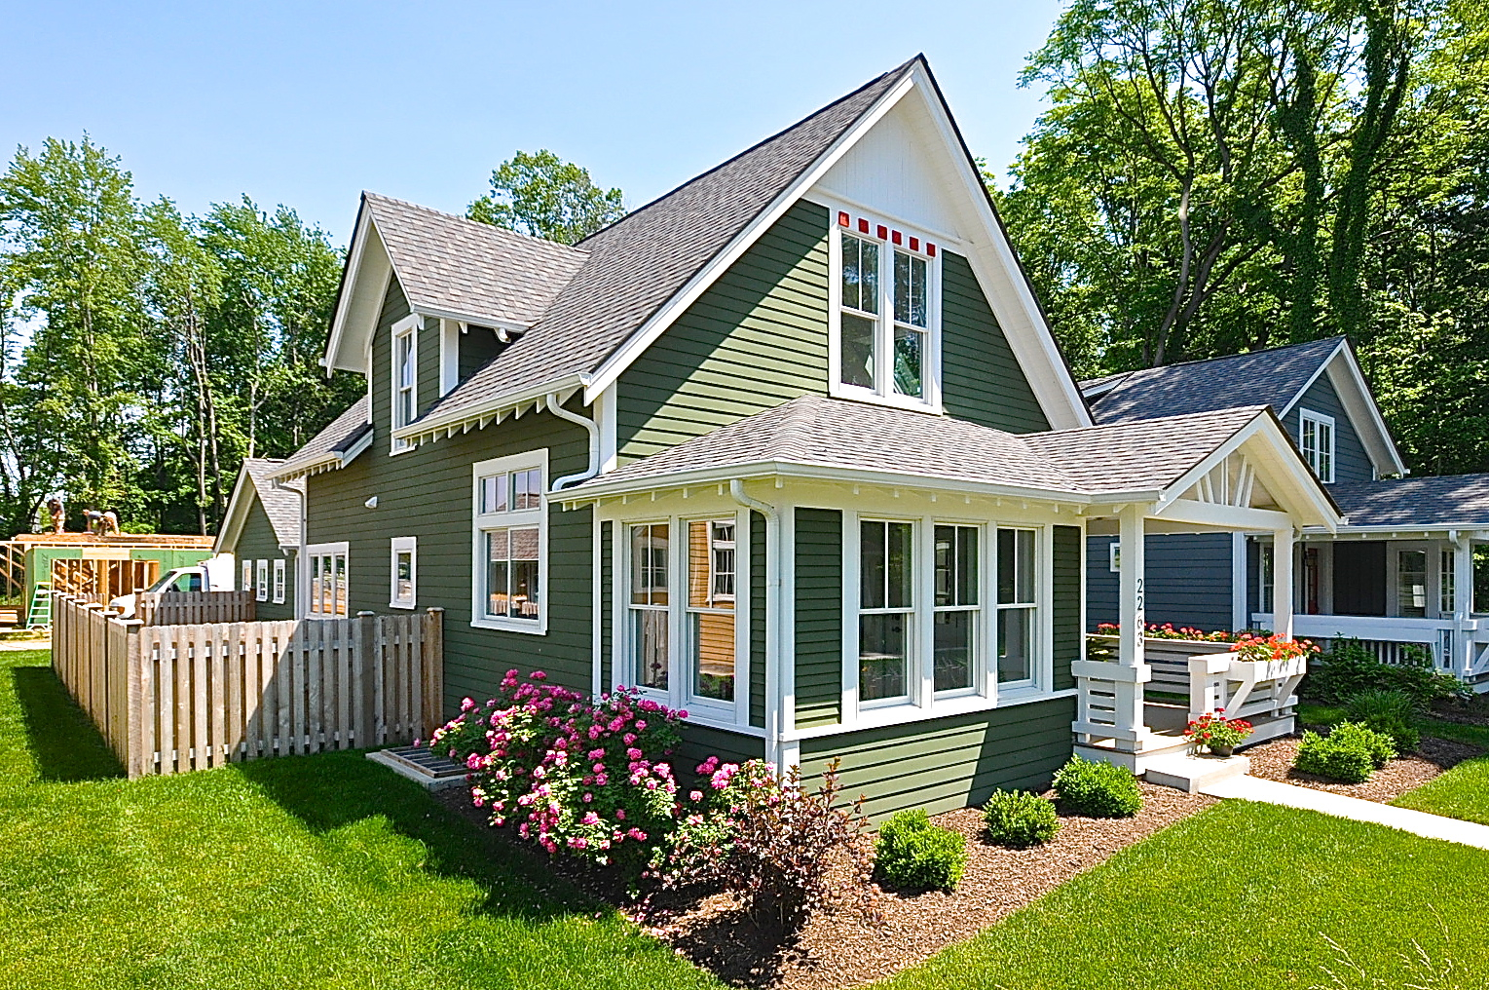
Development review process
ANY PROJECT PROPOSED UNDER THIS BYLAW:
MUST MEET THE DIMENSIONAL AND DESIGN STANDARDS IN THE BYLAW. THESE STANDARDS OFFSET IMPACTS ON ABUTTERS, REQUIRE ACCESSIBLE DESIGN AND ENERGY EFFICIENCY, AND MANDATE DEED RESTRICTIONS SO THE UNITS MAY ONLY BE OCCUPIED BY SENIOR/DISABLED HOUSEHOLDS.
MUST RECEIVE A SPECIAL PERMIT FROM THE PLANNING BOARD. All projects proposed under this bylaw will be reviewed by the planning board for conformance with the multi-family site plan review standards (as applicable) as well as the standards within this bylaw.

Slide 11

Your support is respectfully requested
The Planning Board retains the right to deny any Special Permits for future proposals requested under this Bylaw that are incongruous to their neighborhood. This includes proposals involving lot merger.
No senior housing has been built in Medfield since 2000. There are two senior housing developments – one is income restricted and both have wait lists – yet every resident plans on aging.
The shortage in senior housing is a major regional issue. BANANAism is making it worse and driving cost.

Slide 12
Question and comments
Planning board zoning hearing #2

