Slide 1
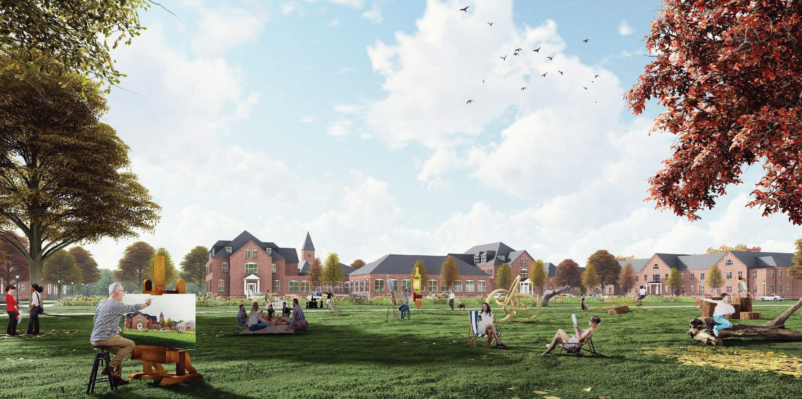
Medfield State Hospital Redevelopment
Presentation to the Town of Medfield Planning Board
April 3, 2023

Slide 2
Order of Discussion
Process Overview | Matt Lawlor, R+C
Outstanding Discussions | Abby Goldenfarb, Trinity
  Status of Paint Shop
  Noise Abatement on WTP
  Further review of Roadways/Parking
  Parcel Boundary Plan
Stormwater Requirements & Design Approach | Jeff Koetteritz, VHB
Offsite Traffic Mitigation Improvements | Matt Kealey, VHB

Slide 3
Where We’ve Been…
Topics Previously Discussed
Public Hearing Session #1 (February 6, 2023)
  Overview of the Project
  Inclusionary Zoning
  Parking/Access/Circulation
  Parking Waiver Requests
Public Hearing Session #2 (March 6, 2023)
  Parking/Access/Circulation Follow-up
  Building Descriptions and Floor Plans
  Historic Resources
Public Hearing Session #3 (March 20, 2023)
  Overall Site Design
    Landscaping and preliminary lighting
  Roadway/Circulation Design
  Infrastructure
    Water & Wastewater
    Energy Conservation Studies

Slide 4
What’s to Come…
Tonight’s Topics for Discussion
Public Hearing Session #4
  Outstanding Discussions from prior hearing sessions
  Stormwater Requirements & Design Approach
  Offsite Traffic Mitigation Improvements
Further Board Q&A and Public Comment
Close Public Comment

Slide 5
What We’re Looking Forward to… Remaining Topics for Discussion
Close of hearing and deliberation with vote expected on April 10, 2023
Post-Approval Conditional Items
  Final Stormwater Management plan
  Photometric/Lighting Plan
  Final arborist analysis and Planting Plan

Slide 6
  Outstanding Discussions | Trinity

Slide 7
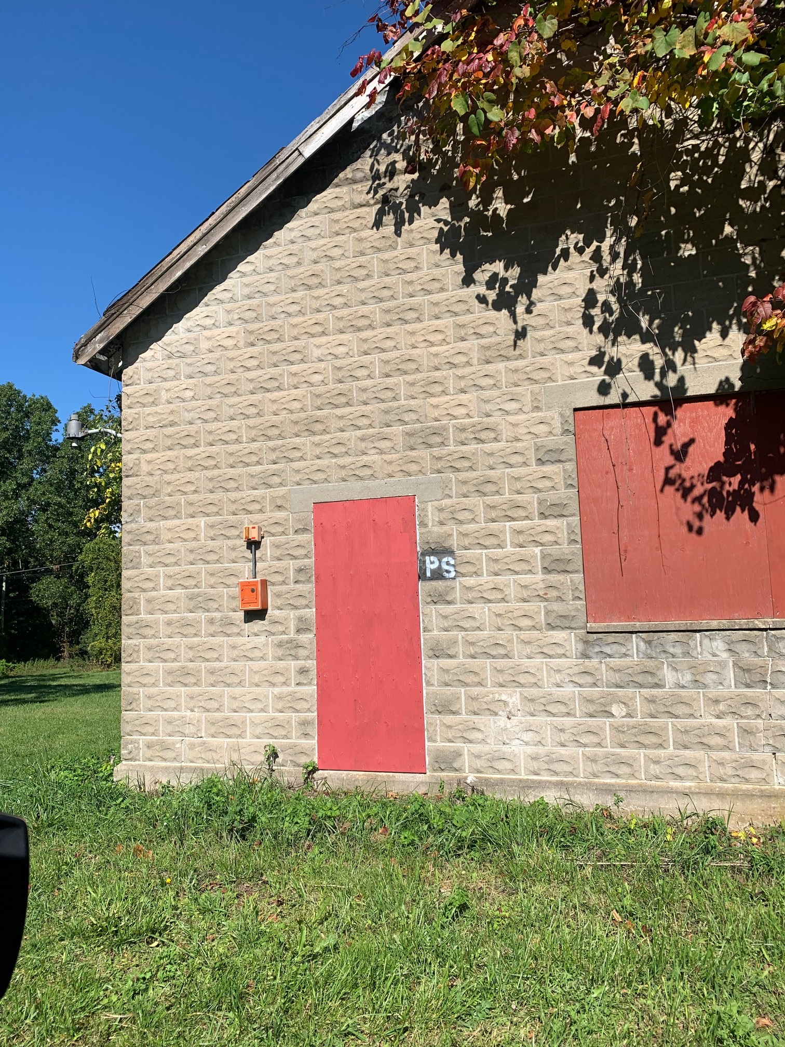
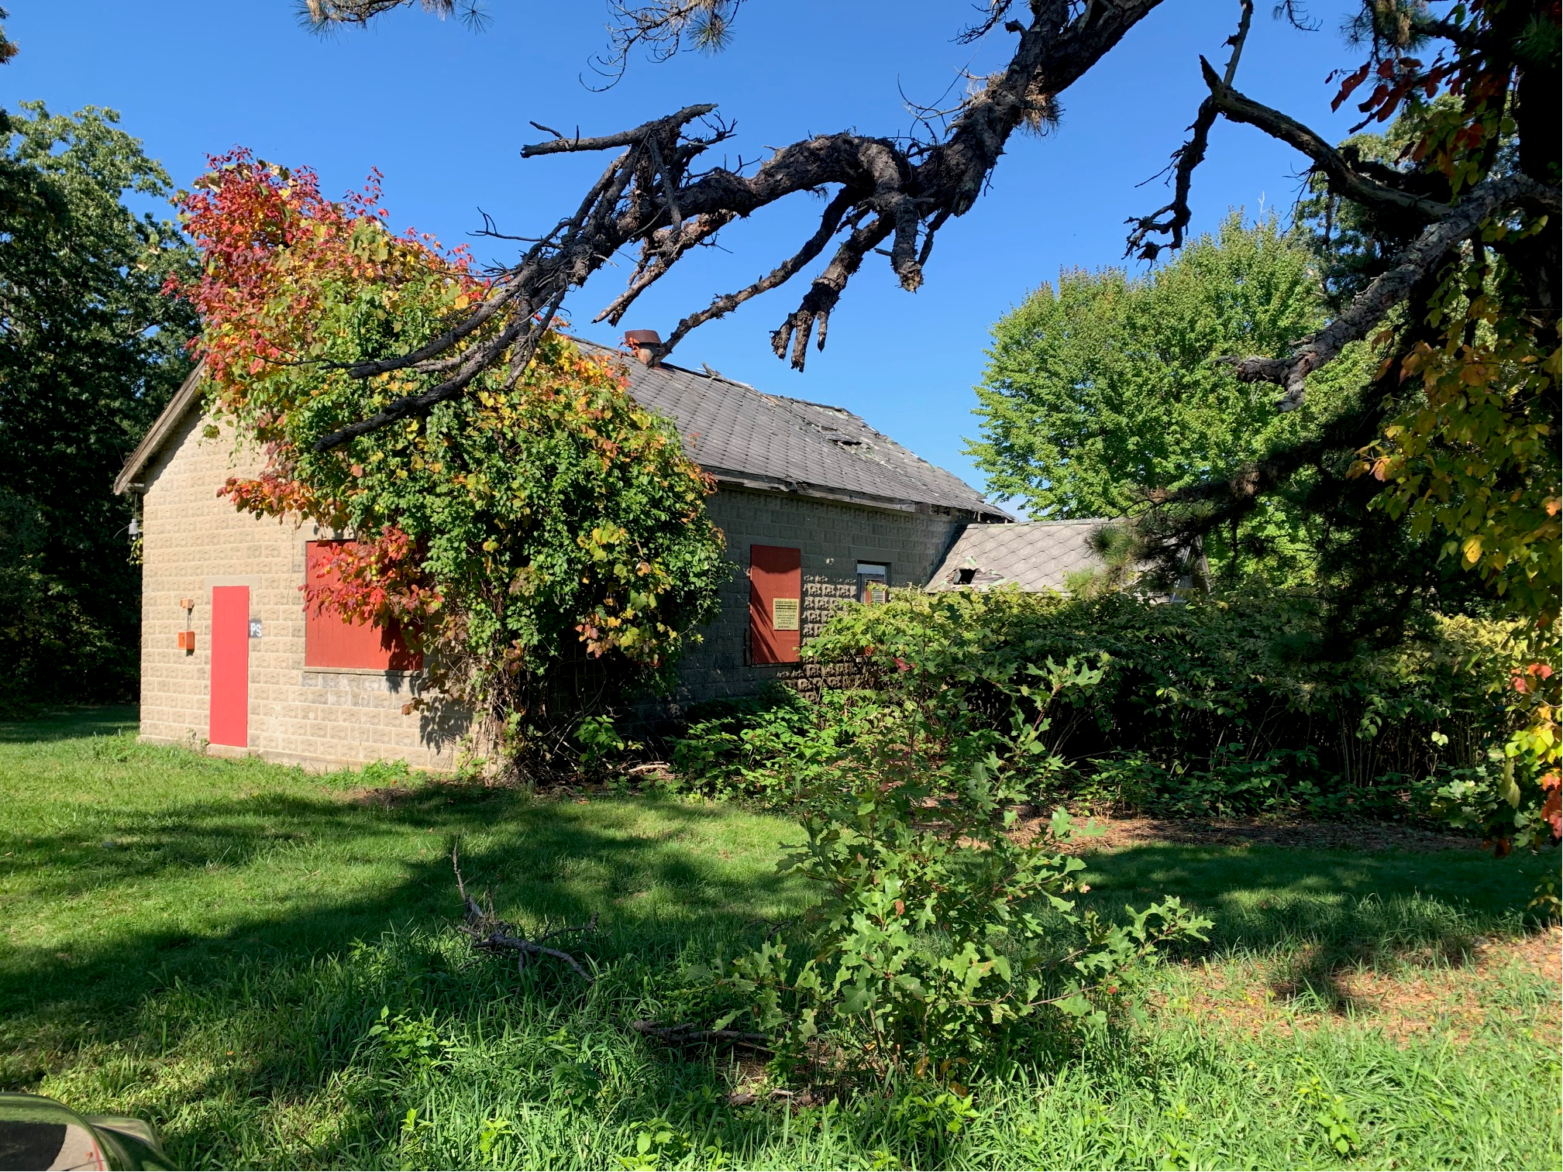
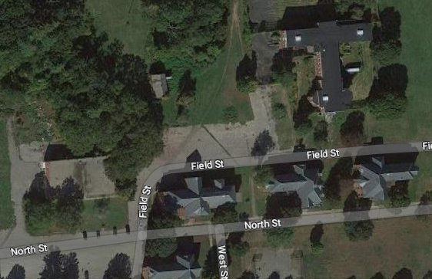
Outstanding Discussions
Status of Paint Shop
Noise Abatement on WTP
Further review of Roadways/Parking

Slide 8
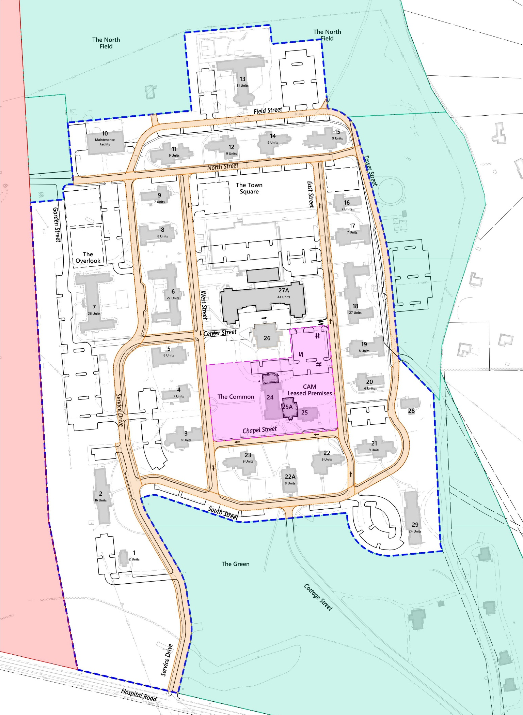
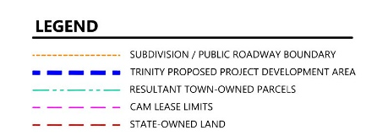
Preliminary Boundary Plan
DRAFT: PENDING REVIEW & APPROVAL OF THE MEDFIELD SELECT BOARD

Slide 9
  Stormwater Design Approach | VHB

Slide 10
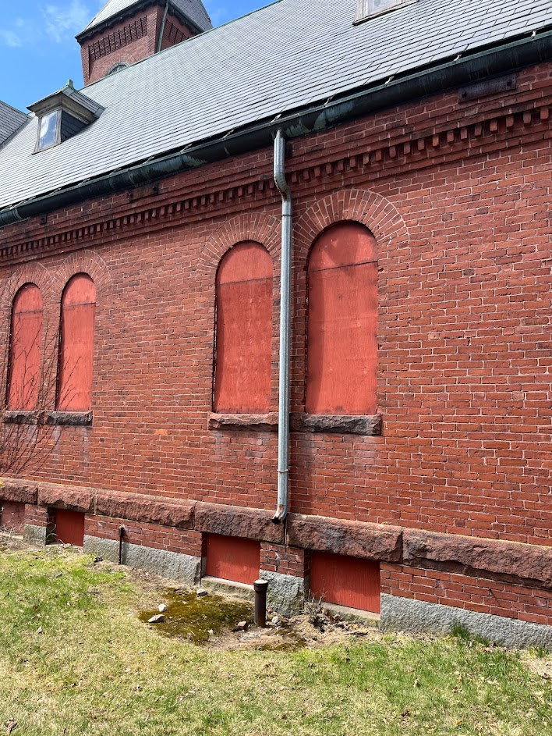
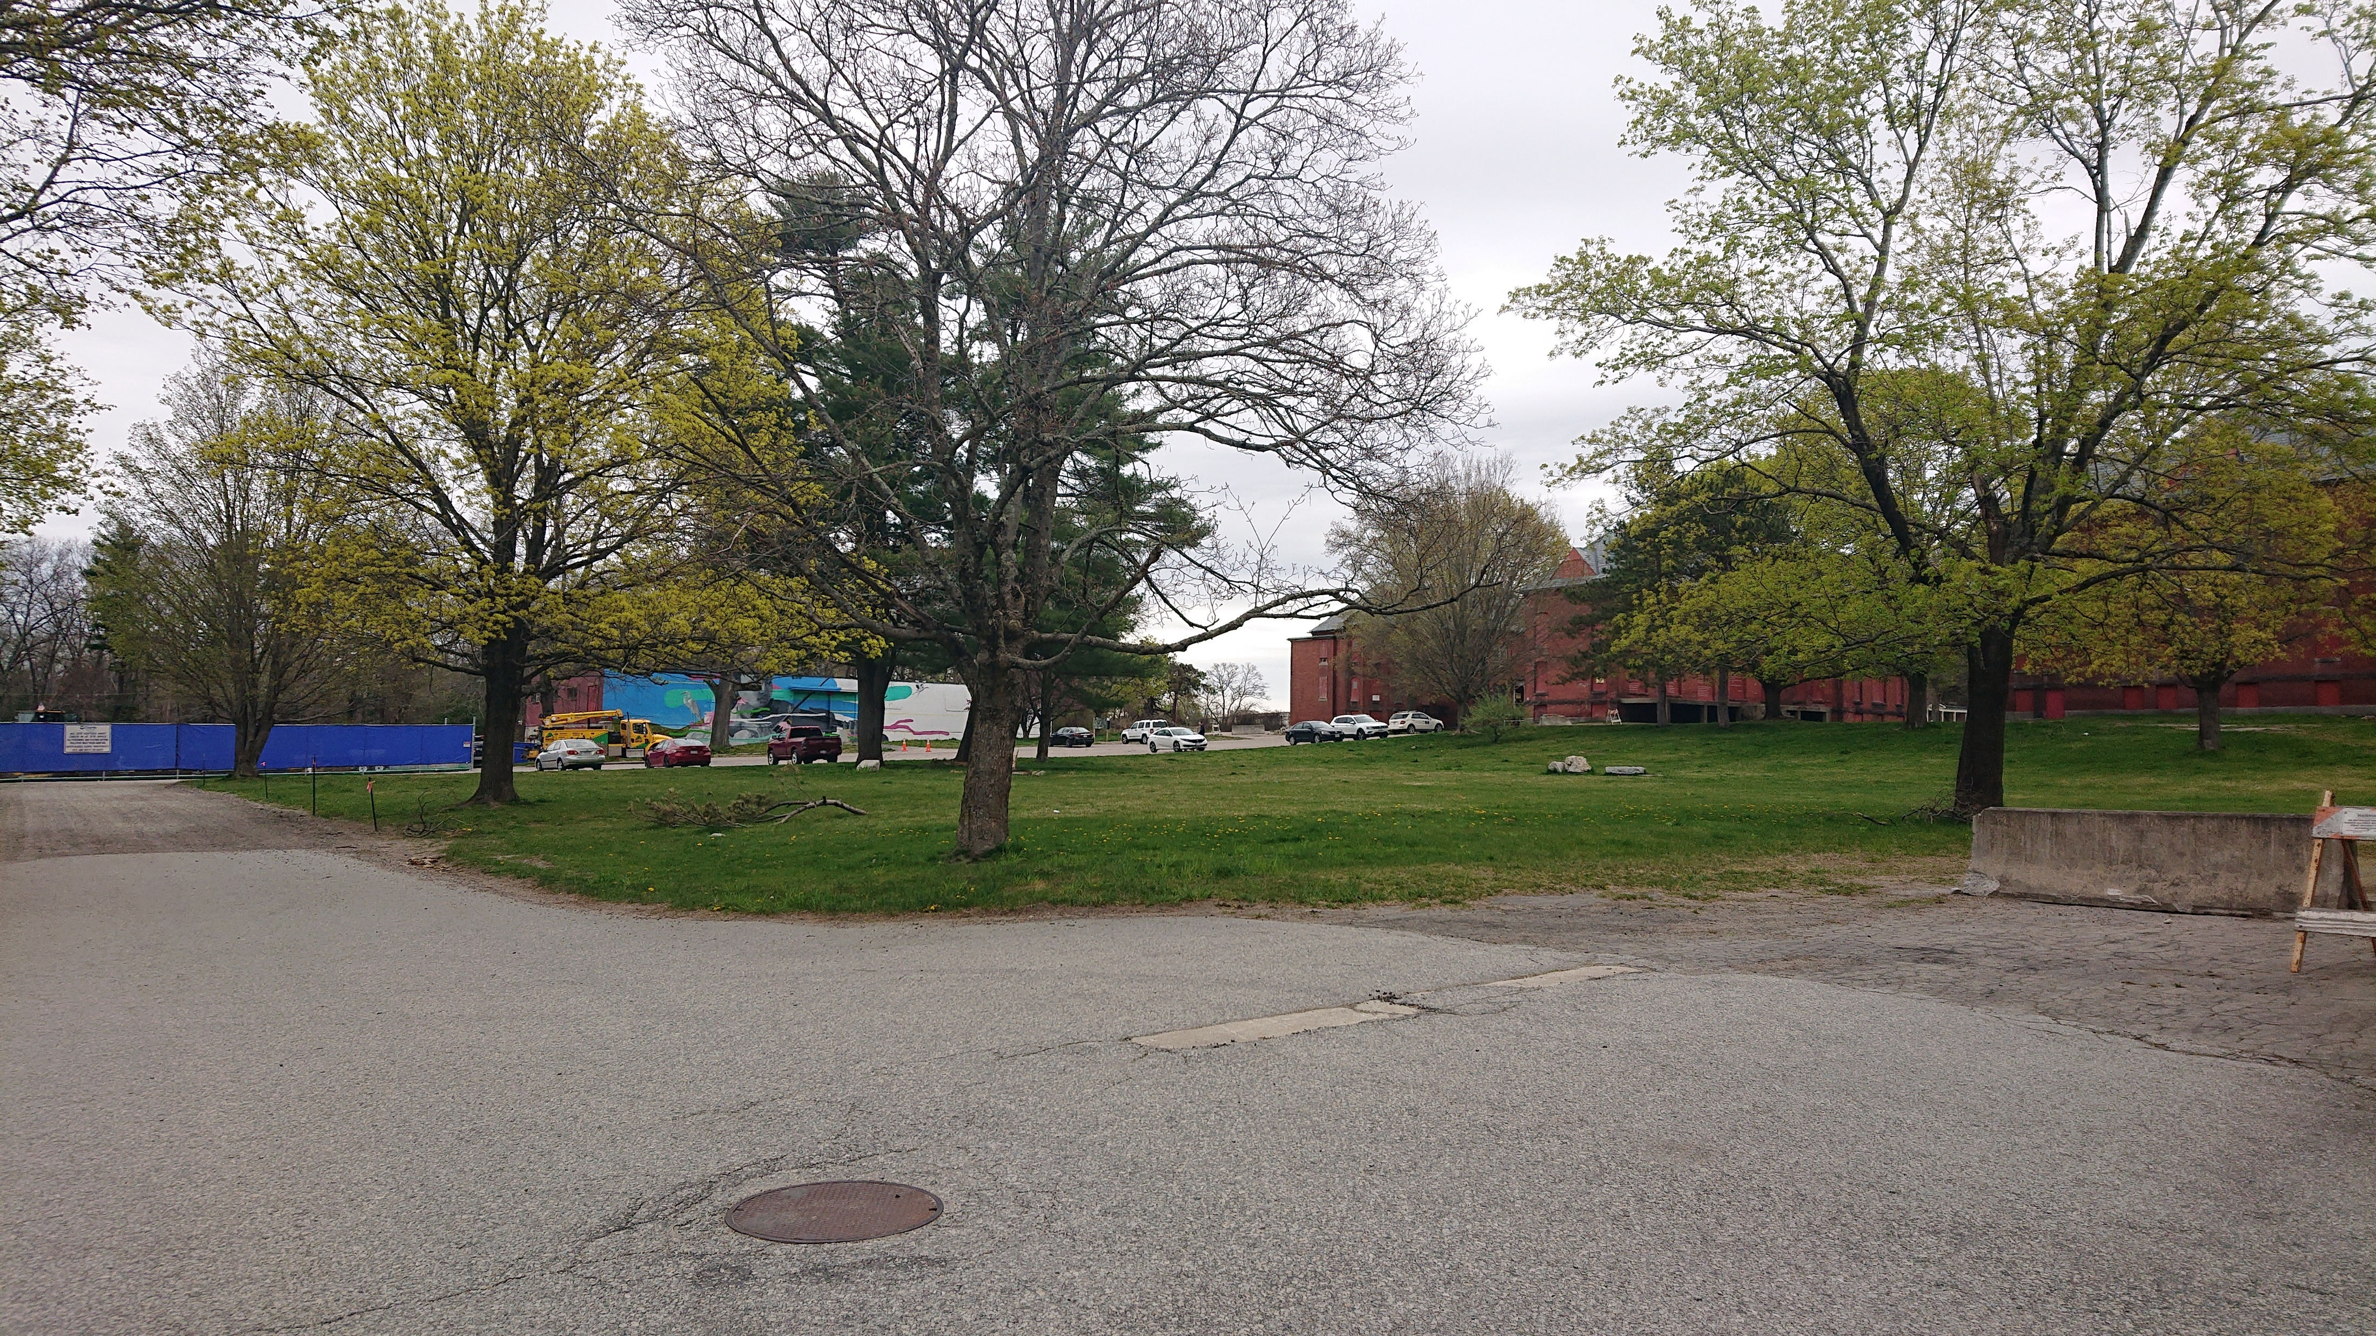
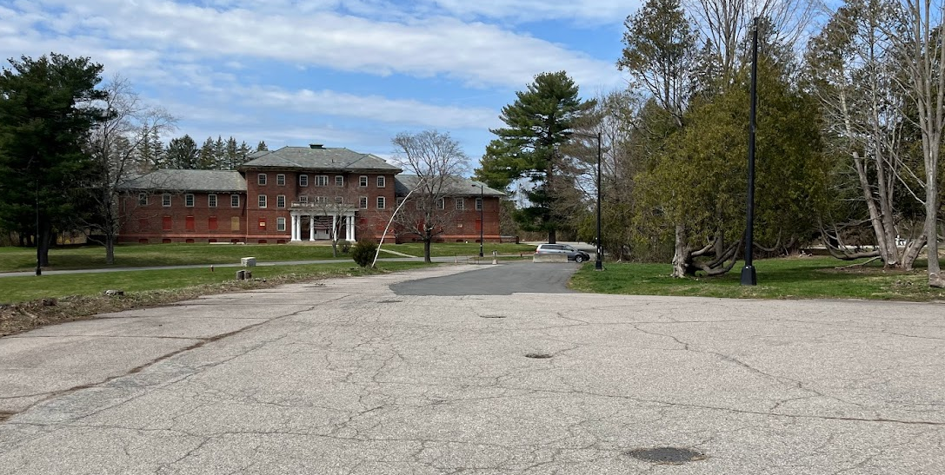
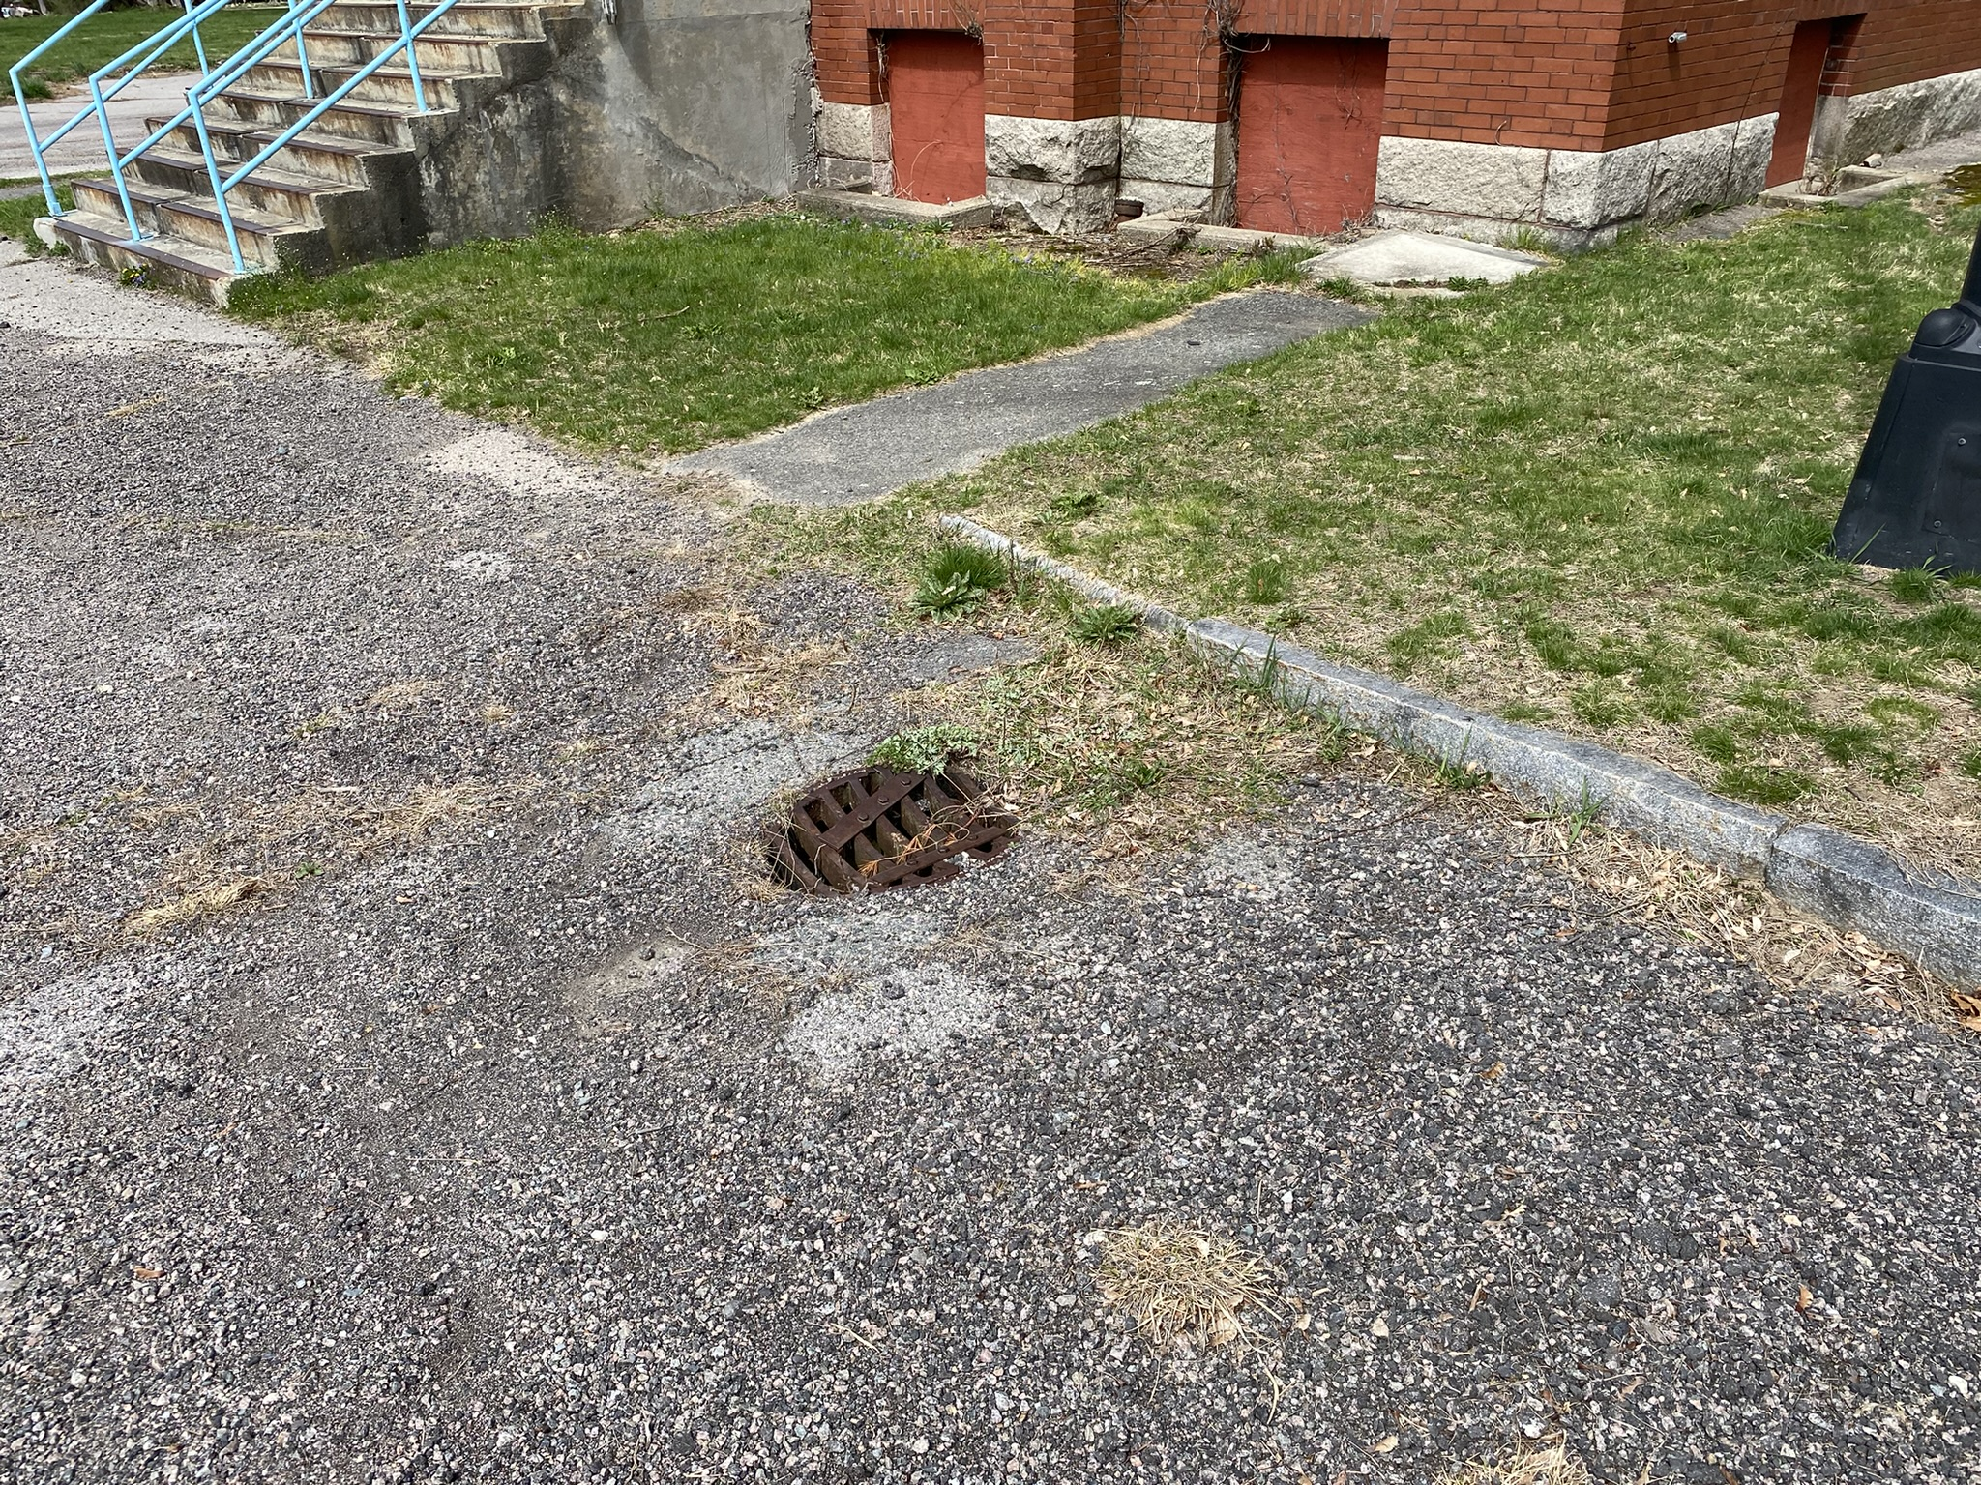
Existing Drainage Conditions
Country-Drainage
Combined Storm-Sanitary
Settled/Collapsed Structures
Disconnected Downspouts

Slide 11
Stormwater Regulatory Targets
Massachusetts Stormwater Handbook
      Mitigating Peak Rates of Runoff
      Stormwater BMPs for Water Quality
      Promoting Recharge
      Erosion and Sedimentation Control (SWPPP and NPDES CGP)
      Operations and Maintenance
      Illicit Discharges
MS4:
  TSS and Phosphorus Removal Targets
Additional MSH District Requirements
      Parking areas shall be designed such that 75% or more of the first 1/2 inch of stormwater runoff from impervious surfaces is treated for water quality by a combination of LID techniques (rain gardens, swales, infiltration facilities, etc.)

Slide 12
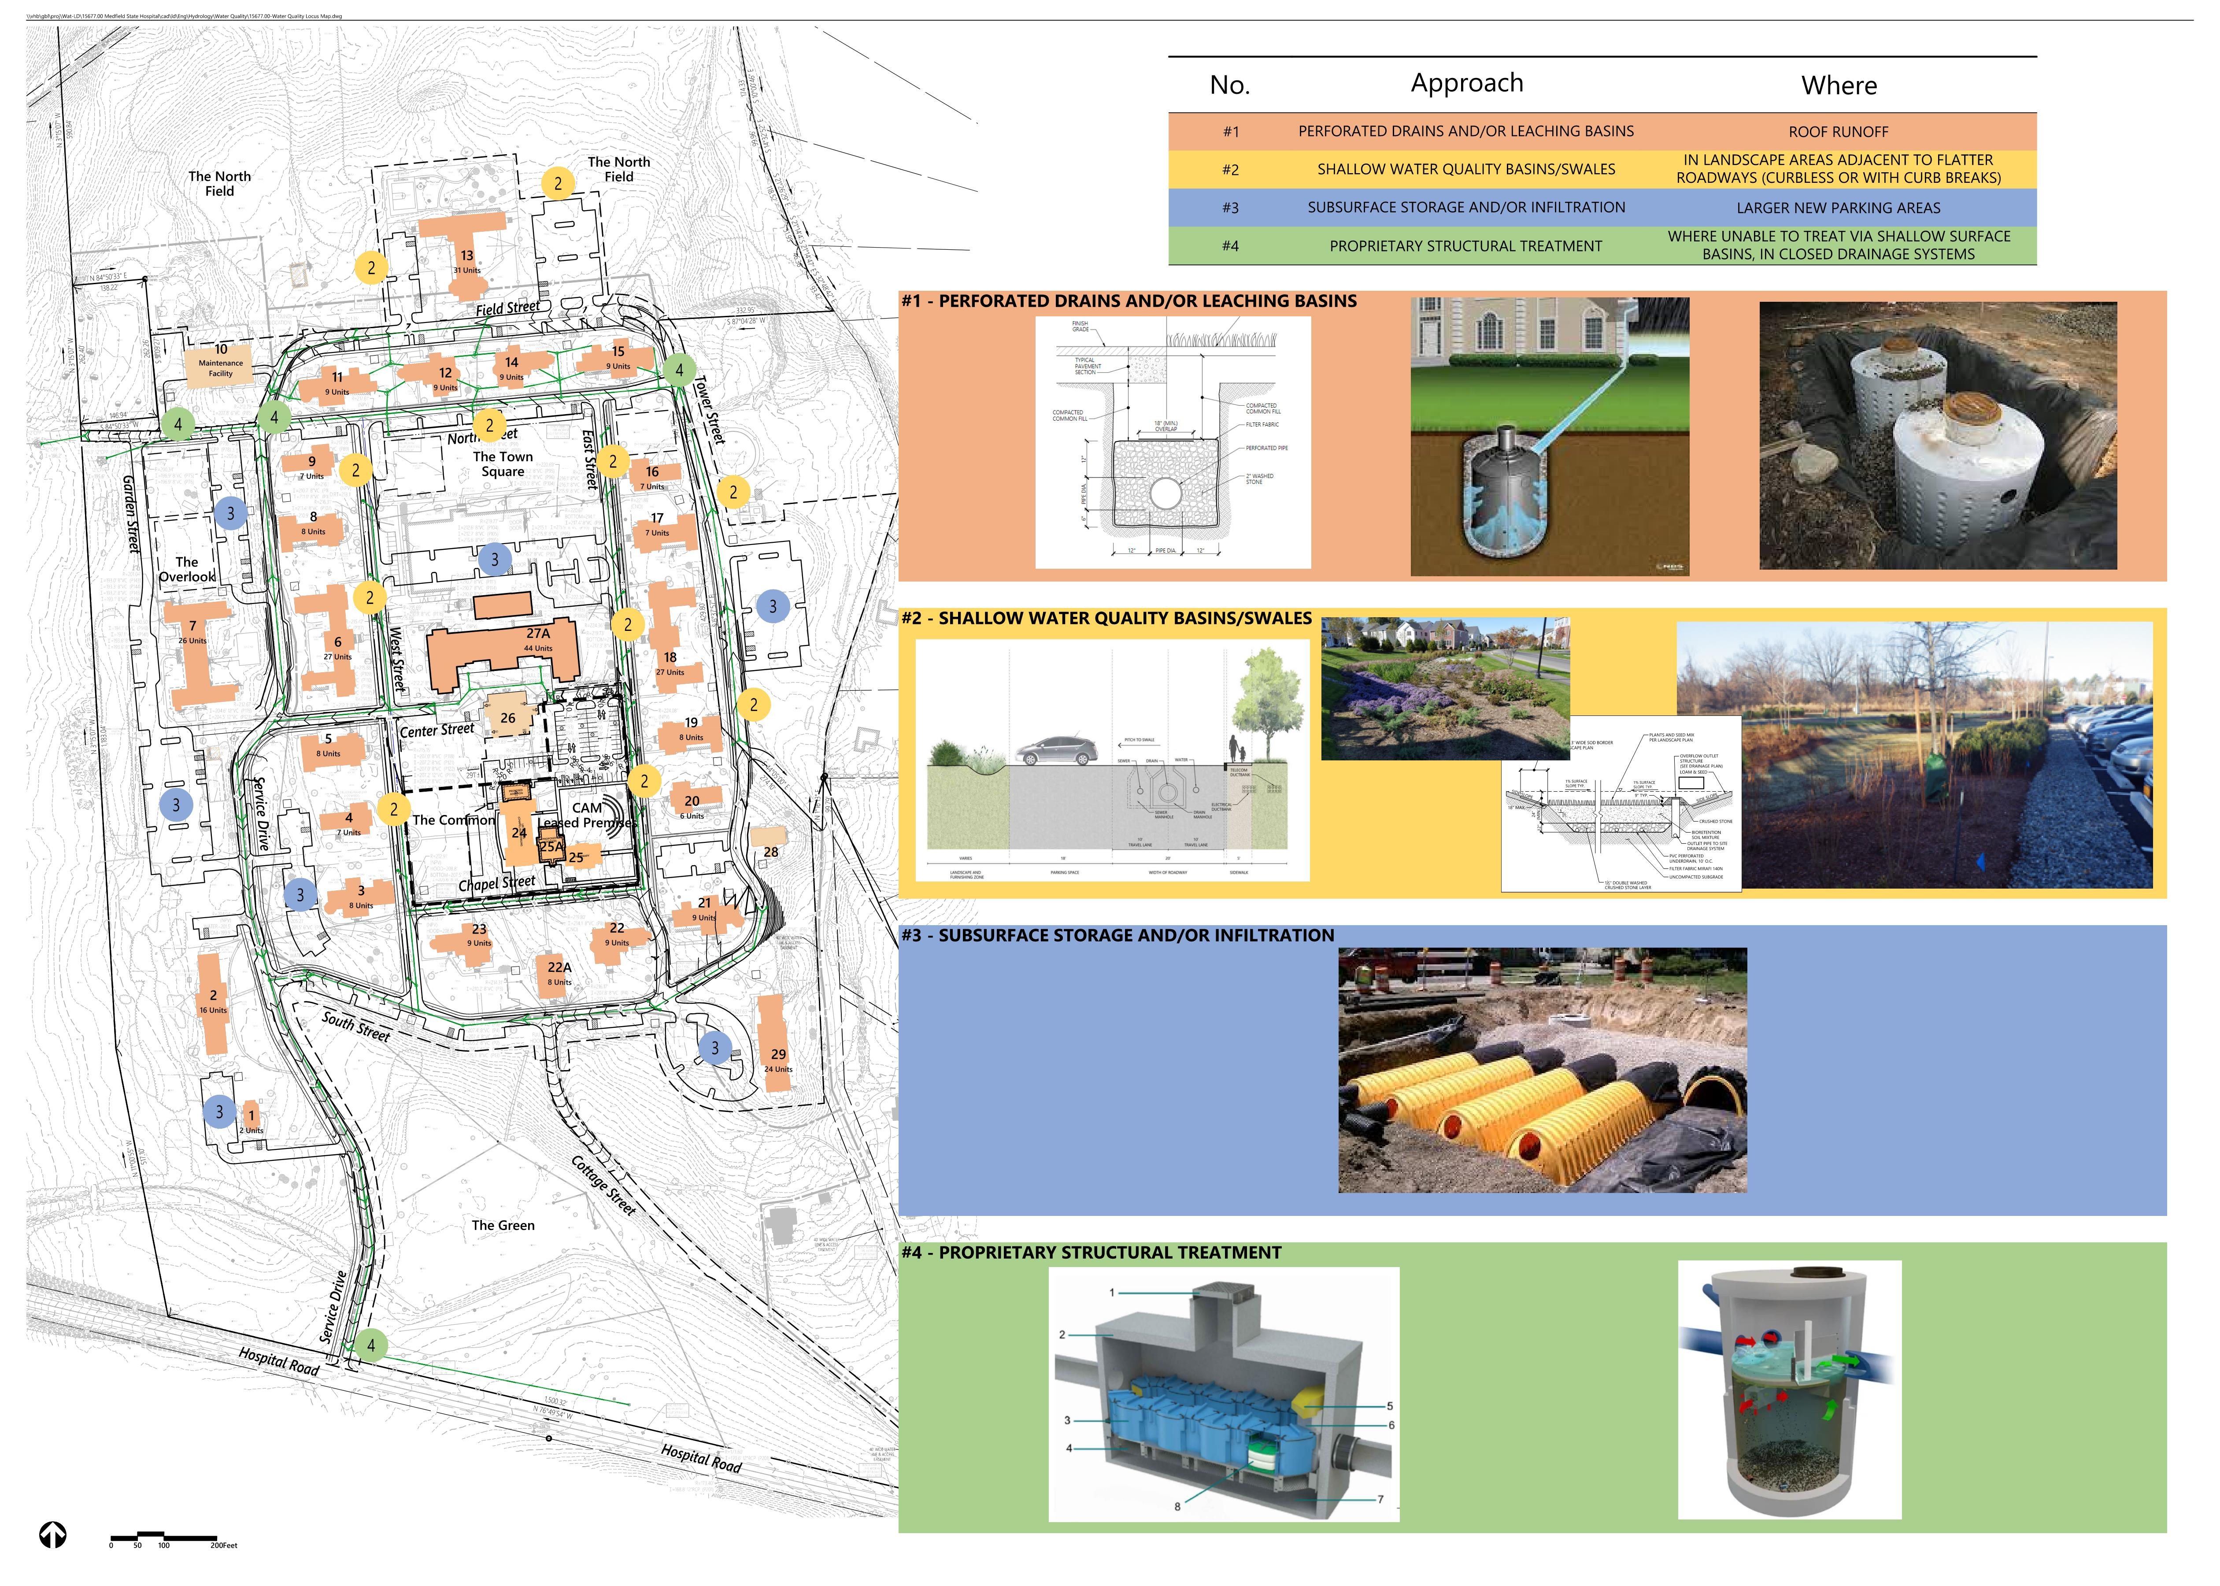
Stormwater Design Approach

Slide 13
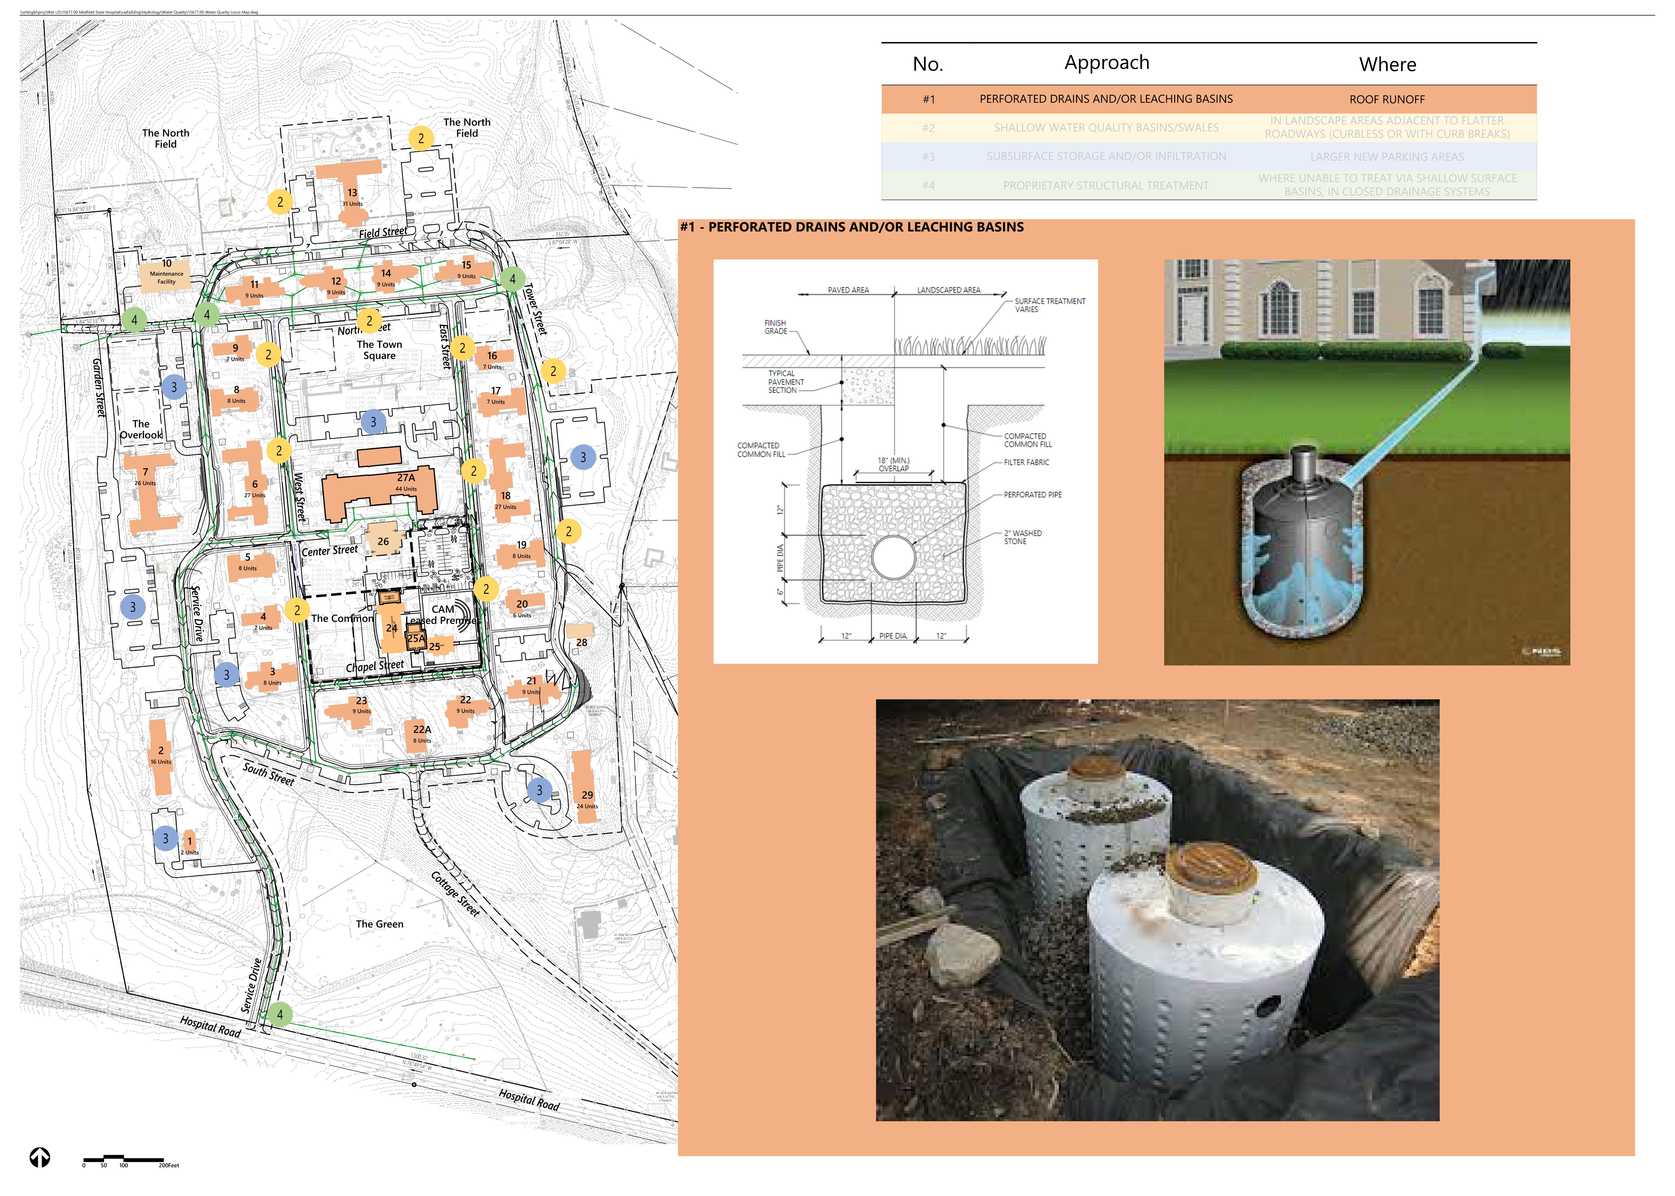
Stormwater Design Approach

Slide 14
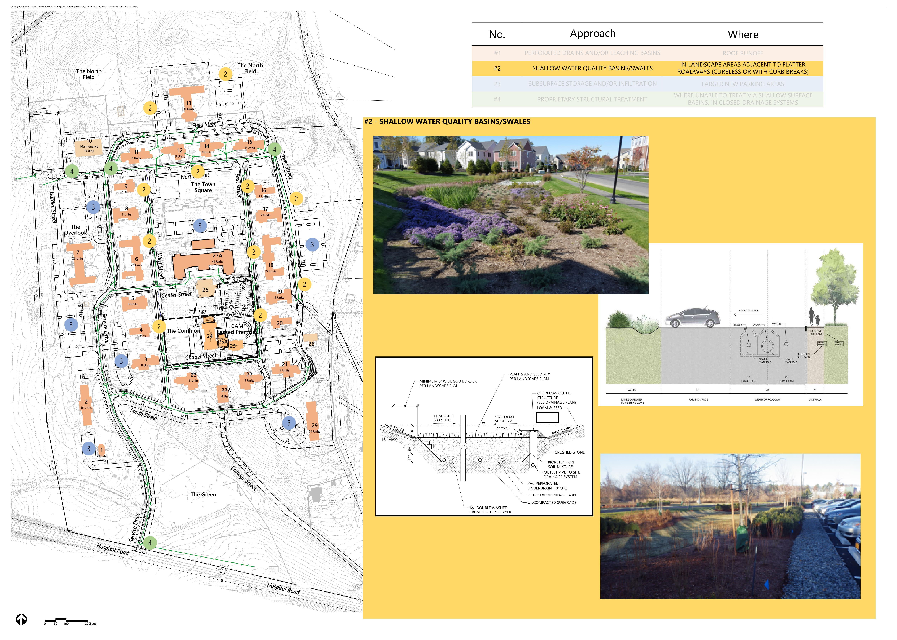
Stormwater Design Approach

Slide 15
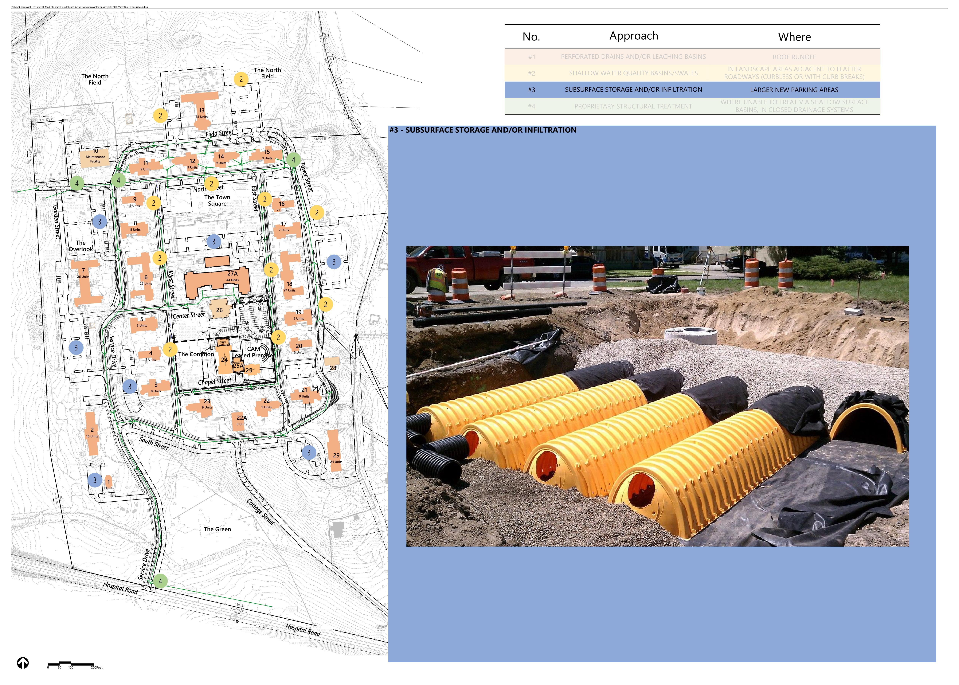
Stormwater Design Approach

Slide 16
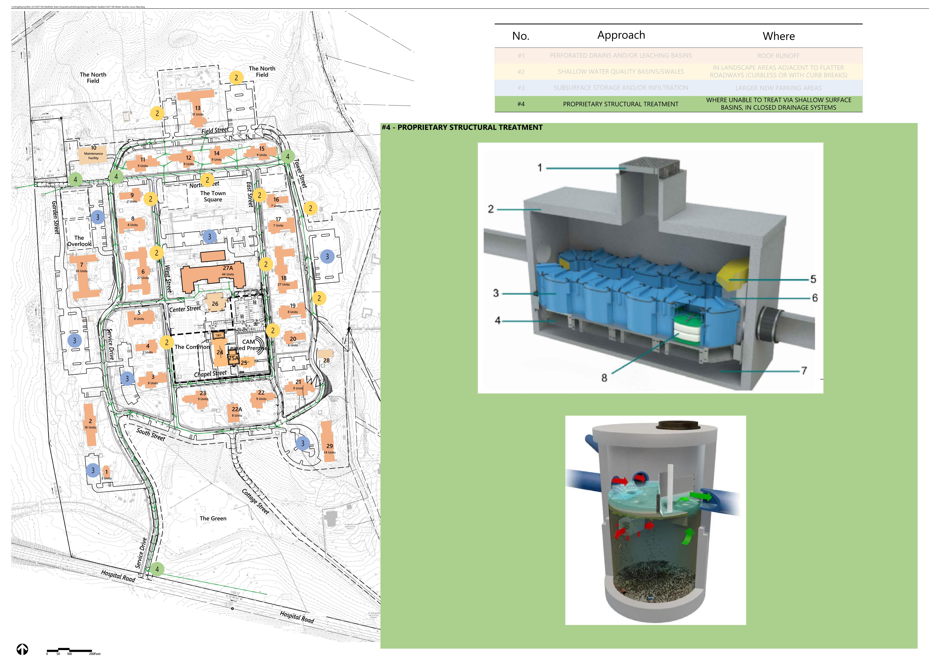
Stormwater Design Approach

Slide 17
  Planning Board Q&A

Slide 18
  Public Comment Opportunity

Slide 19
  Offsite Traffic Mitigation | VHB

Slide 20
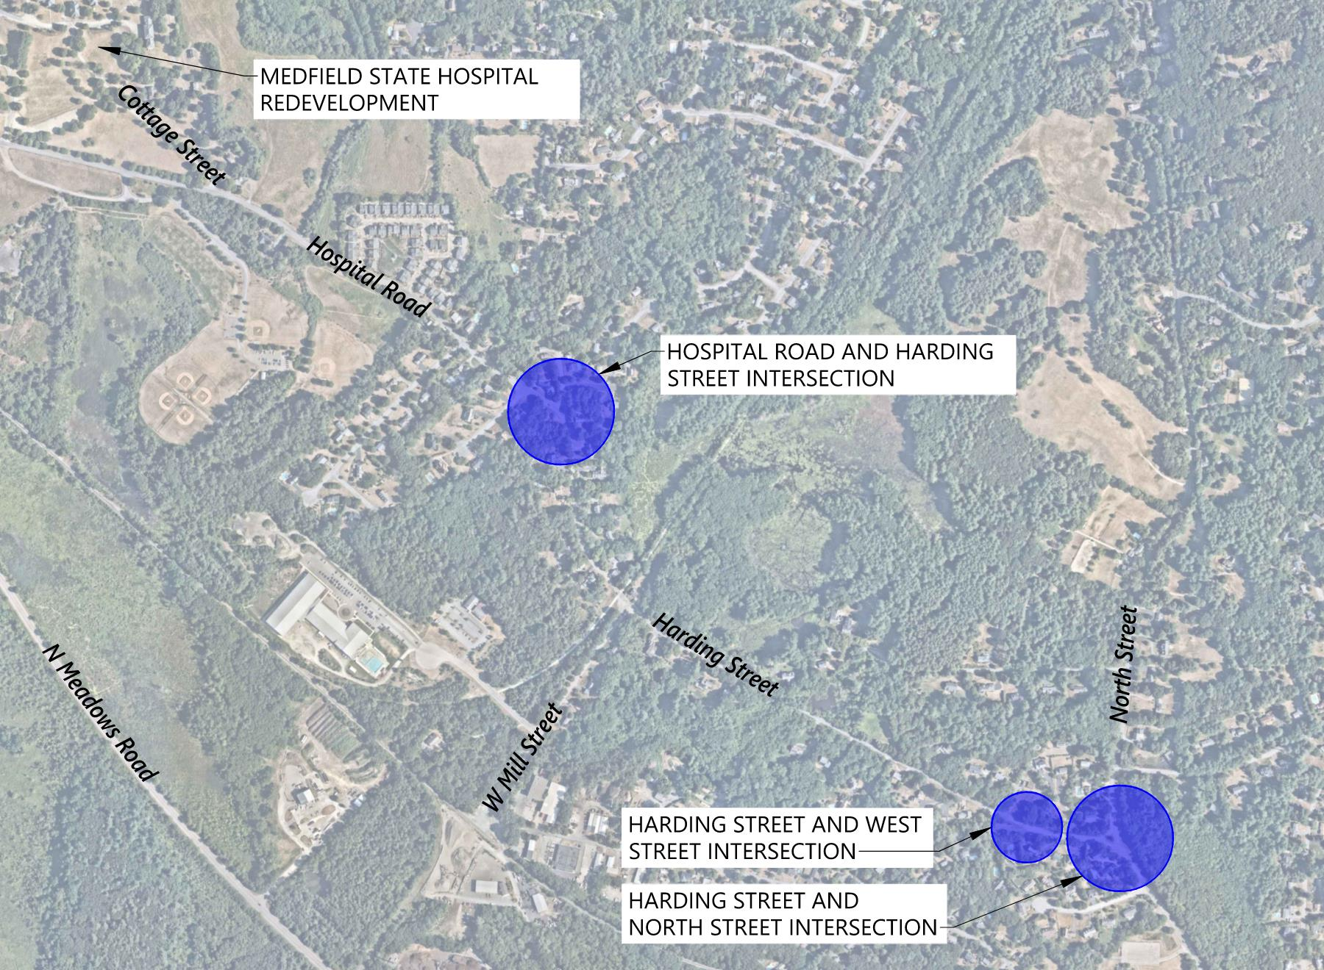
Off-site Improvements

Slide 21
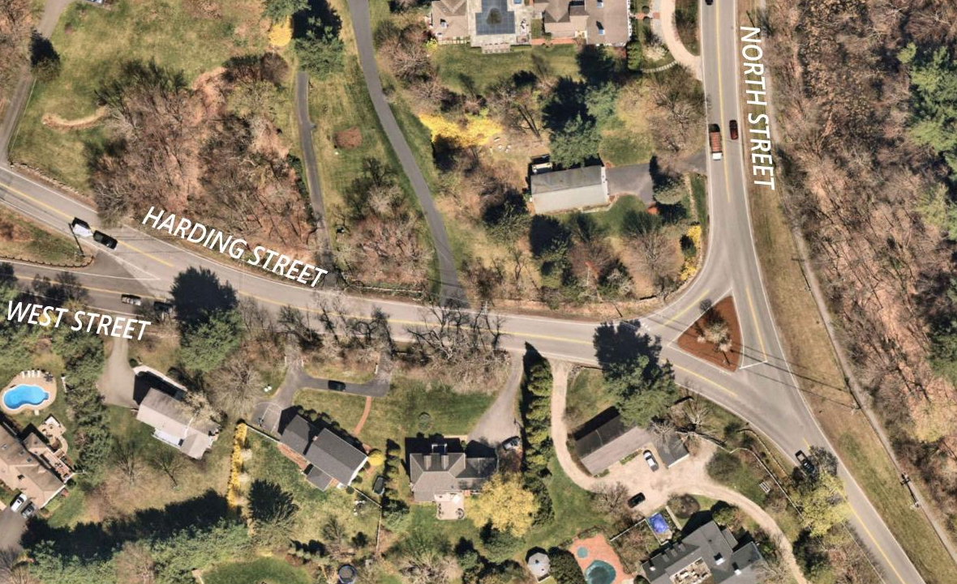
Harding Street at West and North Streets

Slide 22
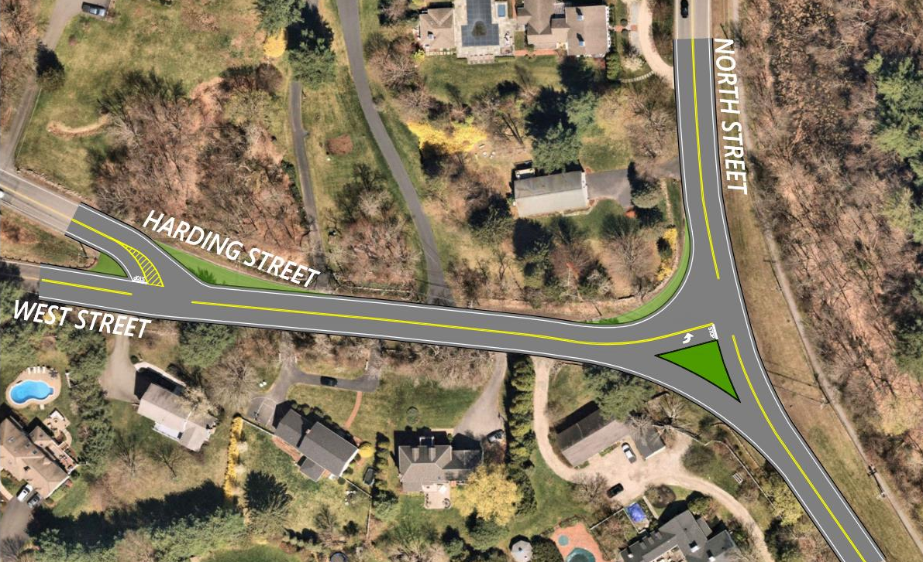
Harding Street at West and North Streets
DRAFT: PENDING REVIEW & APPROVAL OF THE MEDFIELD SELECT BOARD

Slide 23
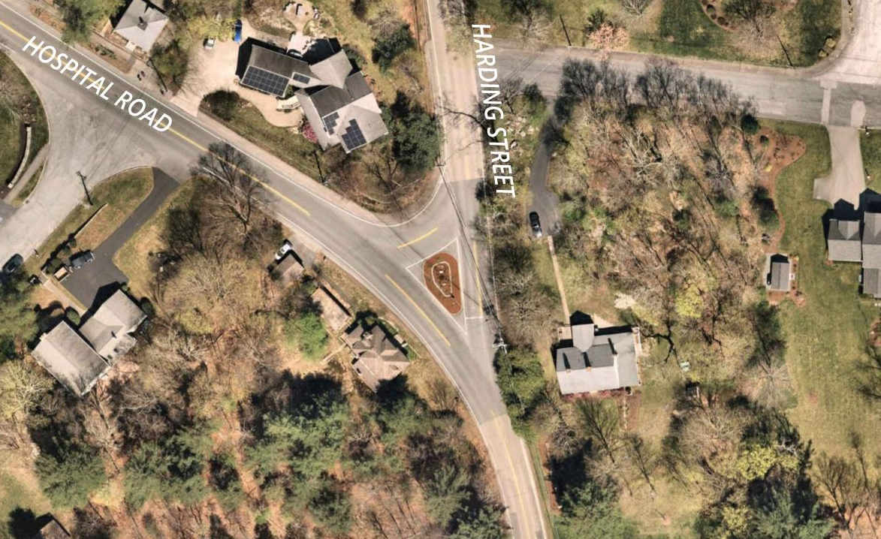
Harding Street at Hospital Road

Slide 24
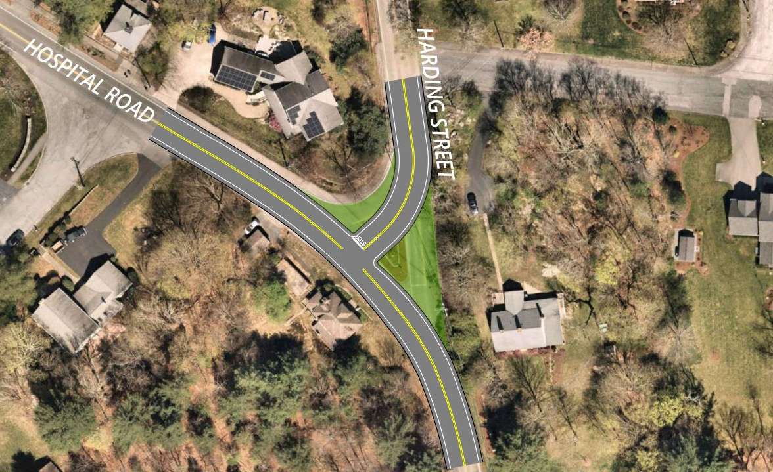
Harding Street at Hospital Road
DRAFT: PENDING REVIEW & APPROVAL OF THE MEDFIELD SELECT BOARD
PENDING SELECT BOARD APPROVAL

Slide 25
  Planning Board Q&A

Slide 26
  Public Comment Opportunity

Slide 27
  THANK YOU!

Slide 28
