Slide 1
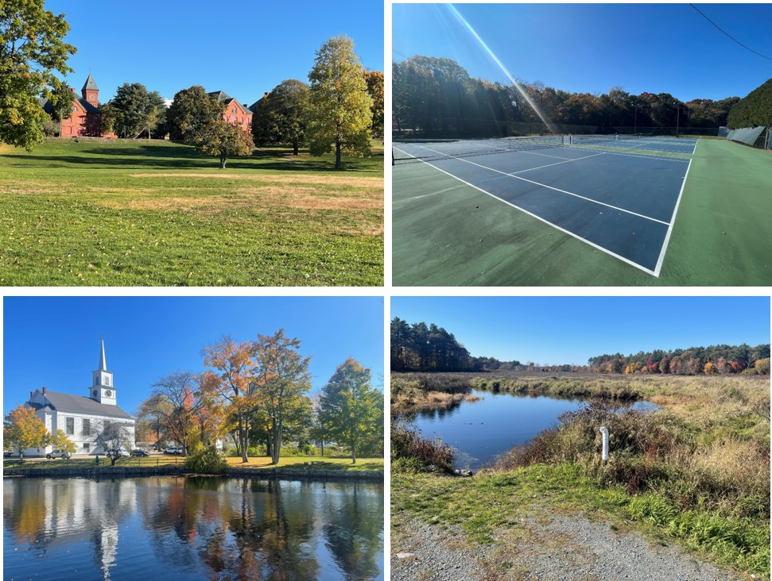
Medfield Open Space & Recreation Plan (2023-2030)
Open Space and Recreation Plan Committee
Lauren Beitelspacher, George Lester, Jerry Potts, Sarah Raposa (Town Planner), Jessica Reilly, Corinne Schieffer, Catherine Scott
Consultant: Wayne Feiden, Plan Sustain, LLC

Slide 2

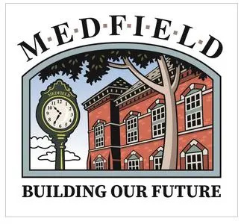
Builds on
Community Engagement
Two public forums/hearing
2019 and 2023 surveys
Written comments
Consultation with town boards and town partners
Past Open Space & Recreation Plans (2017 and earlier)
Townwide Master Plan (2021)
Select Board’s Goals (2023)
Medfield State Hospital Planning (2018-2022)
Current plan is available on the OSRP website: https://www.town.medfield.net/2112/OSRP-Committee

Slide 3
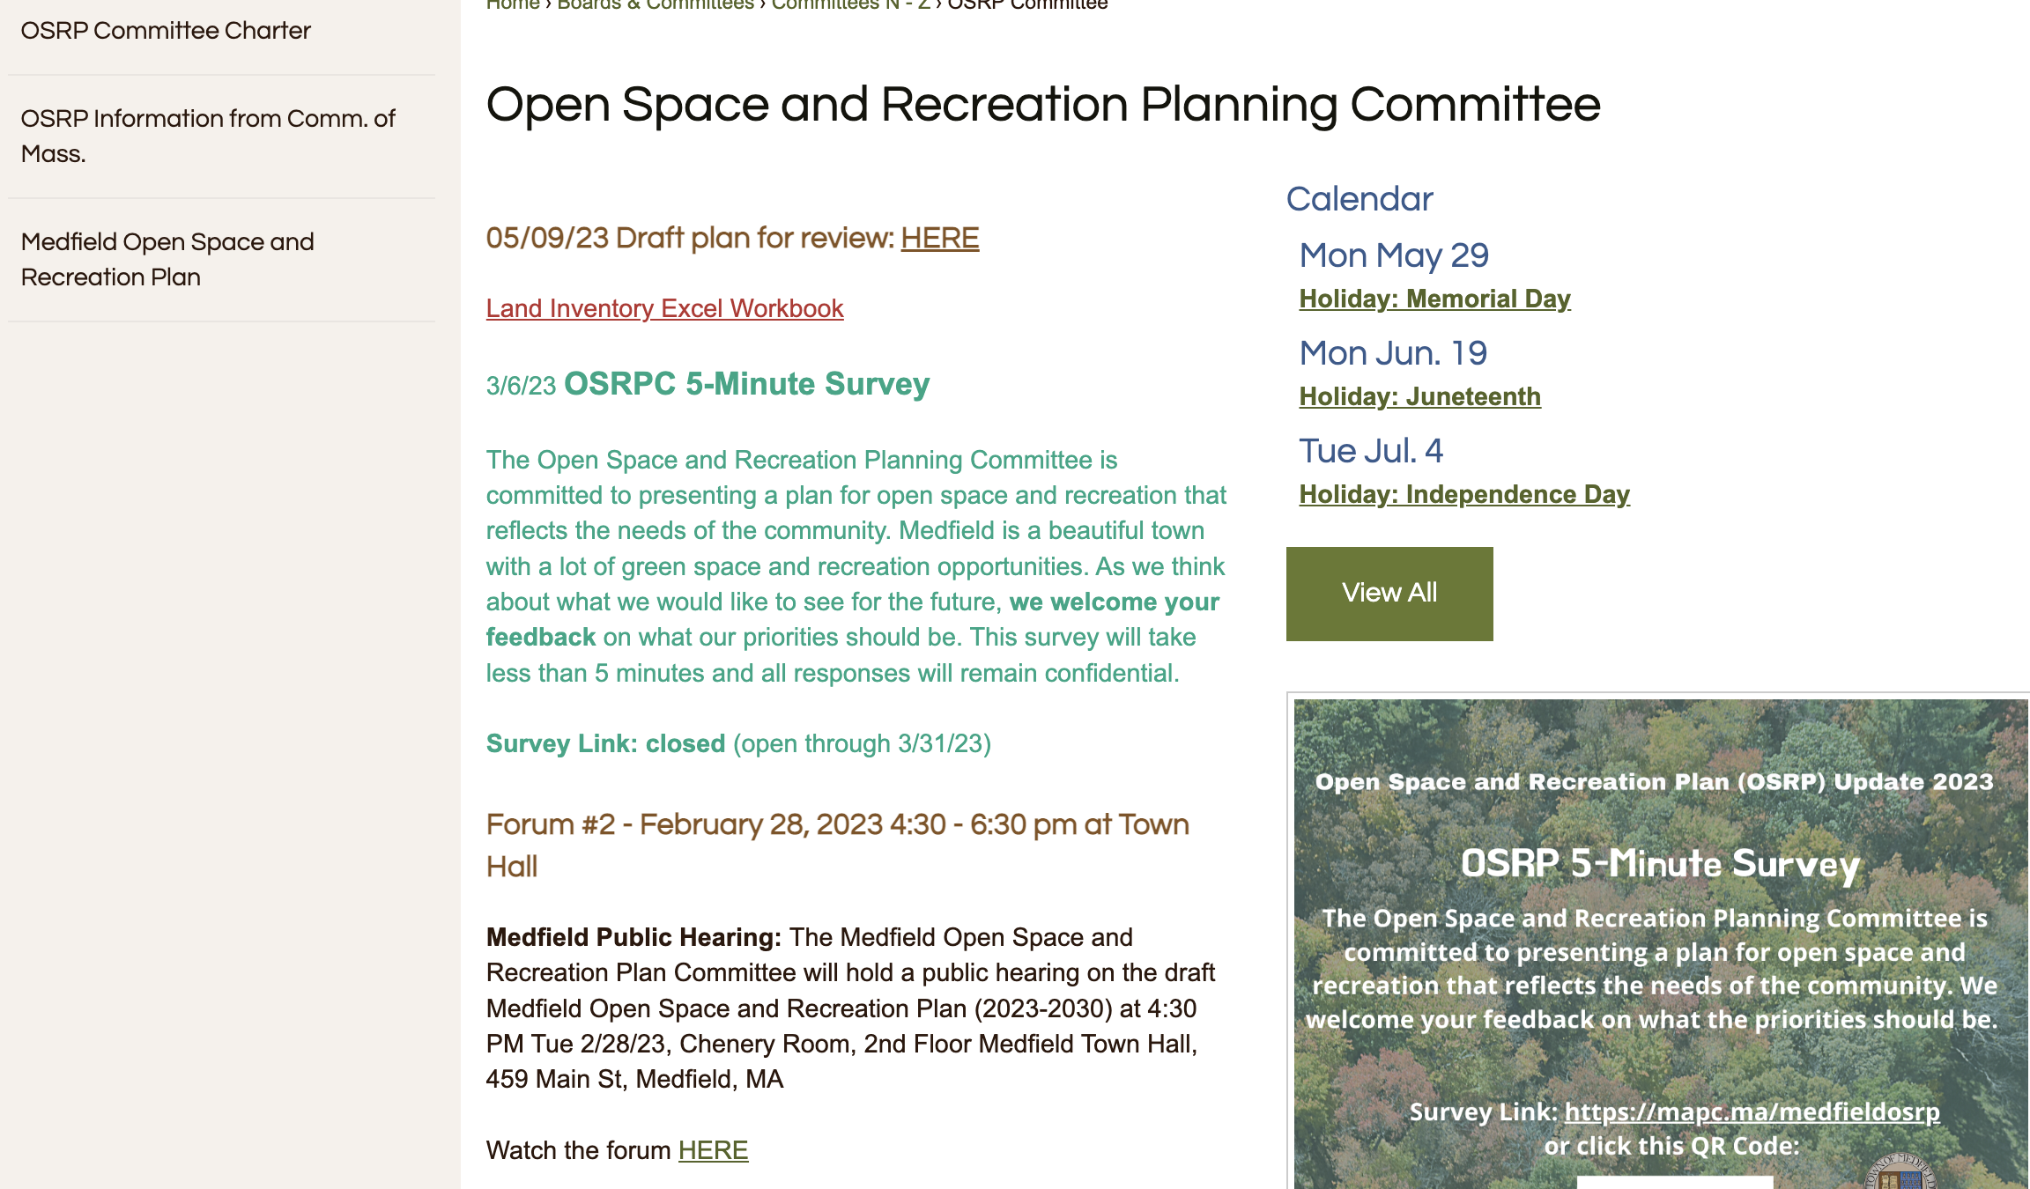

Slide 4
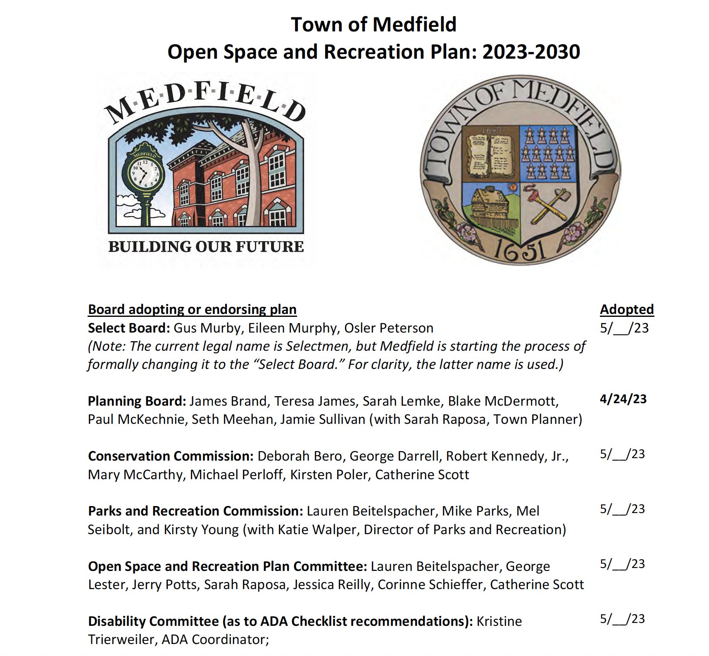
Timeline:
File with the state by no later than end of June.
Approval from each stakeholder listed by end of May.
Update: P&R voted to approve with two conditions
Edits to three properties in the investory
Lowell Mason

Slide 5
Sections of the Plan
Section One ‐ Plan Summary
Section Two – Introduction
Section Three ‐ Community Setting, Regional Context (map), Environmental Justice (map), Zoning (map)
Section Four ‐ Environmental Inventory and Analysis, Surficial Geology (map), Prime and Important Farmland Soils (map), Soils and Other Geological Features (map), Water Resources (map), Aquifer Protection Areas‐DEP Zone II (map), Vernal Pools (map), Archaeological Protection Area (map), Unique Features (map)
Section Five ‐Inventory of Lands of Conservation and Recreation Interest, Open Space Inventory (map) - pages 39-46, 47-51 (Raposa), and 61-96 (Lester)
Section Six ‐ Community Vision (from Townwide Master Plan)- pages 97-98
Section Seven ‐ Analysis of Needs- pages 99-102
Section Eight ‐ Goals and Objectives (from Townwide Master Plan and Select Board Goals)- pages 102 to 106
Section Nine ‐ Seven Year Action Plan, Action Plan (map), pages 107 --quick reference list on pages 125-126.
Section Ten ‐ Public Comments and Survey Results (pages 127 to 138)

Slide 6
Seven Year Action Plan
Action 1: Adopt the Community Preservation Act (CPA) and explore other fiscal opportunities (page 107)
Action 2: Expand parks and active recreation field opportunities on existing or new parcels (page 109)
Action 3: Preserve additional conservation and greenway parcels (page 111)
Action 4: Improve accessibility on conservation and recreation land (page 112)
Action 5: Improve information resources, outreach, and branding (page 114)
Action 6: Expand the emphasis on equity in open space and recreation planning (page 115).
Action 7: Link land use and regulatory systems with open space purchase and management (page 115)
Action 8: Maintain and expand the shared use and connecting path network (page 116)
Action 9: Include sustainability and climate change mitigation and resilience in all actions (page 118)
Action 10: Maintain and manage parks and recreation facilities (page 119)
Action 11: Improve conservation and greenway management and maintenance (page 120)

Slide 7
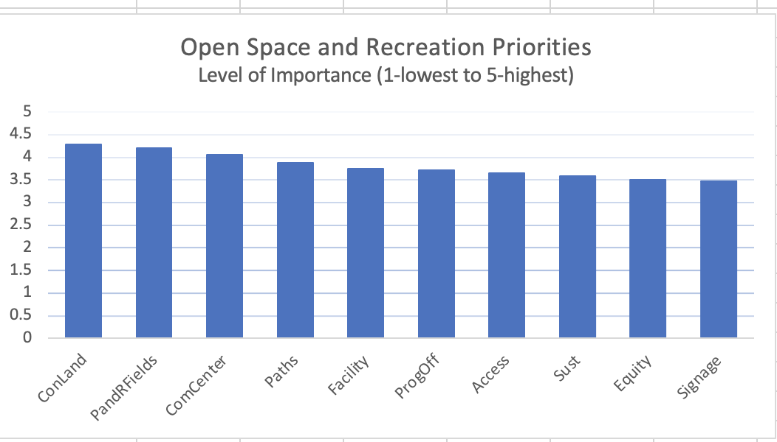
2023 Survey Results- 451 Respondents (completed)

Slide 8
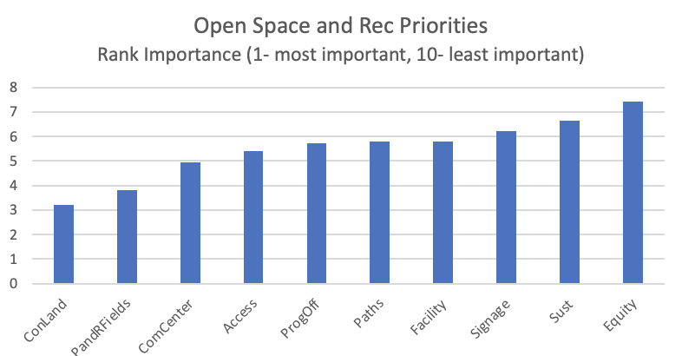
Rank Order- Lower # = Higher Ranked

Slide 9
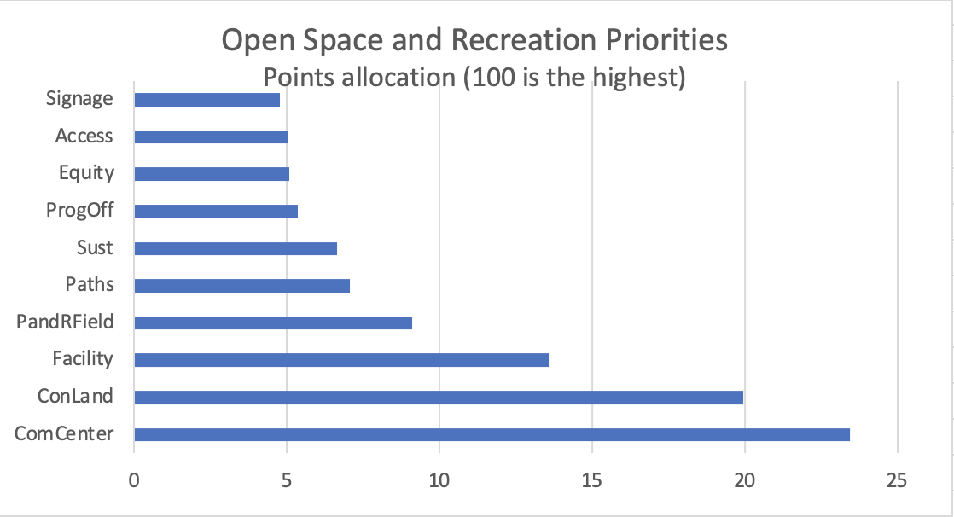
Allocate Points (Up to 100)

Slide 10
Questions on CPA
Scale: 1 is strongly disagree, 5 is strongly agree with the following statements (3 would be neutral)
“I am familiar with the Community Preservation Act.” Mean 2.48, leans disagree
“I am interested in learning more about how the CPA can benefit the Medfield Community.” Mean 3.41, leans agree
“Medfield should explore participation in the CPA program as an additional source of funding.” Mean 3.52, leans agree.

Slide 11
Action 1: Adopt Community Preservation Act (CPA)
Ask Town Meeting to adopt CPA
1, 2, or 3% of property tax bill with $100,000 residential exemption
Open space, recreation, affordable housing, and historic preservation
Could reduce need for future debt (e.g., CPA could have funded the recent Affordable Housing Trust, in part with state match)
Residents are already pay ≈$150,000 in Registry of Deeds fees for state match without any benefits
 |  | 1% | 3%
Mean single-family home property tax bill (FY23) | $12,962
Mean single-family home assessed value (FY23) ($15.43/ $1,000) | $840,000
Mean single-family home value for CPA with residential exemption | $740,000
Mean single-family home CPA surcharge |  | $114 | $342
Projected revenue from adopting CPA (property tax surcharge, less exemptions, plus state match at a conservative 30%) |  | $600,000 | $1,800,000

Slide 12
Action 2: Expand parks and active recreation field opportunities on existing or new parcels
All ages and multigenerational (i.e., young children to older adults)
Permanent recreation at Medfield State Hospital
Improved basketball court tennis court surfaces as needed
Improved lighting for basketball and recreation fields
New disc golf, pickle ball, bike skills park, skate park and dog park
Youth and sports facility or intergenerational community center
Short term: improve existing indoor space
Programming: walking, hiking, running, biking, equestrian, canoeing
☑ CPA eligible costs

Slide 13
Action 3: Preserve additional conservation and greenway parcels
Annual assessment of tax title properties for town uses
Partnership agreements for quick action on rights-of-first refusals
Assess private properties with high conservation value (e.g., a conservation restriction and easement at the Norfolk Hunt Club)
Formalize annual review of potential conservation properties:
Adjoining existing protected open space (e.g. Noon Hill)
Linking conservation and/or recreation parcels or resources
With significant wetlands and water resources
Which enhance climate change resilience and mitigation
Ensuring a wide mix of passive recreation (e.g., trails)
☑ CPA eligible costs

Slide 14
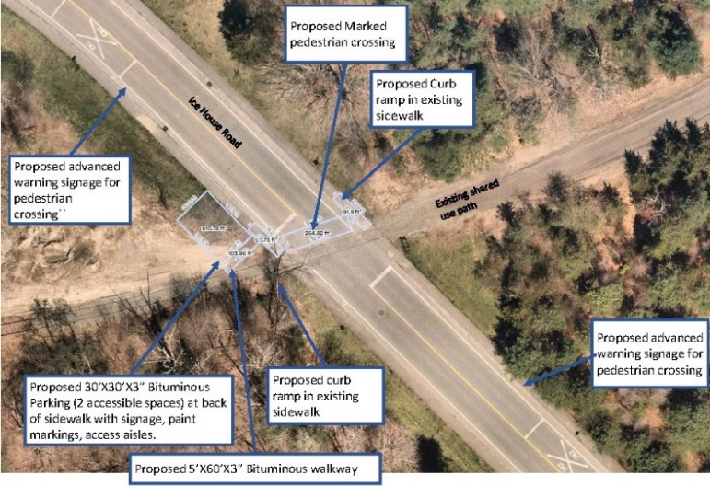
Action 4: Improve accessibility on conservation and recreation land
Open space/recreation aspects- ADA Self-Evaluation & Transition Plan
Accessible canoe launch and fishing (e.g., Causeway Bridge, Bridge St)
“Easy” accessibility improvements (e.g., accessibility signage and ramps/landings at Pfaff Community Center and Hinkley Park)
Accessible parking and path at Holmquist Farm (community gardens)
Variety of accessibility open space services (e.g., mobility, sight, quiet)
Medfield Rail Trail-Ice House Rd Accessible trail
☑ CPA eligible costs

Slide 15
Action 5: Improve information resources, outreach, and branding
Conservation, recreation, and trail and property line wayfinding with clear branding
On-line maps, downloadable PDF maps, and curated trail app
Simple naming conventions (e.g., merge South Meadow Hill into better recognized Noon Hill)
☑ Some CPA eligible costs

Slide 16
Action 6: Expand the emphasis on equity in open space and recreation planning
Ensure recreation programming and facilities meets the needs of all Medfield ages and cultures
Improve housing opportunities so open space preservation does not artificially inflate housing costs (e.g., limited development projects with open space and affordable housing)
Gateway events (e.g., bicycling, mountain biking, fishing, canoeing and kayaking) to introduce passive recreation
☑ Some CPA eligible costs

Slide 17
Action 7: Link land use and regulatory systems with open space purchase and management
Zoning and subdivision revisions to encourage open space (e.g., recent zoning reviews, new incentives)
Strengthen climate change resilience as part of regulatory programs and town procedures
Incorporate Medfield State Hospital Master Planning (The Green and North Field) into open space efforts

Slide 18
Action 8: Maintain and expand the shared use and connecting path network
Examine railroad rights-of-way and other shared use paths (e.g., Landline Greenway Plan, Medfield and Old Colony Rail Trail)
Fill trail gaps with expanded network of bicycle lanes and sidewalks
Build a comprehensive network of trails for walking, running, and biking (e.g., Bay Circuit and Charles River Link Trails improvements)
Acquire private landowner permissions for public use of existing and new trails (e.g. Pinecroft Farm and Norfolk Hunt Club)
☑ some CPA eligible costs

Slide 19
Action 9: Include sustainability and climate change mitigation and resilience in all actions
Prioritize open space preservation which enhances climate resilience (e.g. water storage, air cooling, plant/animal migration)
Prioritize open space preservation which enhance climate change mitigation and regeneration (e.g. carbon storage in trees and soils)
Management and invest in open space which enhances climate resilience and mitigation (e.g., green infrastructure)
Assess and map properties for sustainability purposes
☑ Some CPA eligible costs

Slide 20
Action 10: Maintain and manage parks and recreation facilities
Prioritize improvements which can be done with existing staff and those that save future costs (e.g., avoid future artificial turf needs)
Add green stormwater infrastructure when possible (e.g., rain gardens, bioswales)
☑ Some CPA eligible costs

Slide 21
Action 11: Improve conservation and greenway management and maintenance
Implement OSRP detailed maintenance plan
Ensure adequate resources for basic maintenance of conservation areas (e.g., DPW, Parks and Recreation and/or Planning or Conservation staff)
Sign memorandums of understanding with partners (e.g., TTOR)
Formalize adopt-a-conservation area and adopt-a-trail programs
Improve trail user experience (e.g. trail and trailhead markings)
☑ Some CPA eligible costs

