Slide 1
Medfield
Community Electricity
Wednesday April 24, 2024

Slide 2
Offer new electricity supply options that provide more renewable energy and stable prices for all Medfield residents and businesses.
Although savings cannot be guaranteed, these programs have historically provided savings compared to utility Basic Service over the contract term.
Purpose

Slide 3
Medfield chose Direct Energy Services as its electricity supplier, and will offer three supply options.
Program starts June 2024 and prices are fixed for 30 months.
Our Electricity Supplier

Slide 4
Participation in Medfield Community Electricity will only change the “Supply” portion of your Eversource electricity bill.
What
Changes

Slide 5
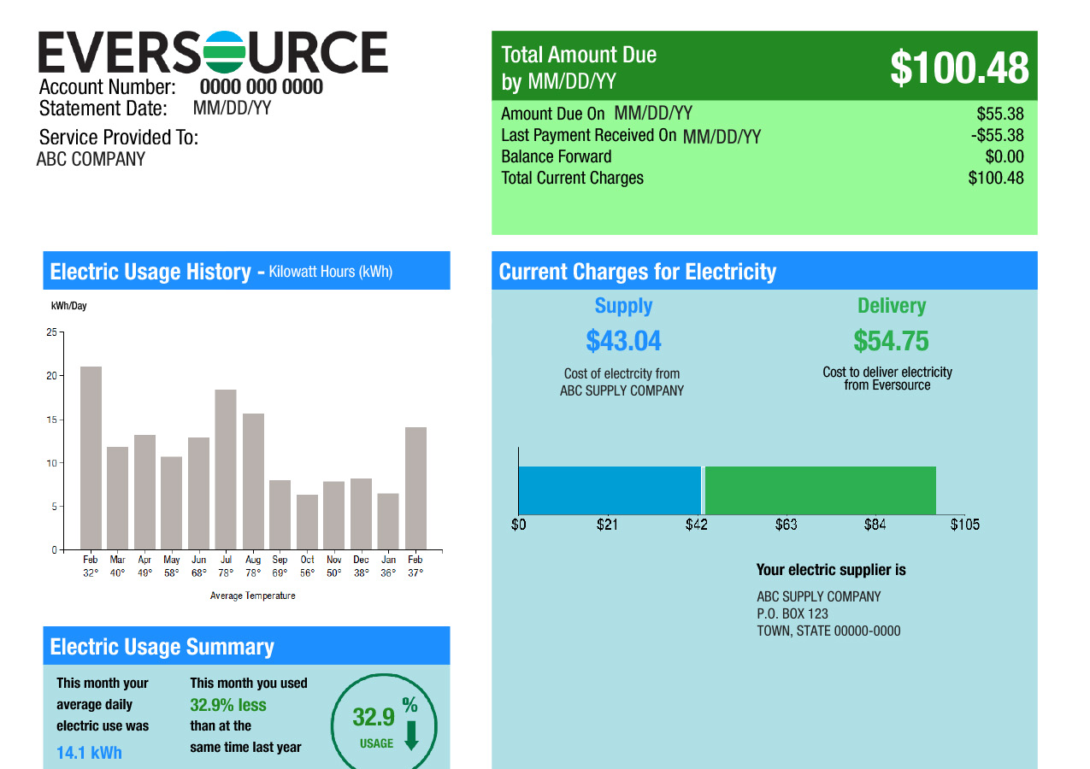
What
Changes

Slide 6
The “Delivery” portion of your Eversource bill will remain the same.
Eversource will still continue to deliver electricity, manage billing, maintain poles and wires, and respond to storm outages
Anyone using budget billing or receiving low-income rate discounts will continue to receive their current benefits.
Customers receiving net metering or other solar benefits will continue to receive their current benefits.
What Stays the Same

Slide 7
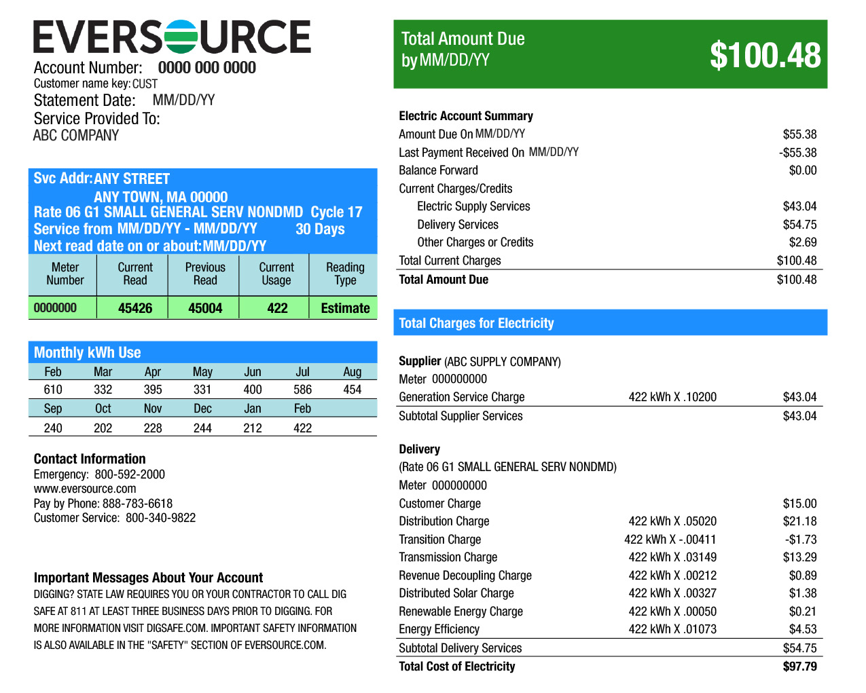
What Stays the Same

Slide 8
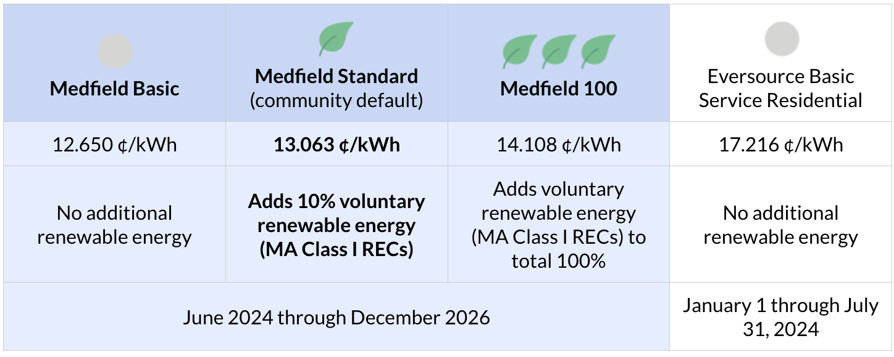
Our Program Options
Future savings compared to utility Basic Service cannot be guaranteed.

Slide 9
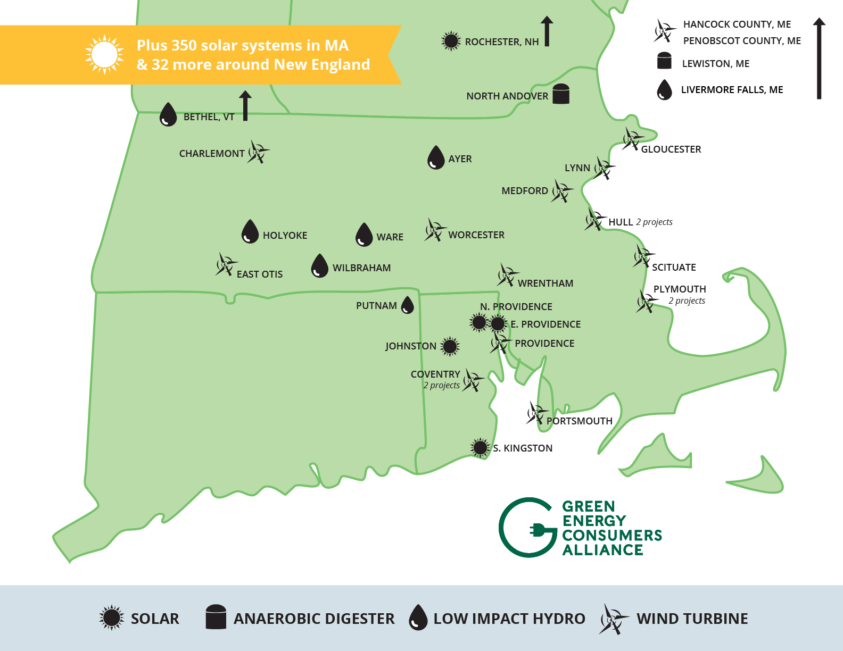
Our Voluntary Renewables
Come only from Class I sources, the State’s term for new, in-region renewables
From wind, solar, low-impact hydro and anaerobic digestion in New England
Class I preferred by MA Dept. of Energy Resources because it supports the growth of additional renewables

Slide 10
Participation & Enrollment
Participation is voluntary.
There is never any penalty or fee to opt out of the program.
The enrollment process differs based on your current electricity supplier.

Slide 11
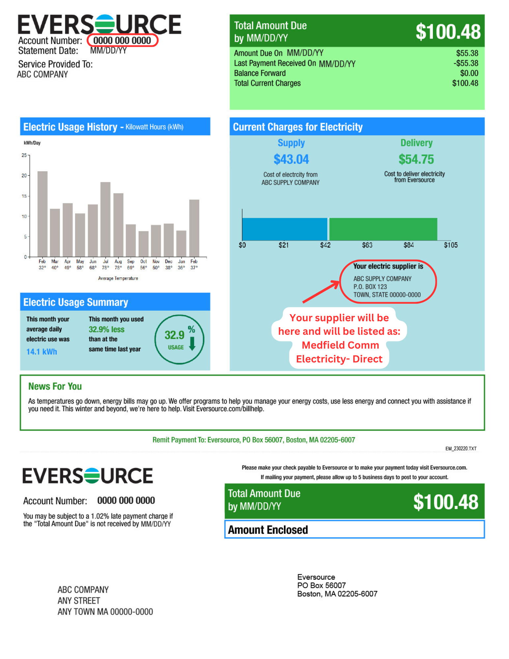

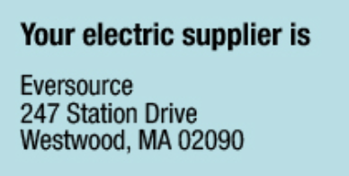

How To Find Your Current Supplier
If your electricity supplier says Eversource, then you are using Basic Service.

Slide 12
Customers on Basic Service
(1 of 3)
Anyone using Eversource Basic Service is eligible to be automatically enrolled in the Medfield Standard as of their June meter read.
These customers on Eversource Basic Service received a notification letter in mid-April, explaining their options.
If an eligible customer takes no action, they will be enrolled in Medfield Standard starting in June.

Slide 13
Customers on Basic Service
(2 of 3)
If eligible for automatic enrollment:
May 15: deadline to opt-out before the program starts.
You may opt-out at any time after May 15, and you will be returned to Eversource Basic Service supply on your next meter read.
There is never any penalty or fee to opt out of the program.

Slide 14
Customers on Basic Service
(3 of 3)
To Opt Out of the Medfield Program:
Return the postage paid card in your notification letter OR fill out the online form at Electricity.Medfield.net OR call our supplier, Direct Energy, at (866) 968-8065
To Choose a different Medfield option:
Fill out the online form at Electricity.Medfield.net OR call our supplier, Direct Energy, at (866) 968-8065

Slide 15
Customers Using Their Own Supplier
Anyone currently using their own supplier will not receive the notification letter and will not be automatically enrolled.
These customers can voluntarily join the program, but should check with their current supplier in case their current supplier charges penalties or early termination fees.

Slide 16
Our Pre-Launch Awareness
In addition to the notification letter, we have spread the word through:
Press release (front page story in Hometown Weekly) and online news blurb
Notice running on Medfield TV
Brochures: Town Hall entrance, Public Safety building, Library and CENTER at Medfield, Starbucks, Blue Moon and Kingsbury Club
Poster at library, sandwich board by Town Hall
Postcard sent to all eligible customers
Social media posts (Facebook, X)

Slide 17


Medfield Community Electricity (MCE) is different from other “third-party” electricity supply offers.
Third-party contracts, individual residents can’t negotiate contract terms.
MCE negotiated a contract focused on the best interests of our residents and businesses
Third-party contracts often have hidden fees, like early termination penalties.
MCE has no hidden fees, no termination or cancellation penalties
Third-party contracts often switch to variable pricing, and many customers do not notice.
MCE is committed to transparency and will always have fixed pricing, announced publicly before it takes effect
No independent expert to help monitor your contract.
MCE’s consultant will conduct ongoing oversight on our supplier to ensure they are fully compliant.

Slide 18
Questions
& Support
To opt-out, change your option or proactively enroll:
Call Direct Energy at (866) 968-8065
OR
Fill out the enroll or opt-out form at Electricity.Medfield.net
For questions, contact Medfield’s consultant, Good Energy:
Call (508) 296-4767
Fill out the contact form at Electricity.Medfield.net
Reminder: you may change your option or opt-out of the program at any time

Slide 19
Our Program Options
Future savings compared to utility Basic Service cannot be guaranteed.

Slide 20
Sample Bill Showing Medfield Community Electricity

Slide 21
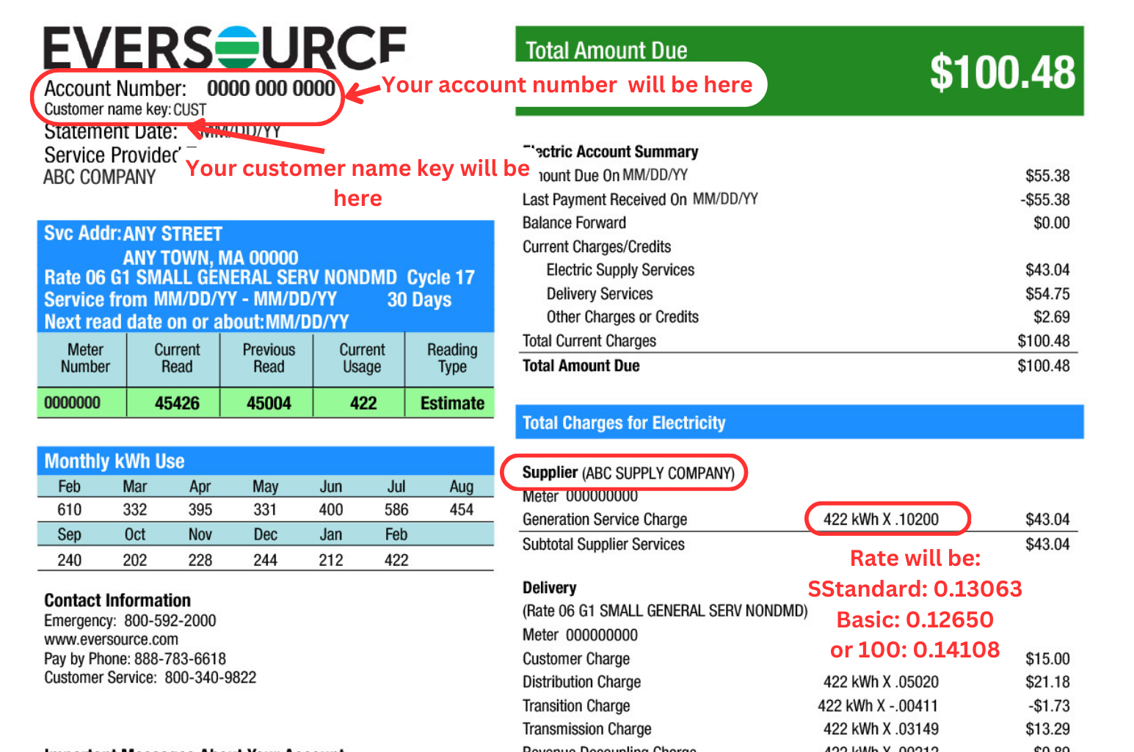
Sample Bill Showing Medfield Community Electricity
.17216
Rate on MCE will be:
Standard: 0.13063
Basic: 0.12650
or 100: 0.14108

Slide 22
Customer
Protections
Our expert consultant (Good Energy), ensures the supplier (Direct Energy) meets quality standards, and runs the program in accordance with the contract
Pricing will always be transparent: the Town will announce any price changes at least 30-days in advance
There are no hidden fees or variable costs
You always have the option to leave at anytime, without penalty

Slide 23
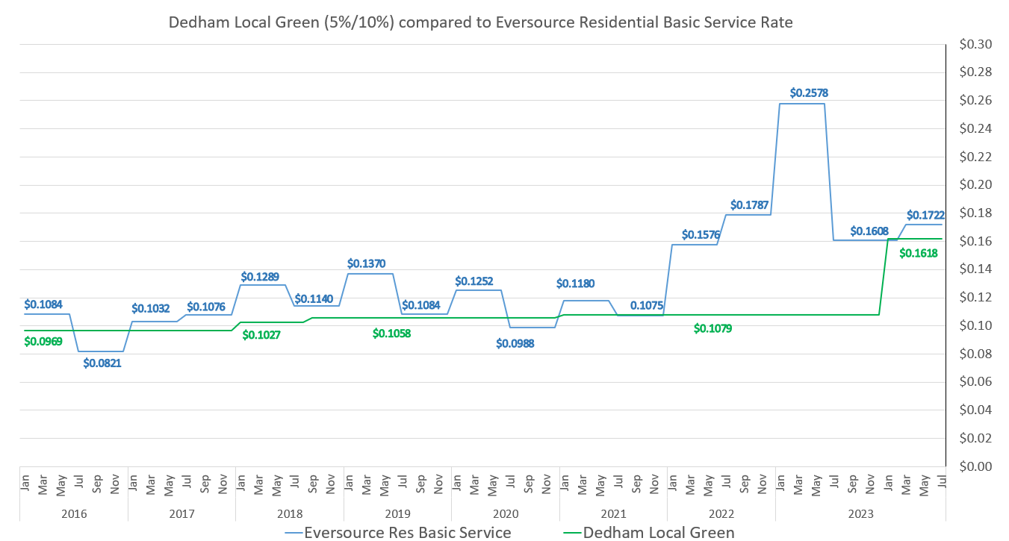
Dedham Local Green (5%/10%) Compared to Eversource Basic Service
Future savings compared to utility Basic Service cannot be guaranteed.

Slide 24
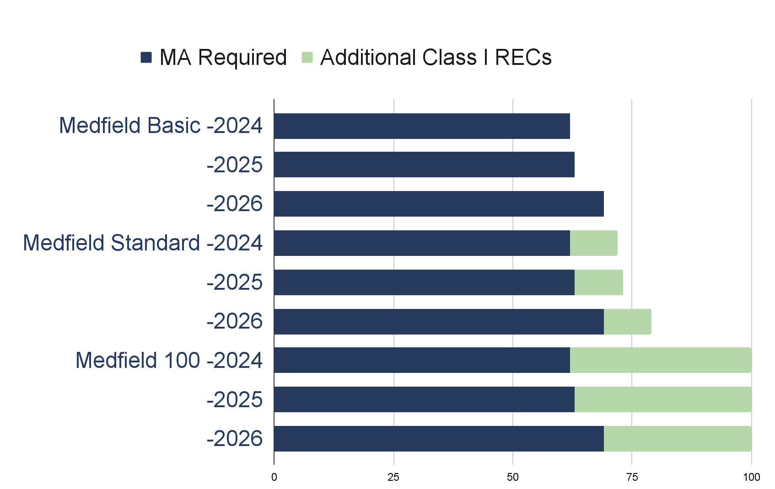
Program Products Renewable Content 2024-2026
Medfield Basic
62%
63%
69%
Medfield Standard (community default)
72%
73%
79%
Medfield 100
100%
100%
100%

Slide 25
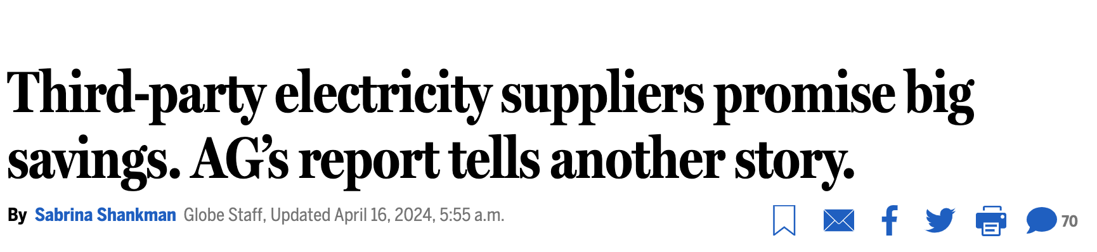
Attorney General reports about electricity suppliers refer to contracts directly with residential customers. They do not refer to municipal aggregation programs, like Medfield Community Electricity, which are officially offered through a City or Town government.
Aggregation programs have buying power to negotiate strong terms and conditions to provide consumer protections.

