Slide 1
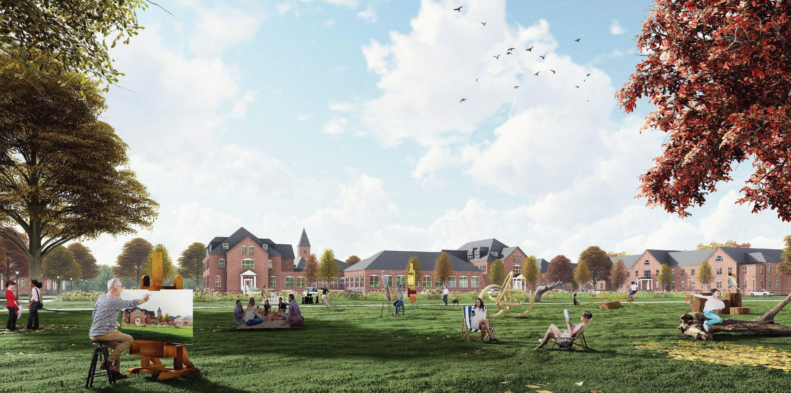
Medfield State Hospital Redevelopment
Presentation to the Town of Medfield Planning Board
March 20, 2023

Slide 2
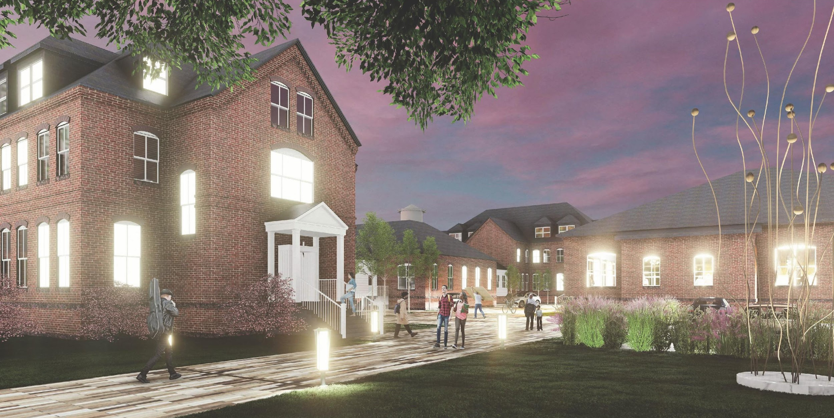
Where We’ve Been… Topics Previously Discussed
Public Hearing Session #1
Overview of the Project
Inclusionary Zoning
Parking/Access/Circulation
Parking Waiver Requests
Public Hearing Session #2
Parking/Access/Circulation Follow-up
Building Descriptions and Floor Plans
Historic Resources

Slide 3
What’s to Come… Tonight’s Topics for Discussion
Public Hearing Session #3
Overall Site Design
Landscape and
preliminary lighting
Roadway/Circulation Design
Infrastructure
Water & Wastewater
Solar and Geothermal Feasibility

Slide 4
What We’re Looking Forward to… Remaining Topics for Discussion
Public Hearing Session #4 – April 3rd
Stormwater Best Management Practices (delayed due to scheduling conflicts with Medfield DPW)
Off-site traffic mitigation/improvements
Project recap
Close hearing
Planning Board deliberation and vote
Post-Approval Conditional Items
Stormwater Management plan
Photometric/Lighting plan
Final arborist analysis and planting plan

Slide 5
Landscape | KMDG

Slide 6
Landscape | KMDG
EXISTING CONDITIONS

Slide 7
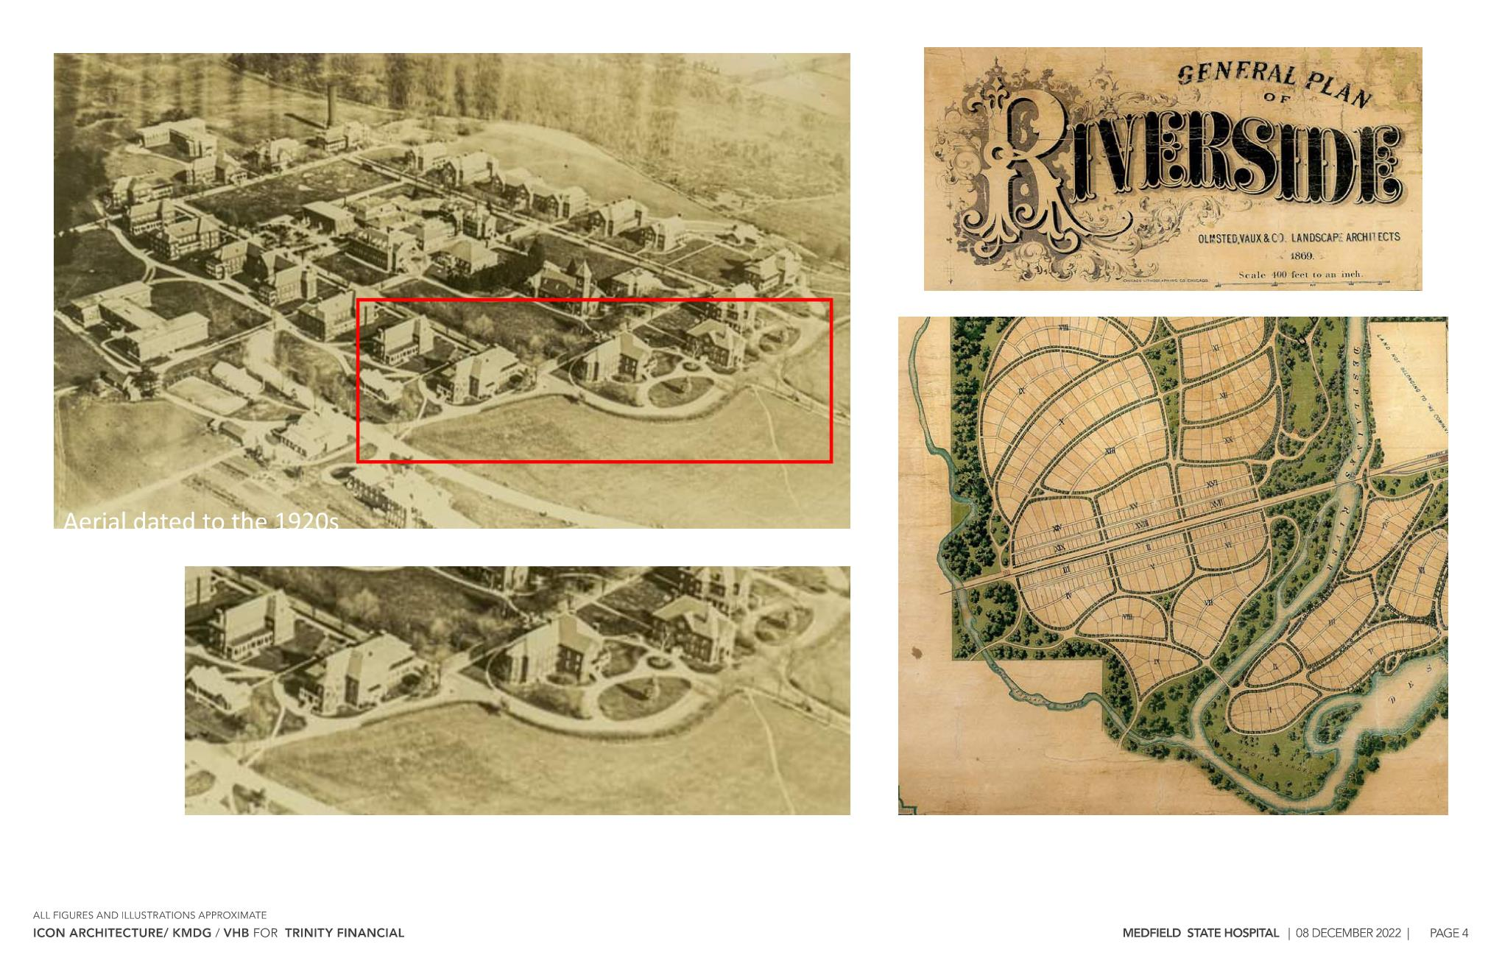

Slide 8
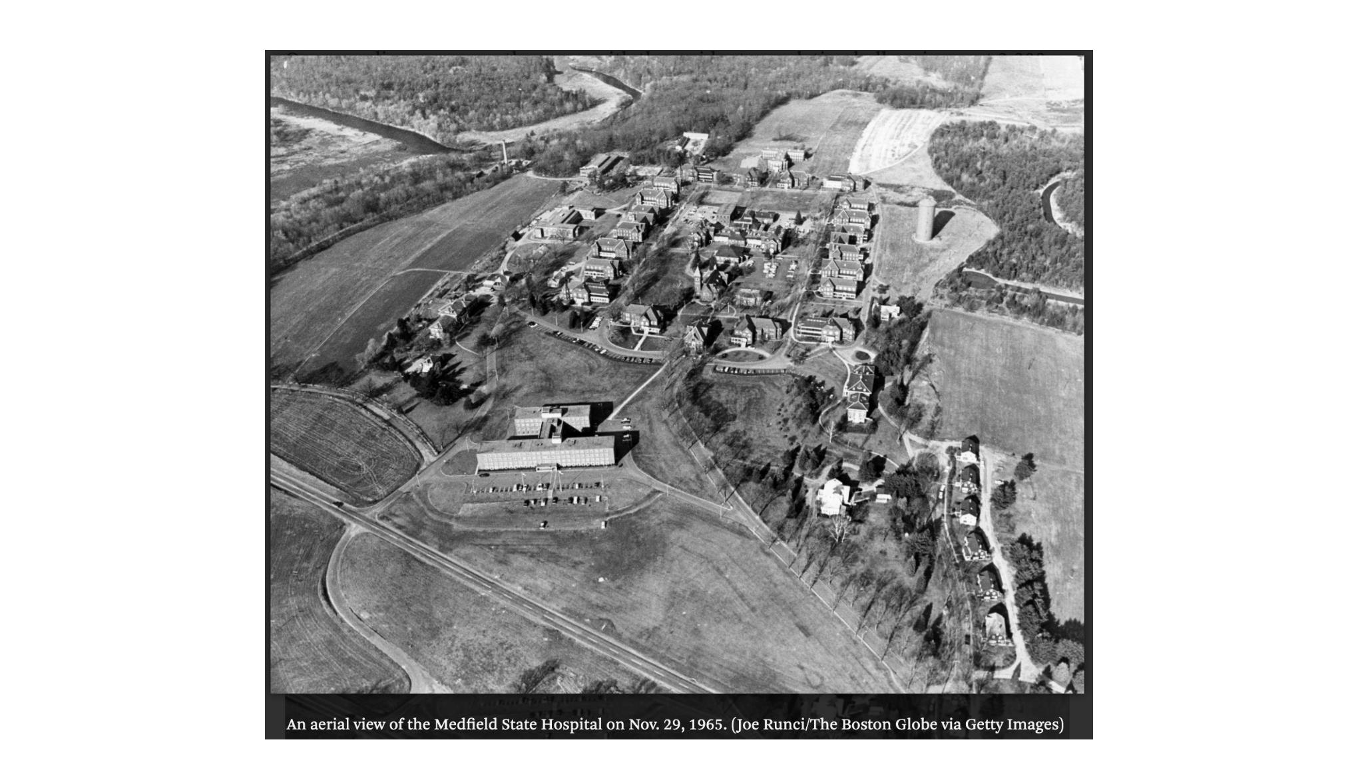

Slide 9
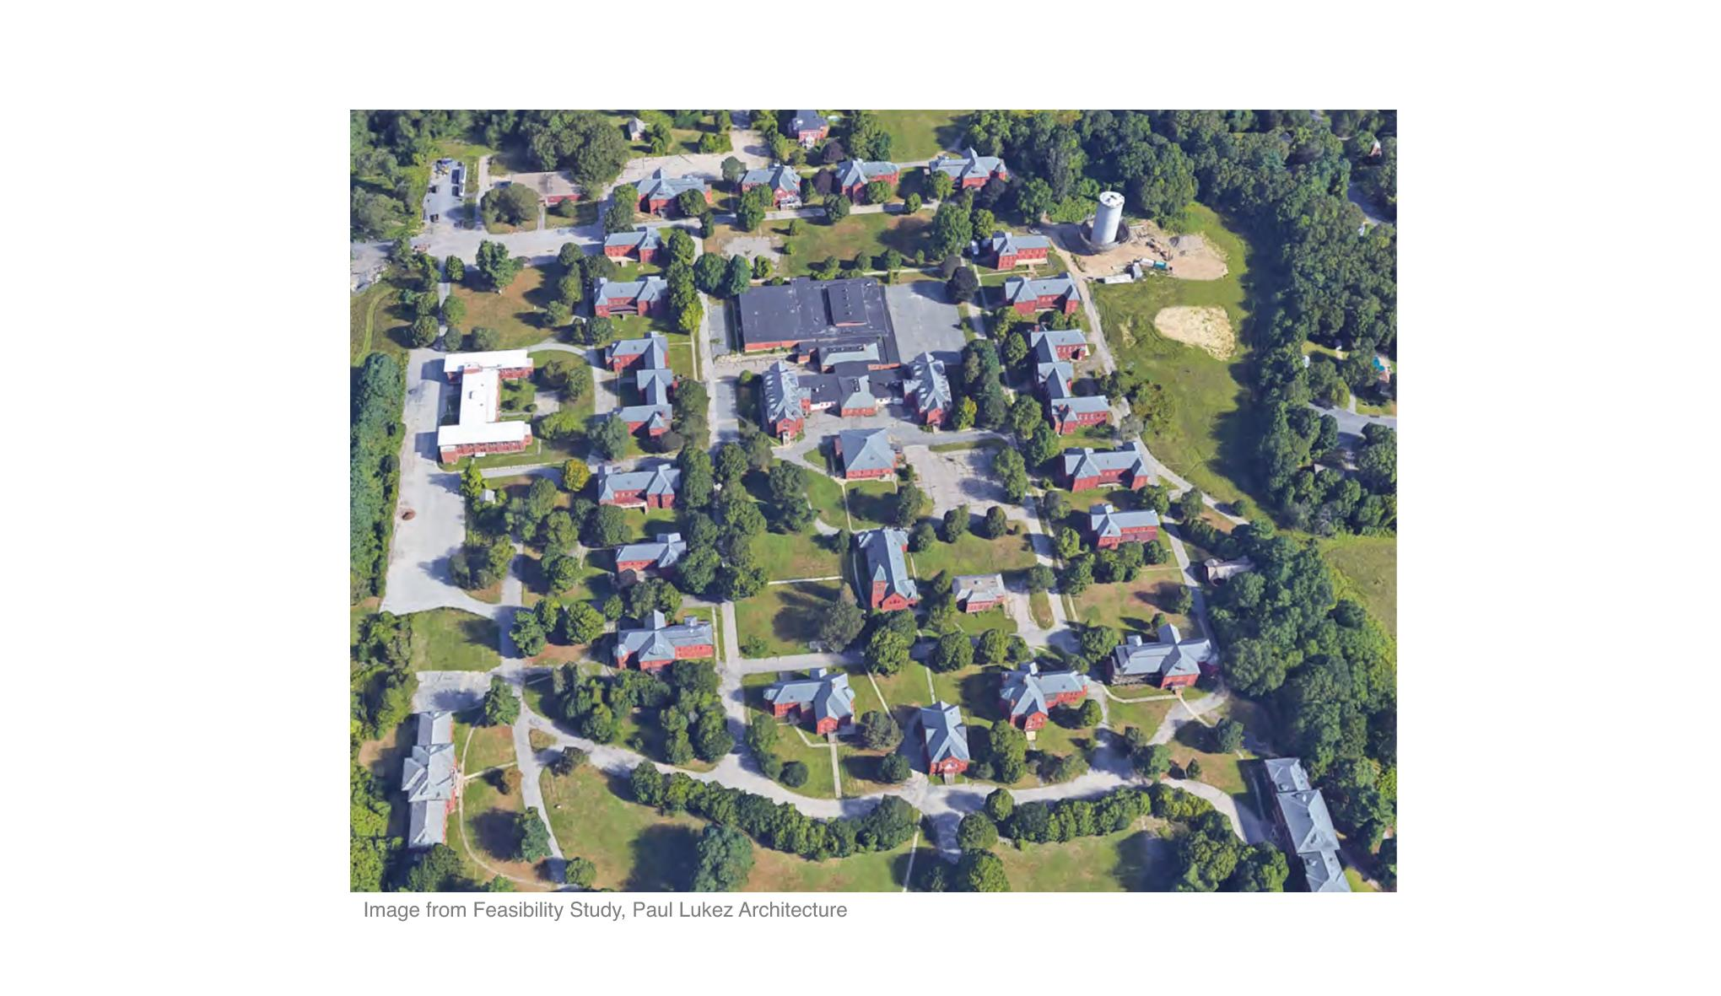

Slide 10
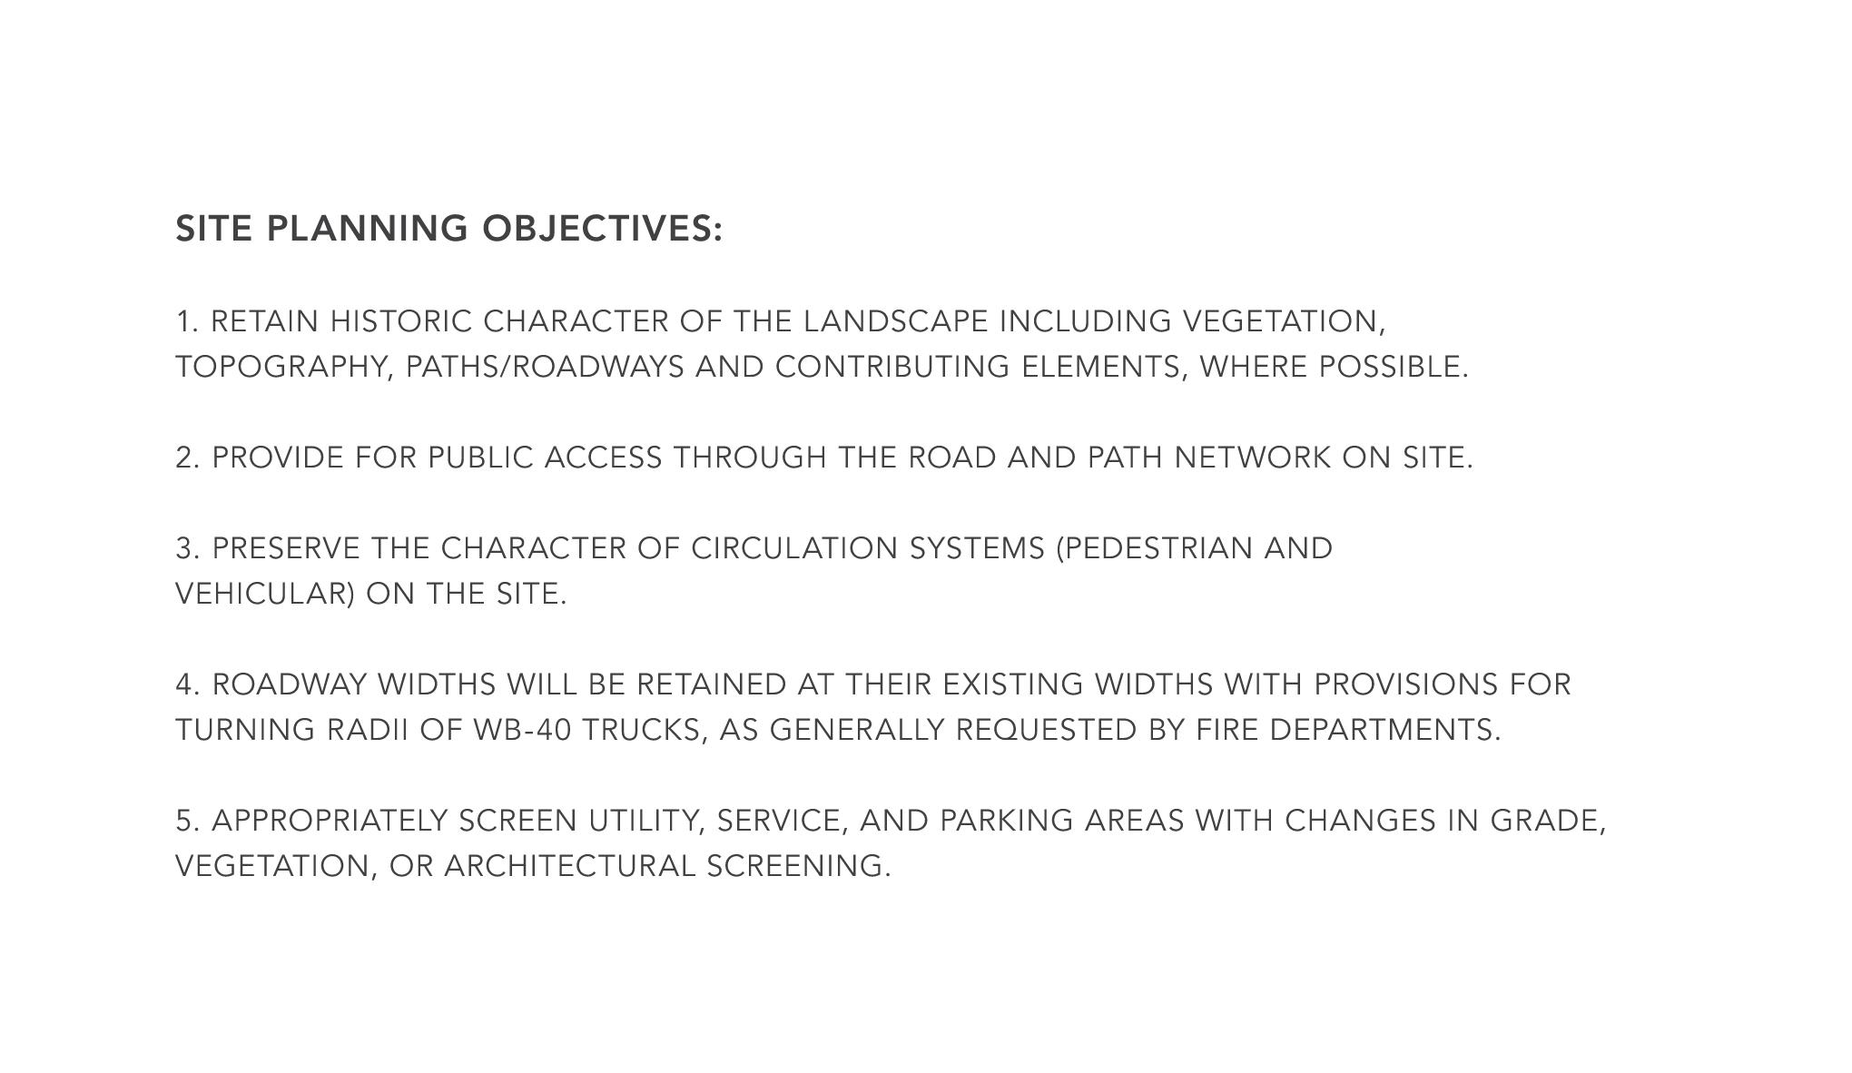

Slide 11
Landscape | KMDG
EXISTING TREE ANALYSIS

Slide 12
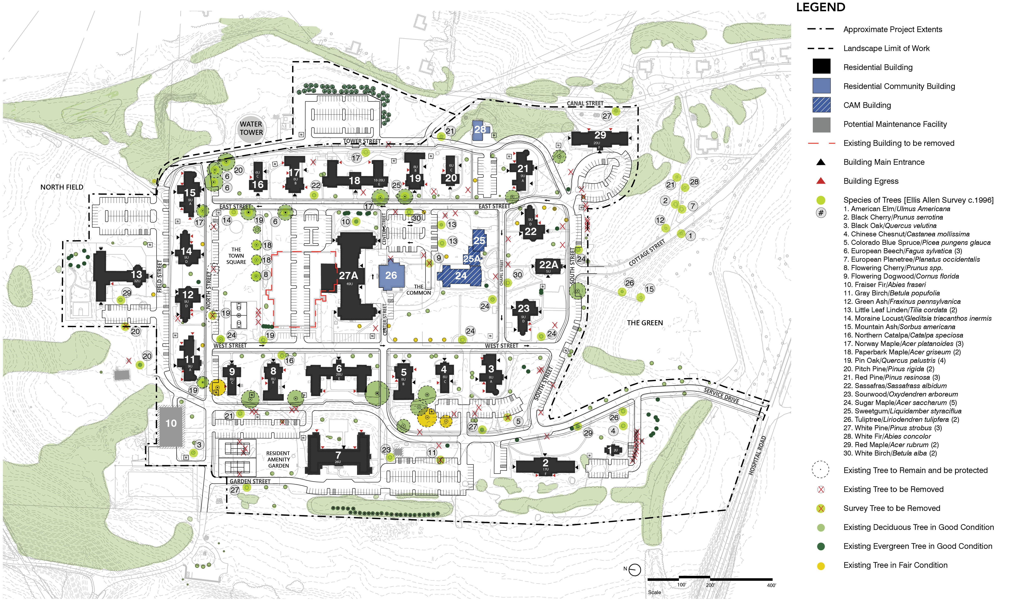

Slide 13
Landscape | KMDG
SITE PLANS

Slide 14
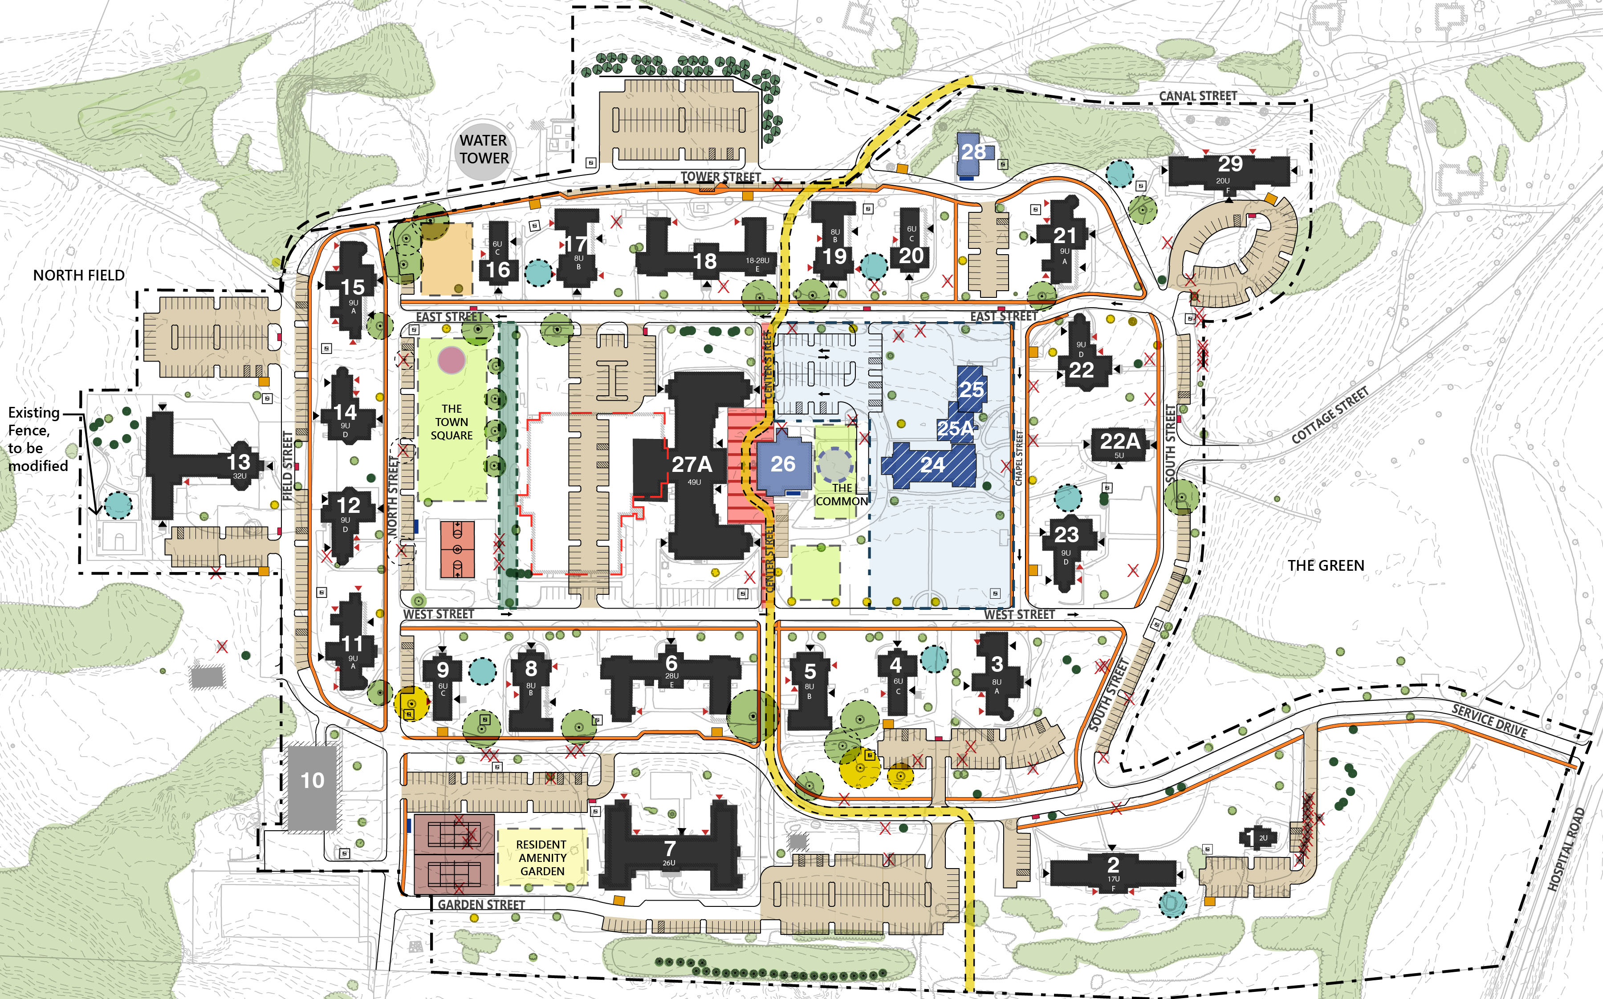
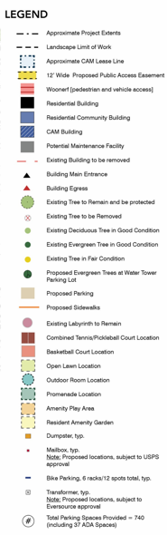

Slide 15
MSH Site Plan

Slide 16
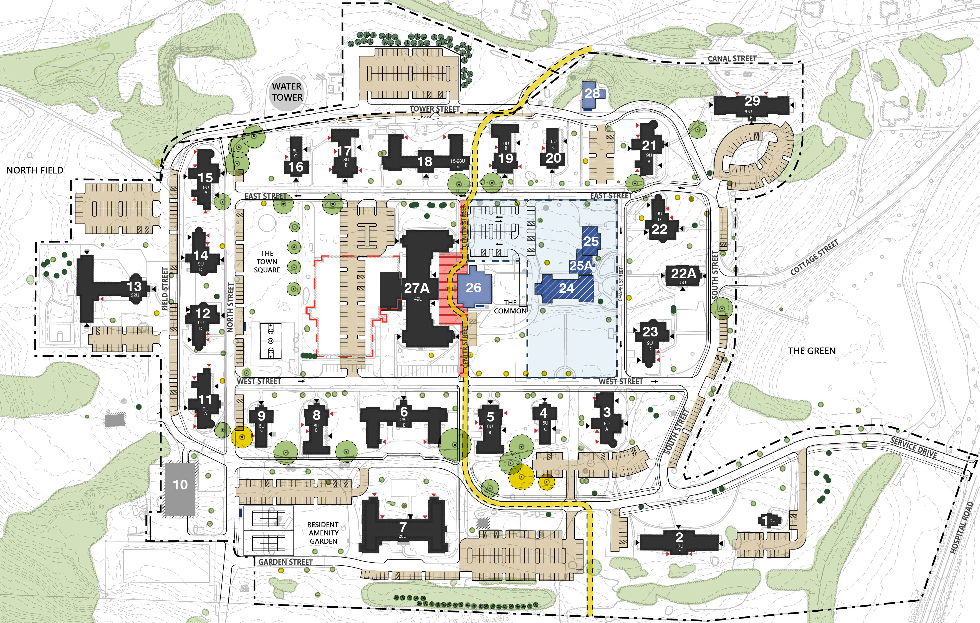
MSH Bike Parking

Slide 17
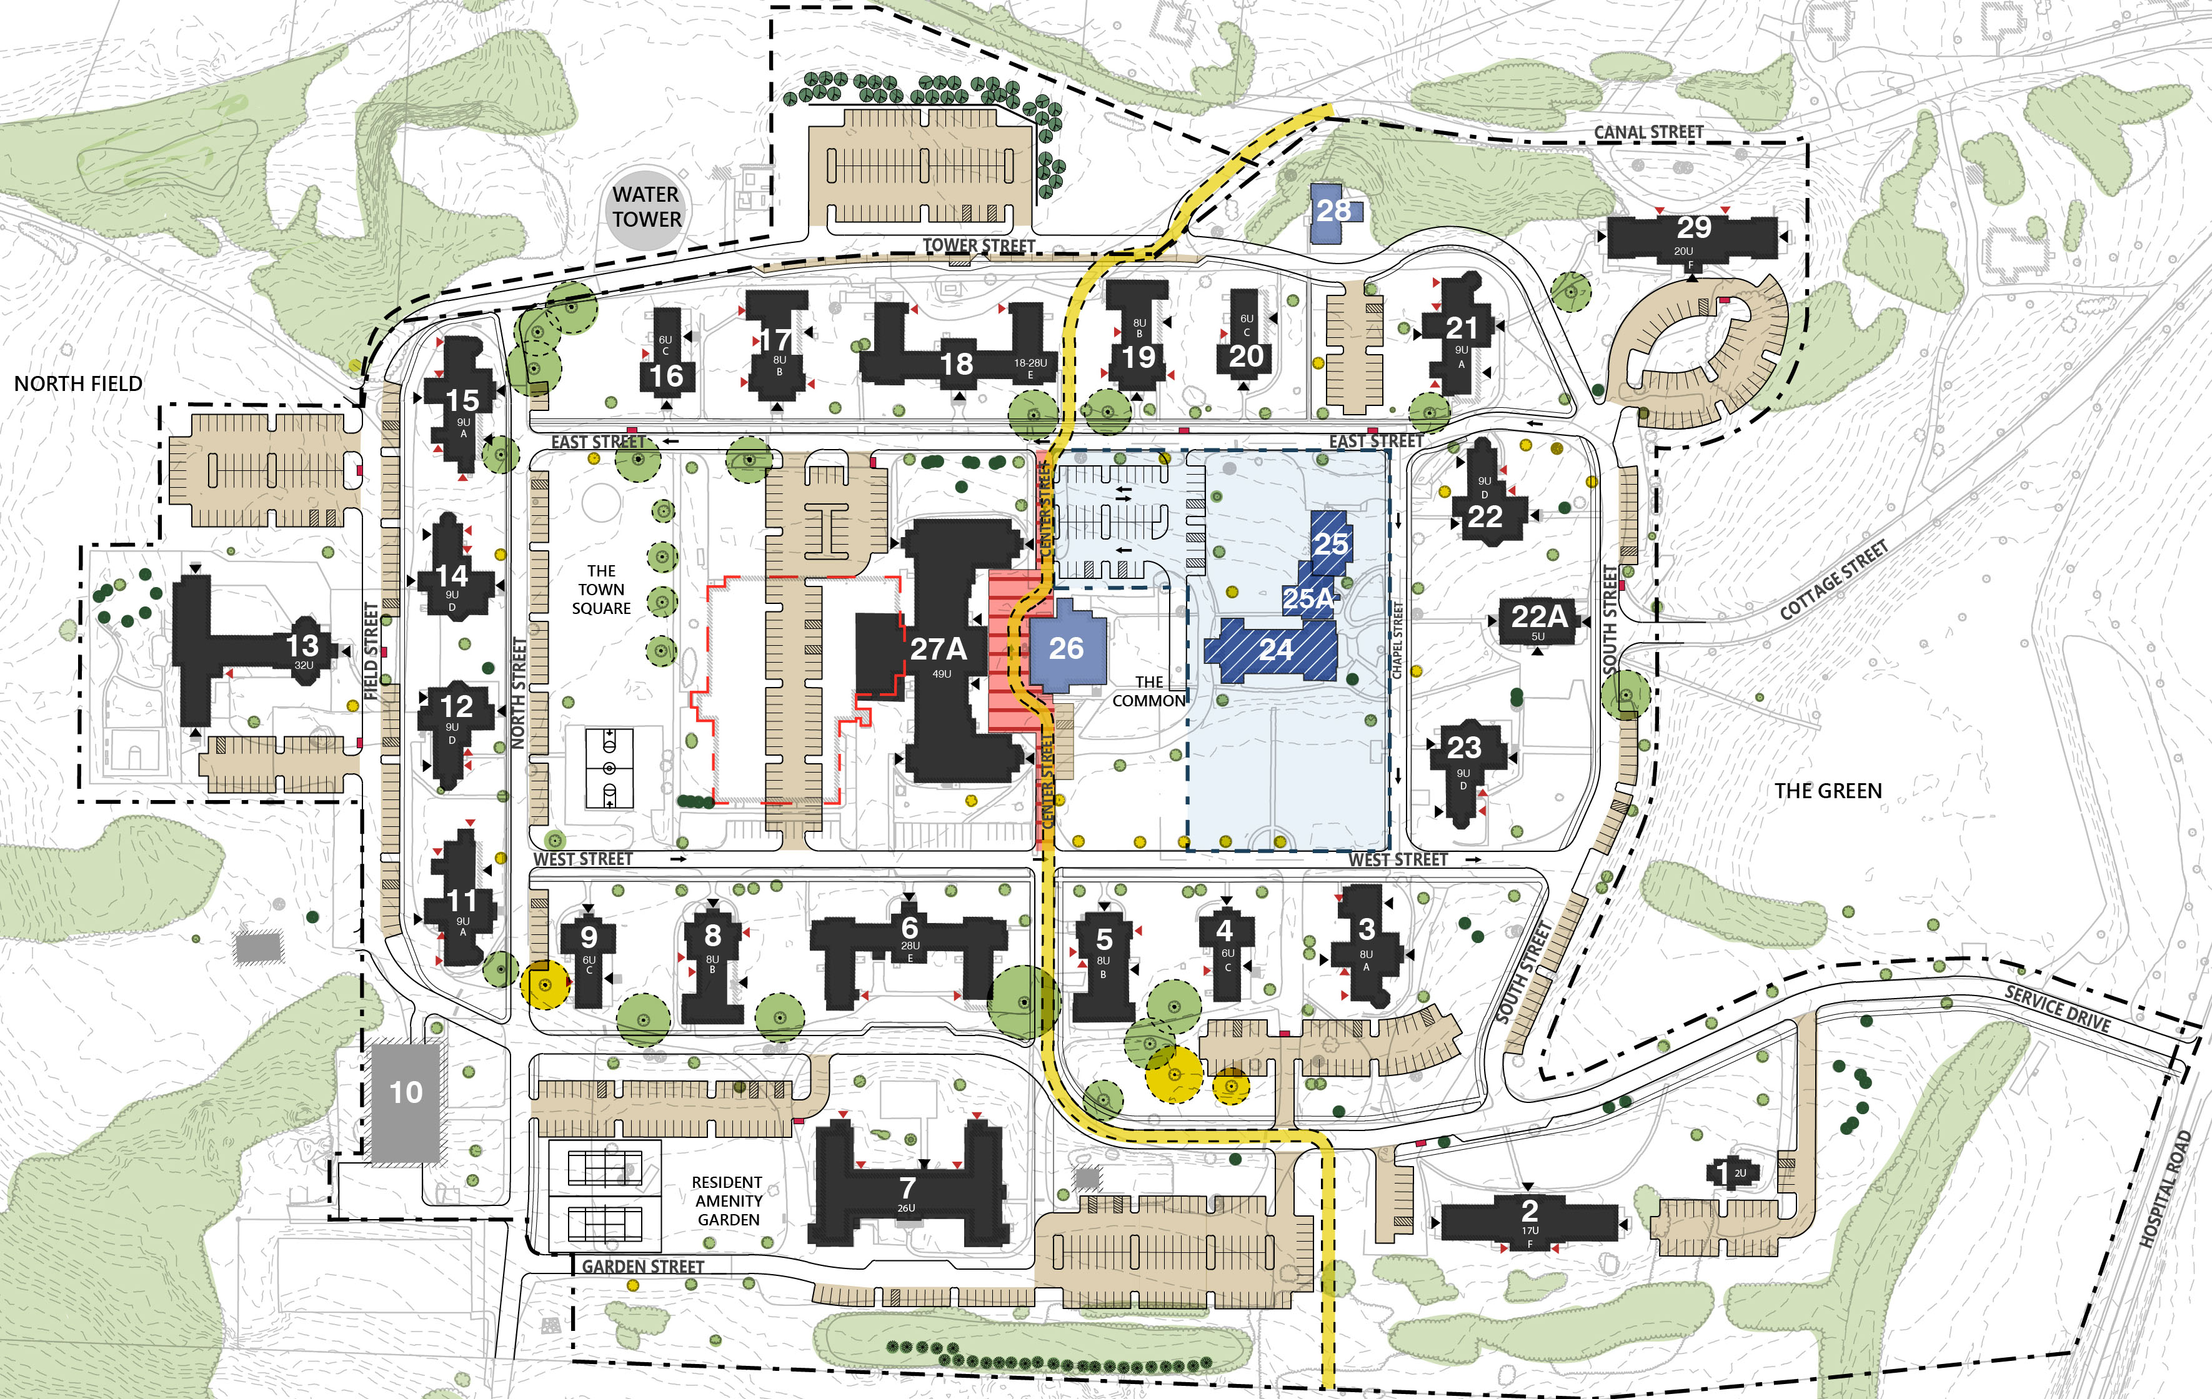
MSH Mailboxes (Subject to USPS Review & Approval)

Slide 18
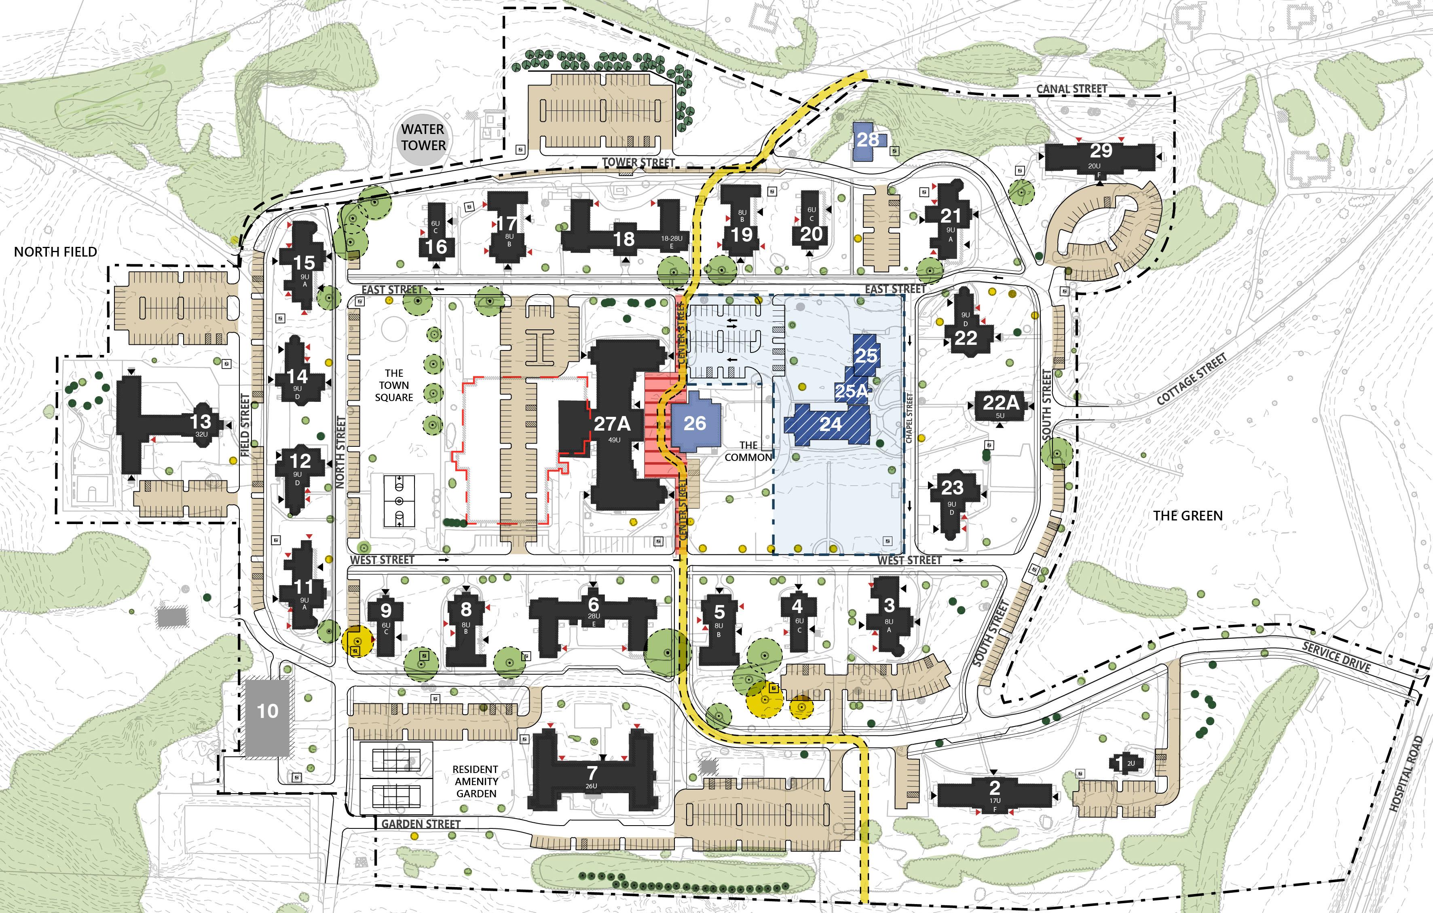
MSH Transformers

Slide 19
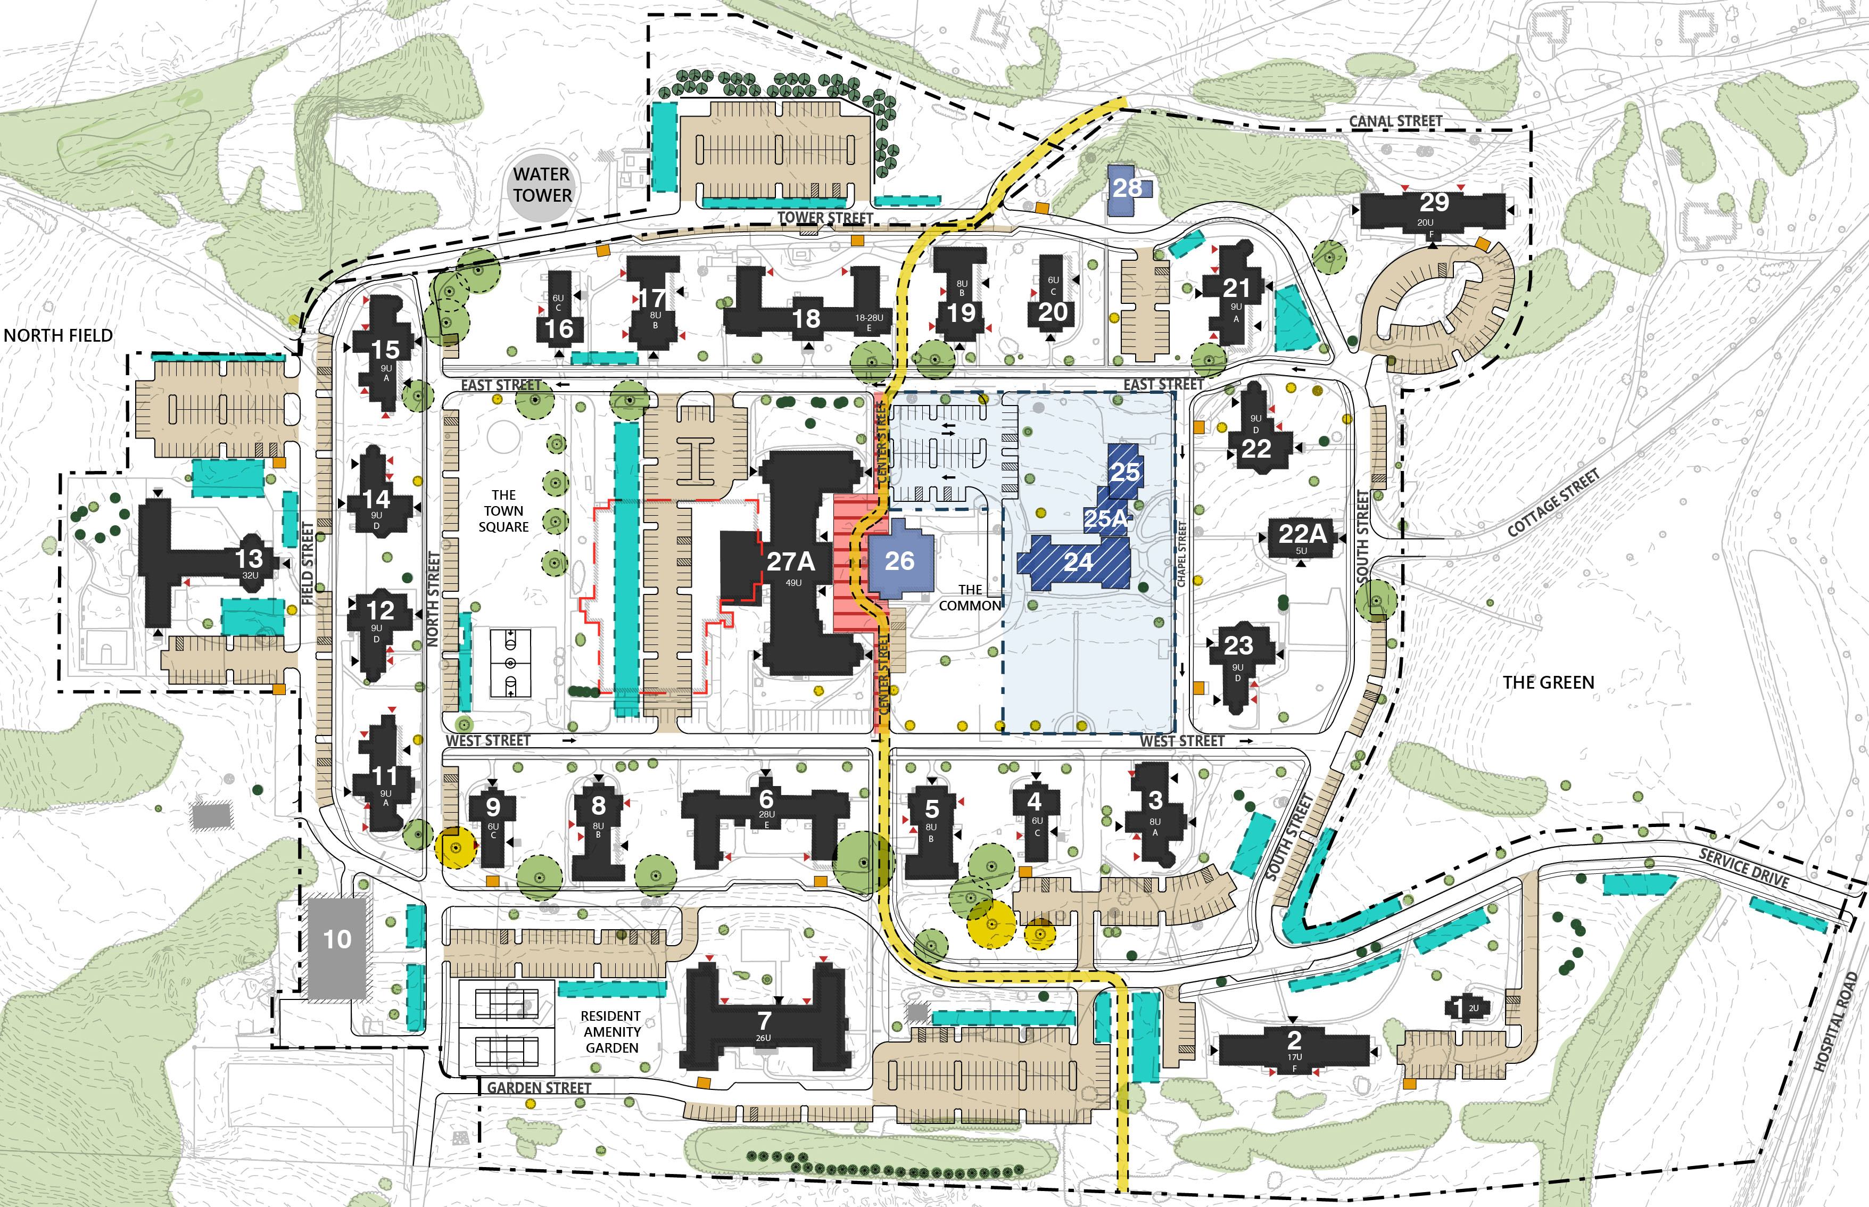
MSH Snow Storage and Dumpster Locations

Slide 21
Landscape | KMDG
WATER TOWER PARKING LOT

Slide 22
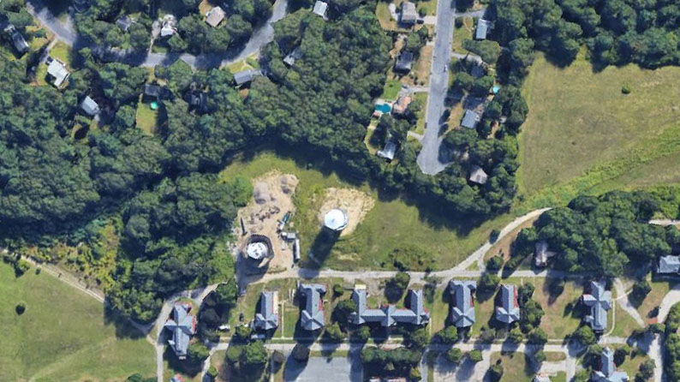
EVERGREEN
LONGMEADOW
WATER TOWER
Water Tower Parking Lot Existing Site

Slide 23
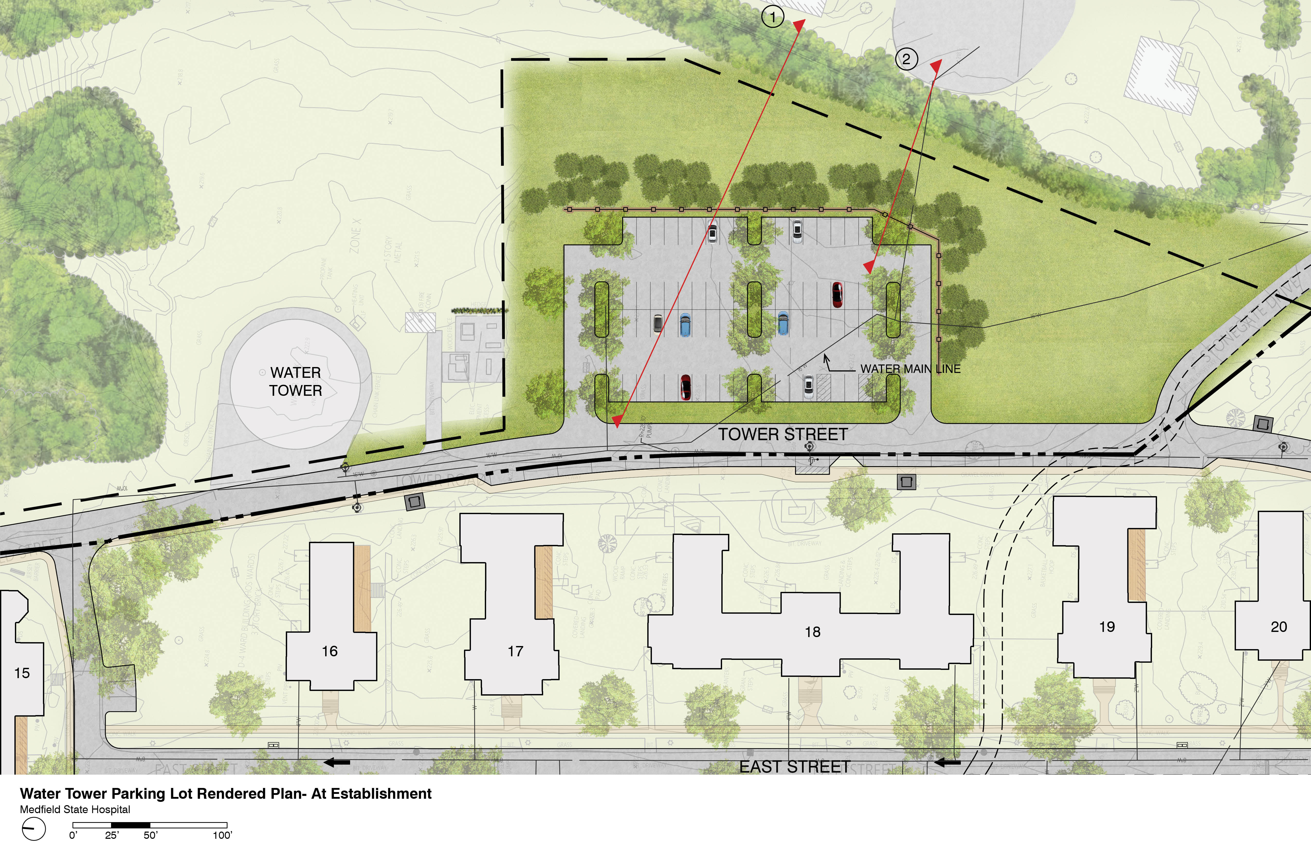

Slide 24
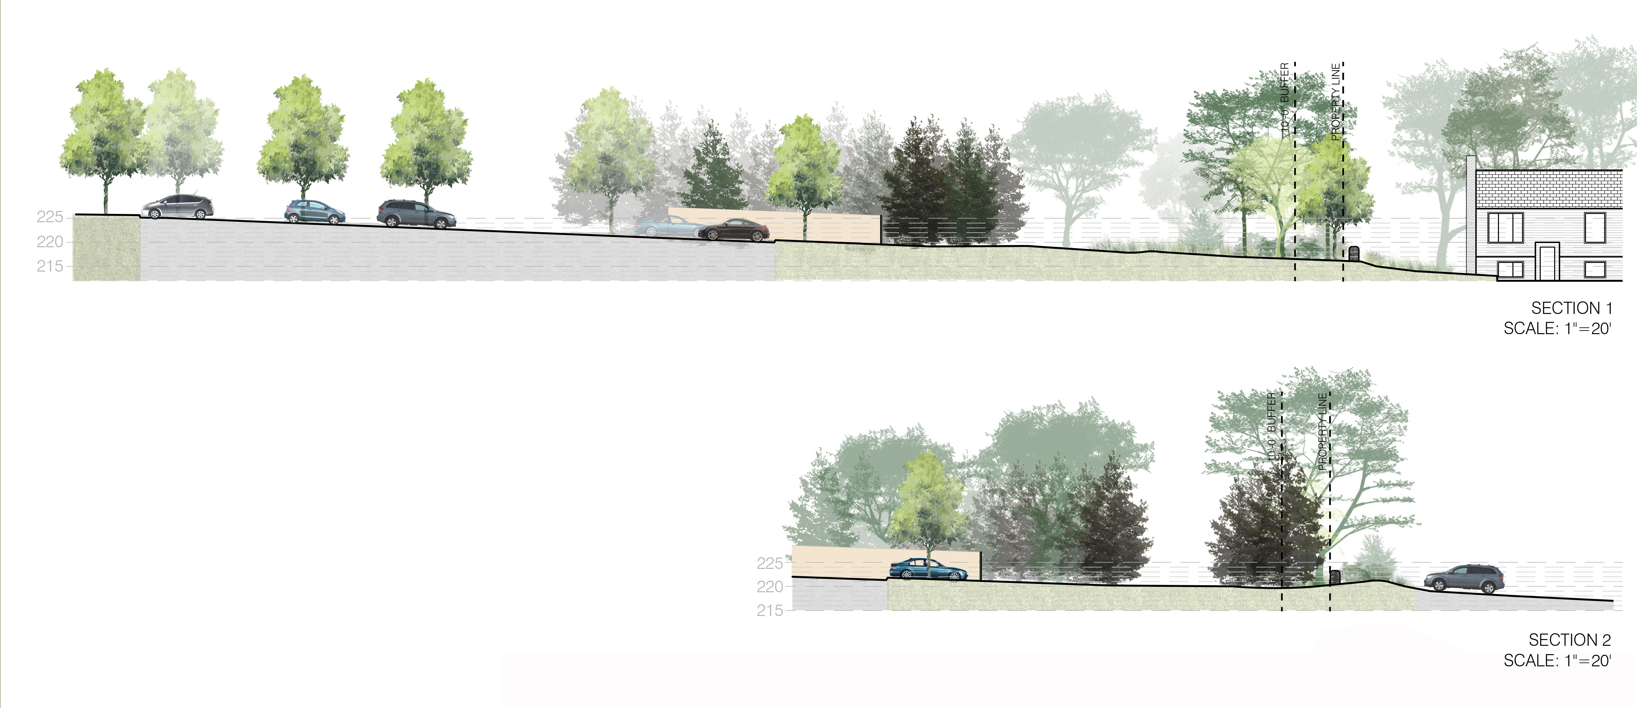

Slide 25
Landscape | KMDG
LIGHTING

Slide 26
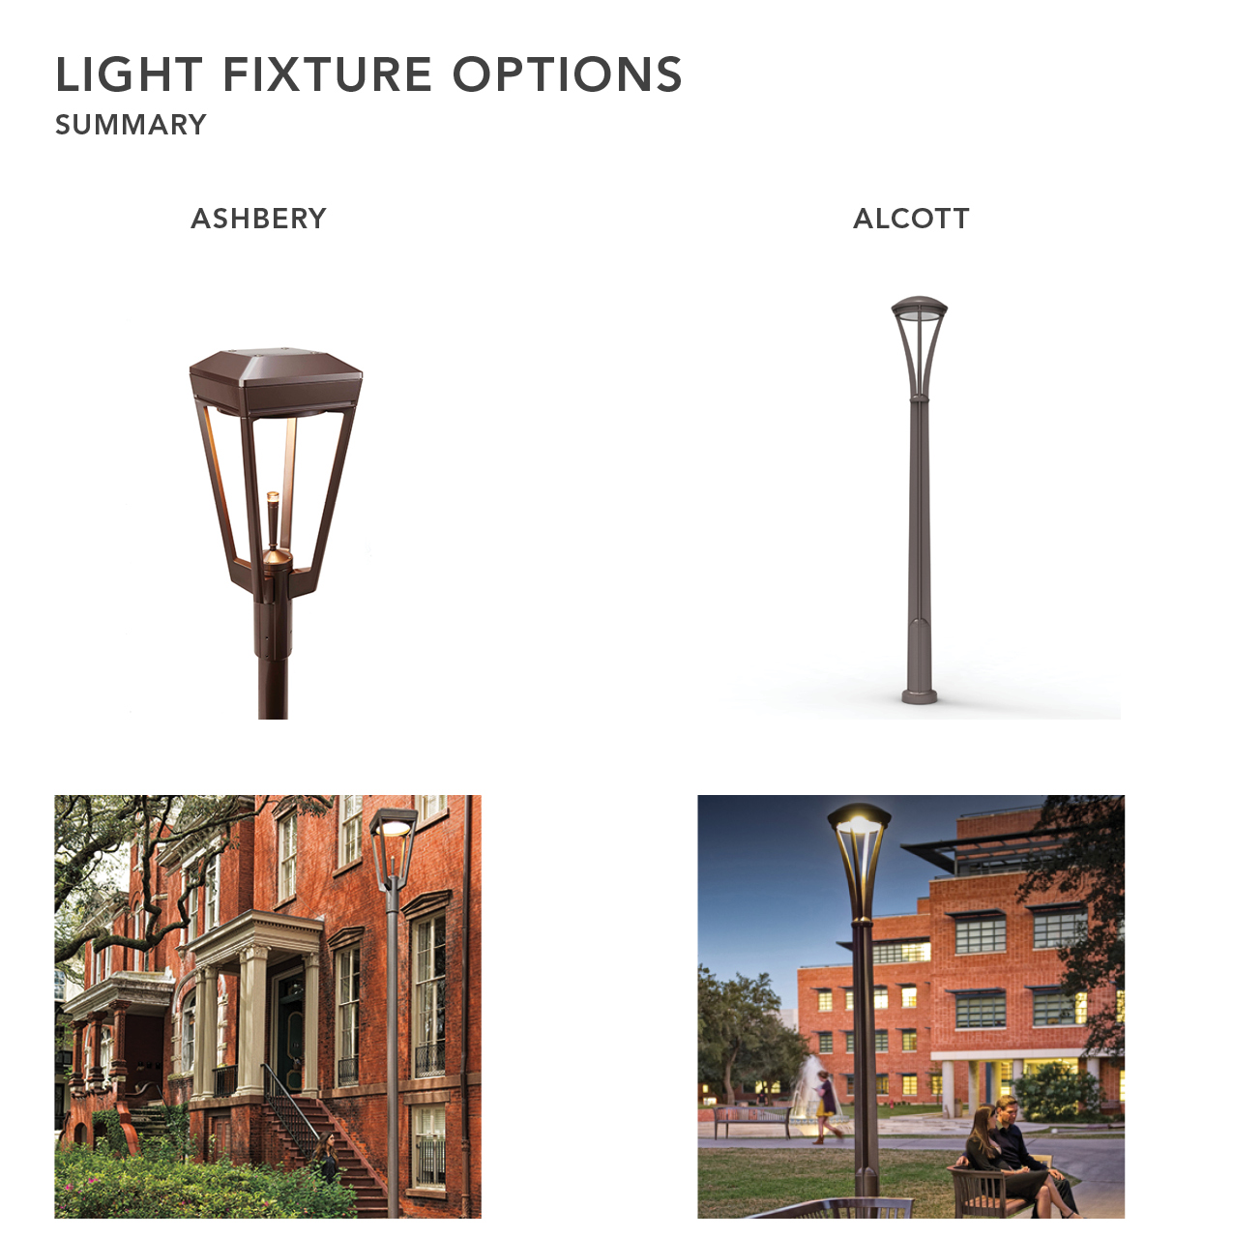
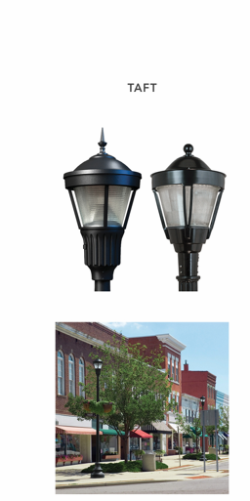

Slide 27
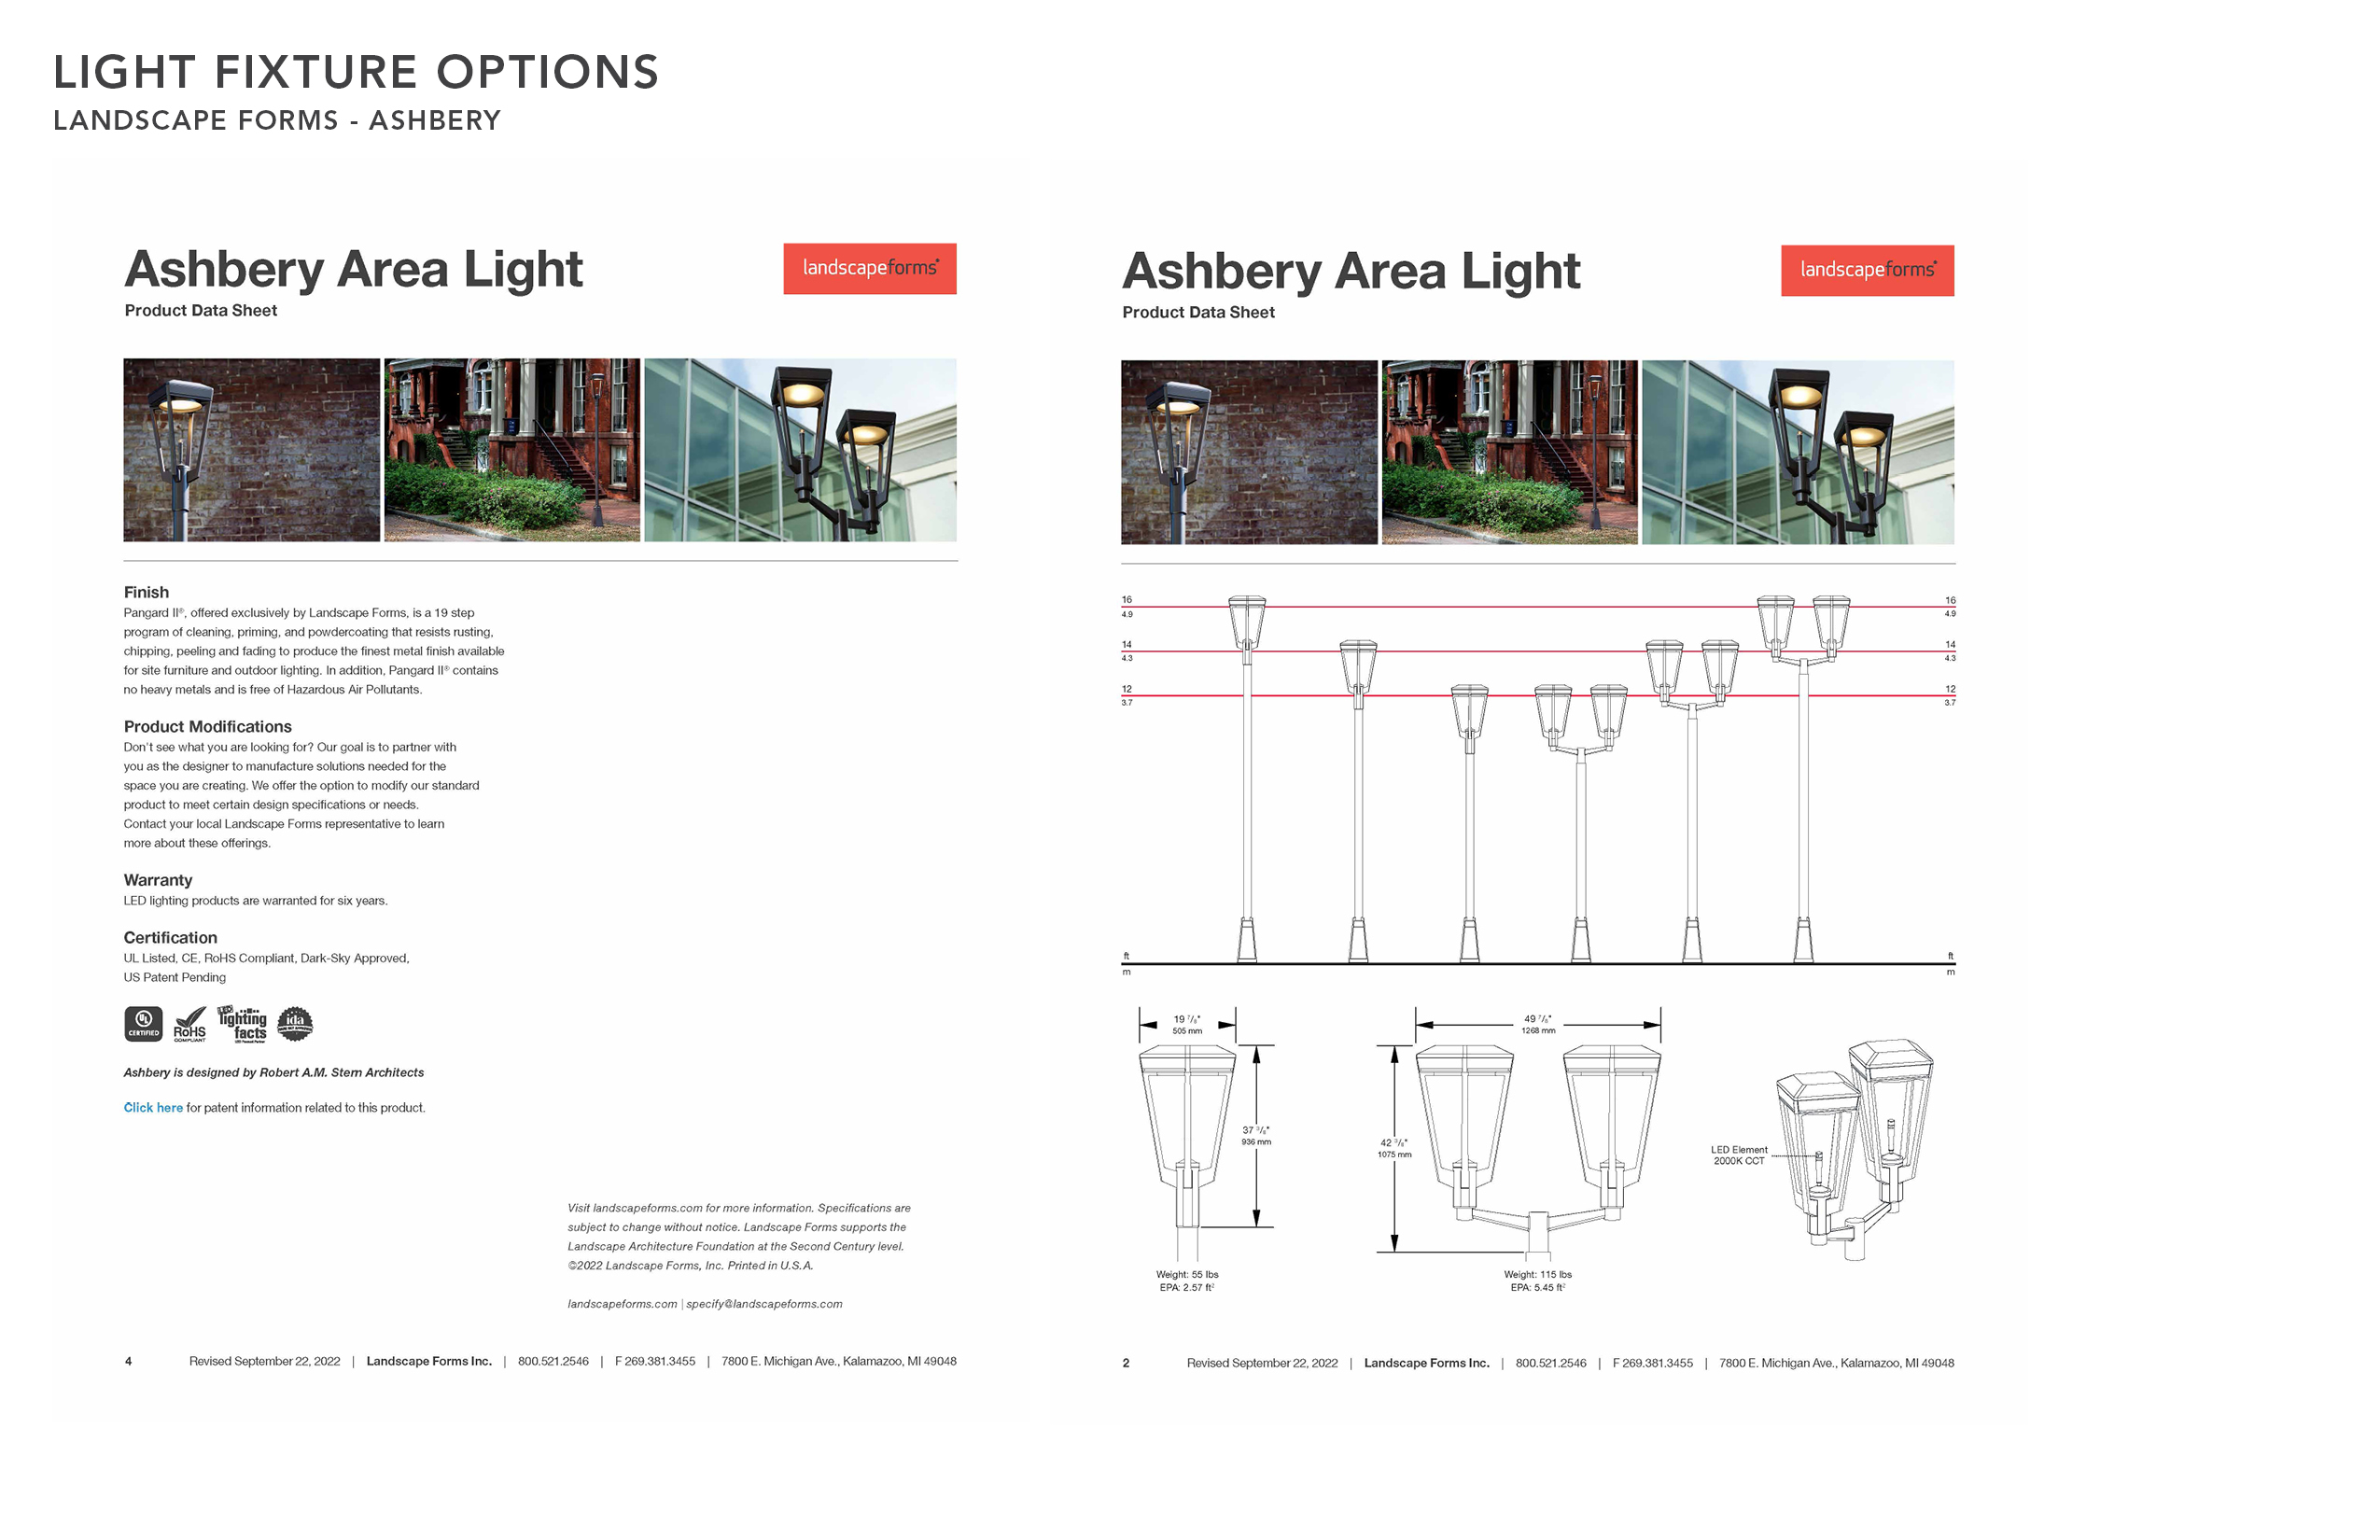
SITE PLAN

Slide 28
Planning Board Q&A

Slide 29
Public Comment Opportunity

Slide 30
Roadways, Parking & Circulation |VHB

Slide 31
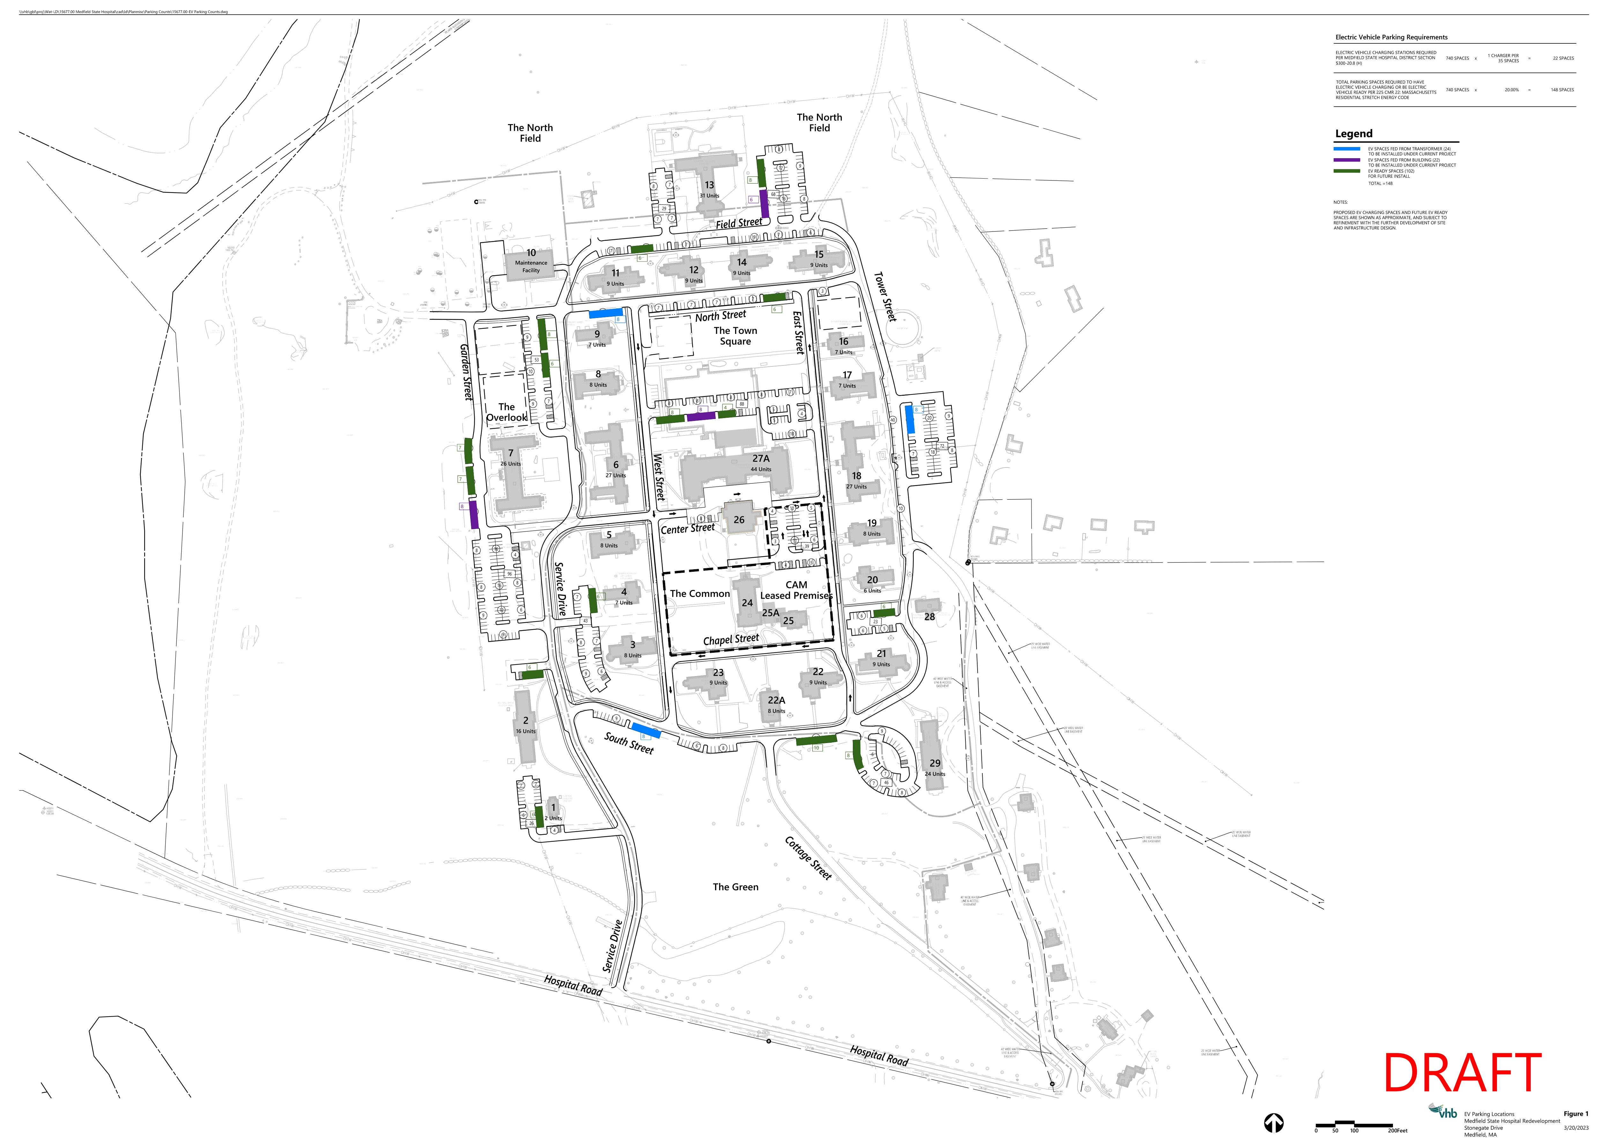
Electric Vehicle Charging
Requirements
22 EV Parking Spaces Required per MSH District Section 300-20.8(H) at 1 charger per 35 spaces
Total of 148 Parking Spaces to have EV Charging Stations or be EV Ready per 225 CMR 22: Massachusetts Residential Stretch Energy Code
Provided
46 EV Parking Spaces
102 EV Ready Parking Spaces

Slide 32
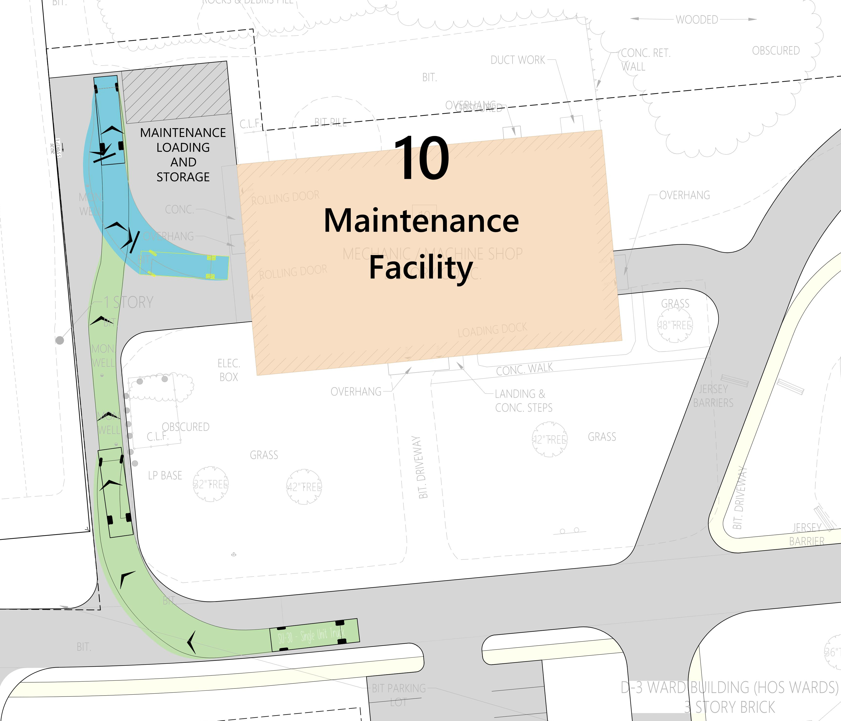
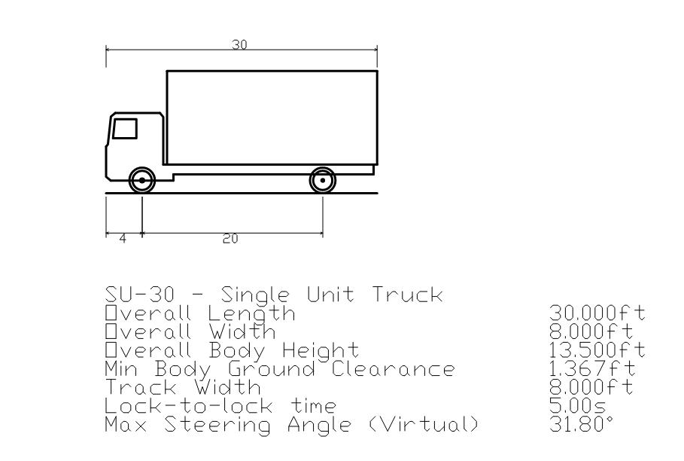
Building 10 Maintenance Facility

Slide 33
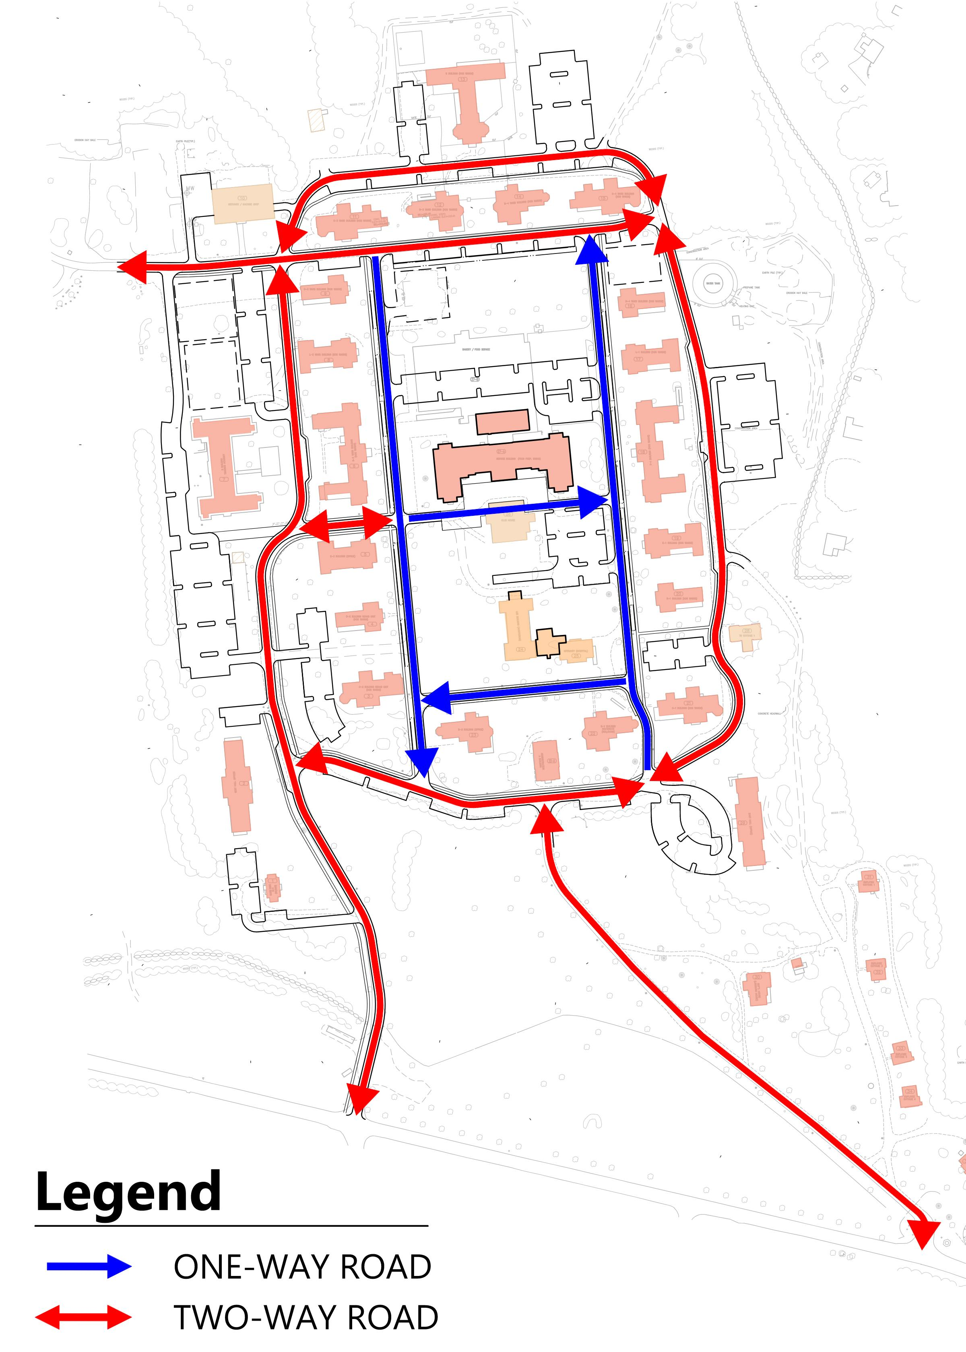
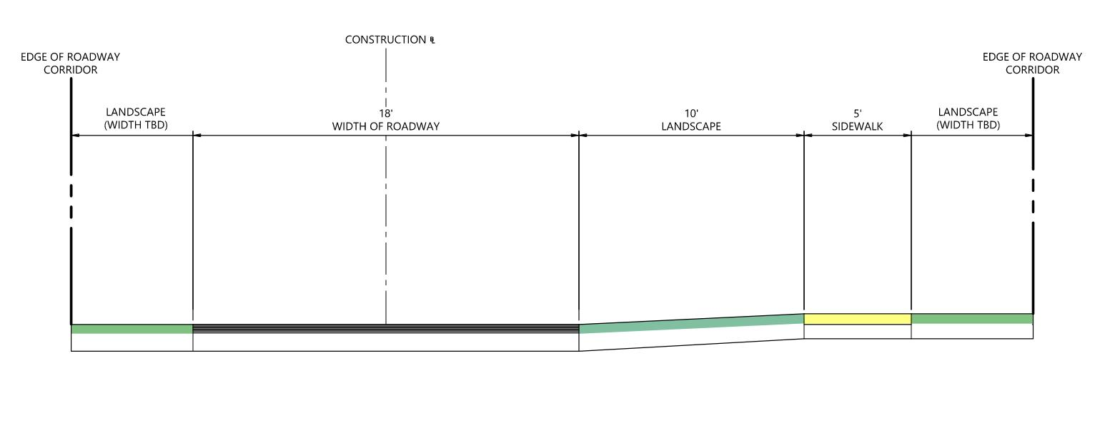
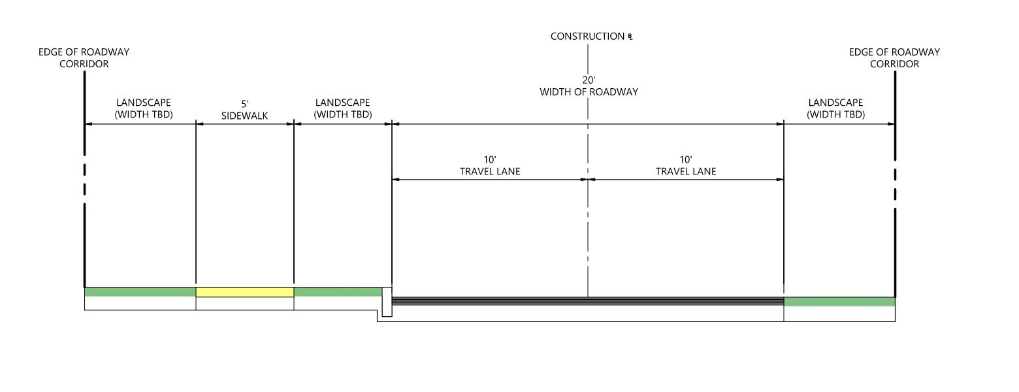
Typical One-Way Road
Typical Two-Way Road
Notes:
Not meeting subdivision requirements, intent is to meet historical context and preserve existing trees while providing a safe and accessible site
Mimic historic context, minimize vehicle speeds, minimize impervious area
Outer loop vs inner limited types
Emergency access throughout per coordination with MFD (WB-40 trailer sizing for reference)
Aligned with infrastructure to support the redevelopment
VGC curbing

Slide 34
Infrastructure | VHB

Slide 35
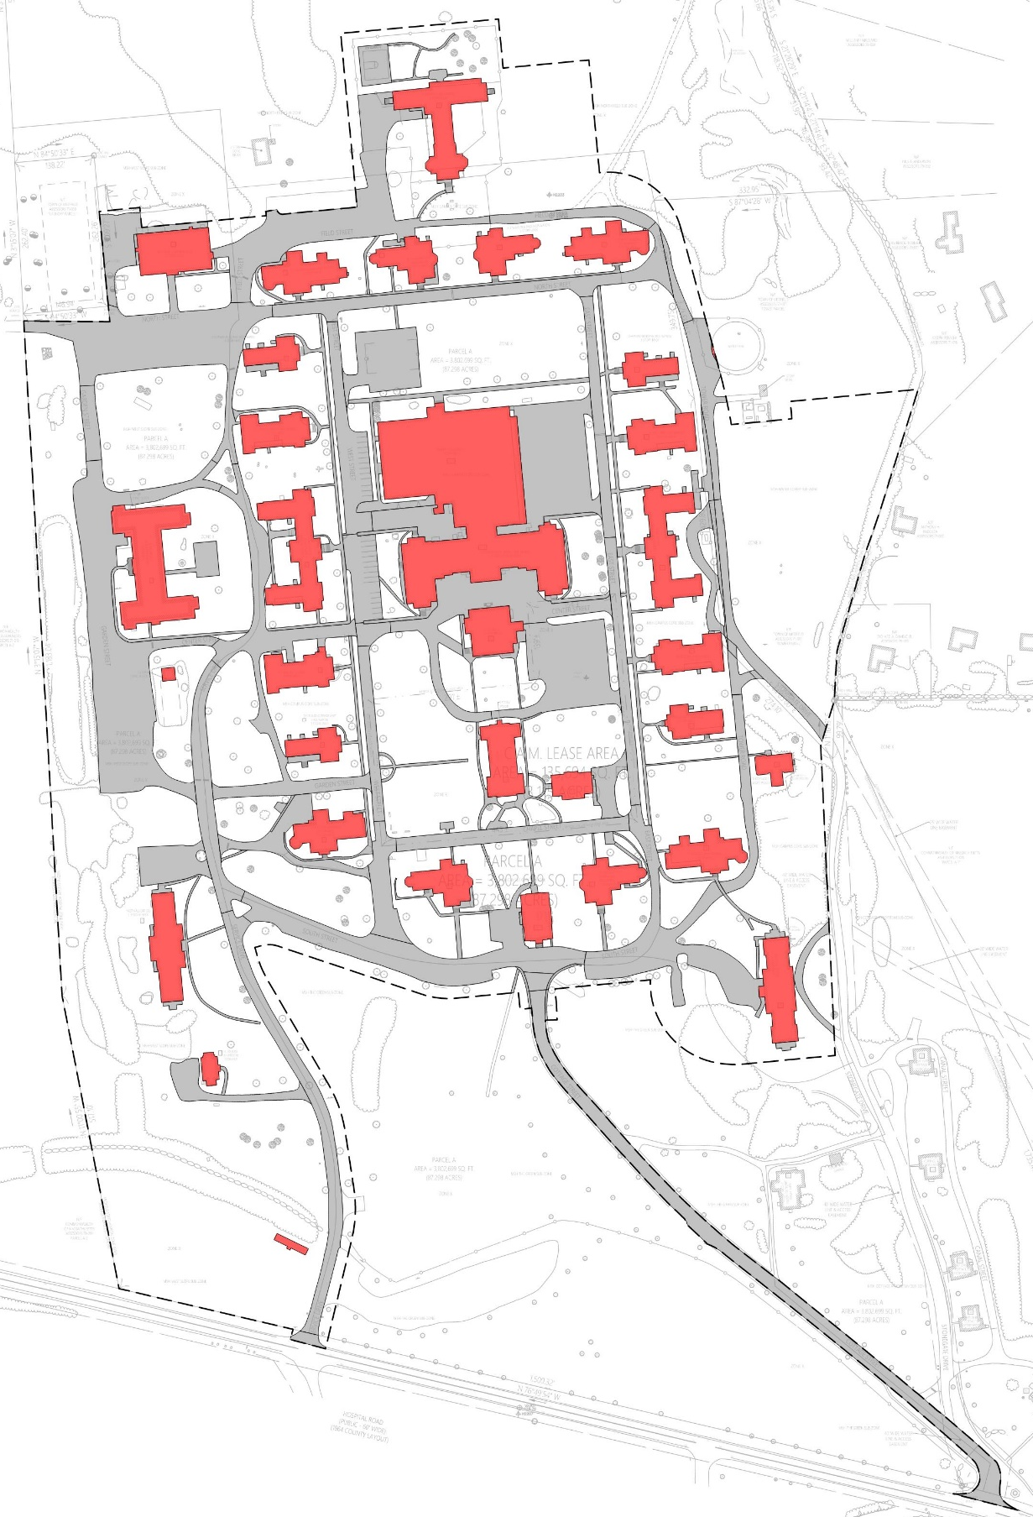
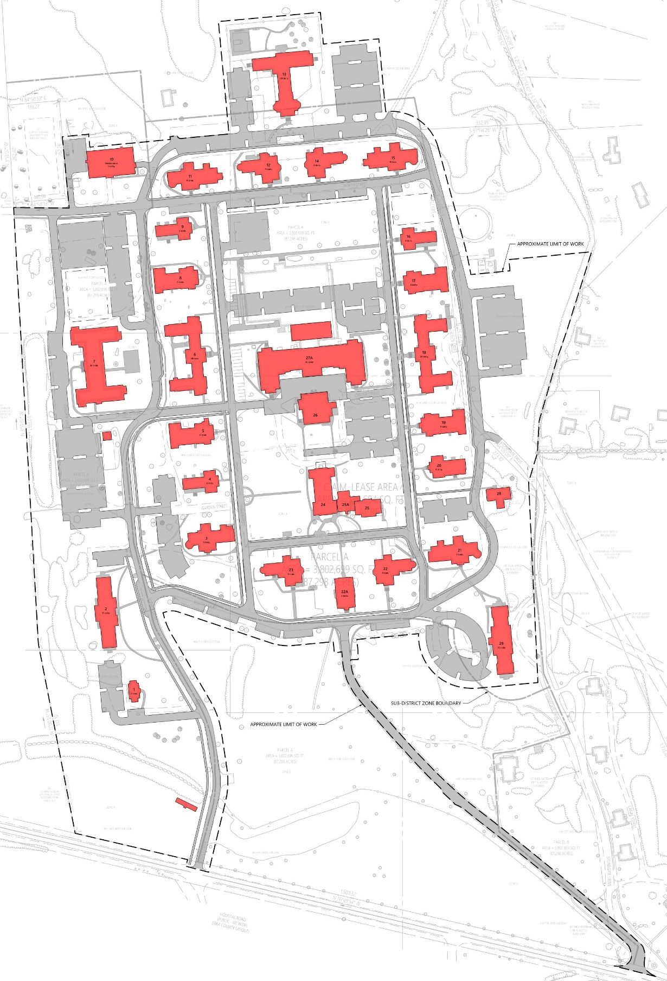
Preliminary Impervious Area Analysis
Total Project Area: 50.5 acres
Approximate Proposed Impervious Area: 19.5 acres
Approximate Change in Impervious Area: 0.5 acres
Stormwater Management Plan will mitigate increase in impervious surface area.
Existing Conditions
Proposed Conditions
Notes:
Previous Impervious Area Analysis
Town Meeting – Original Conceptual Layout: -0.8 acres change in impervious
November Submission – Added sidewalks, significant design changes: -0.2 acres change in impervious
January Submission – Bldg 29, CAM, Cottage Street, Tower lot expansion: +0.3 acres change in impervious
Latest – Added basketball and pickleball, reduction of existing impervious: +0.5 acres change in impervious

Slide 36
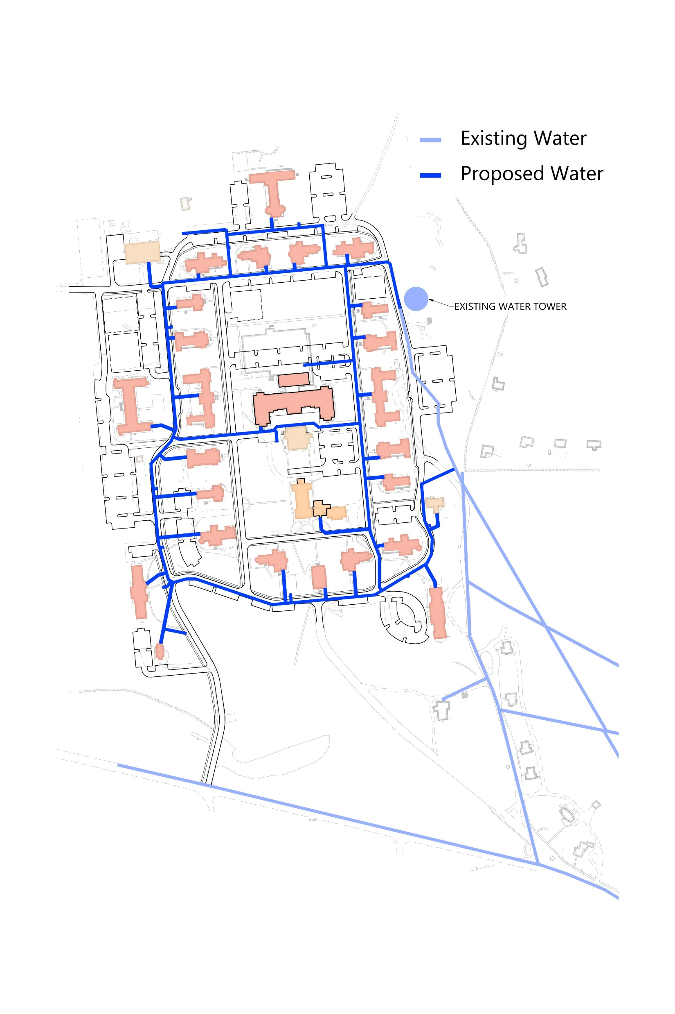
Water Infrastructure
Previously Estimated Residential Water Demand from Master Plan: 114,007 GPD
Current Proposed Residential Water Demand: 69,468 GPD
Hydrants within 100-ft of all FDCs (7-ft offset from roadways, typ)
New 8” mains, connection to existing 16” main
Potential for Irrigation Water Usage
Per the Land Disposition Agreement, “The Designated Developer may use public water for irrigation of the Project Area following construction but said use shall be subject to approval by the Medfield Board of Water and Sewerage during the permitting process for the Project.”
Notes:
The Project team has evaluated the proposed program against the water system improvements identified in the November 14, 2019 memorandum included in the Master Plan, and utilize the Proposed Water Plan as prepared by Pare Engineering Corporation, dated September 25, 2019 for the preliminary basis of design.
Estimated water demand for the Redevelopment Project, CAM Buildings, and future Town-retained buildings is identified in the Master Plan is 69,468 GPD based on a 10-percent increase over the estimated sewer flows to account for non-consumptive uses. This usage is below the projected demand of approximately 114,007 GPD from the water and sewer report by Pare Engineering, which stated that the projected demand could be accommodated under current authorized limits.
The Project will include all new water distribution infrastructure designed and installed to the Medfield Water & Sewer Department’s standards and will be fed via the existing water storage tank located in The Water Tower sub-district and existing 16” water main that extends down towards Hospital Road. This will include installation of a new 8” ductile iron water distribution loop system with associated building connections for domestic and fire protection services, gate valves, hydrants and a minimum of two (2) connections back to the active portion of existing 16” water main located at the eastern portion of the Site as shown on the Schematic Design plans. Individual water meters are anticipated to be proposed at each renovated building.

Slide 37
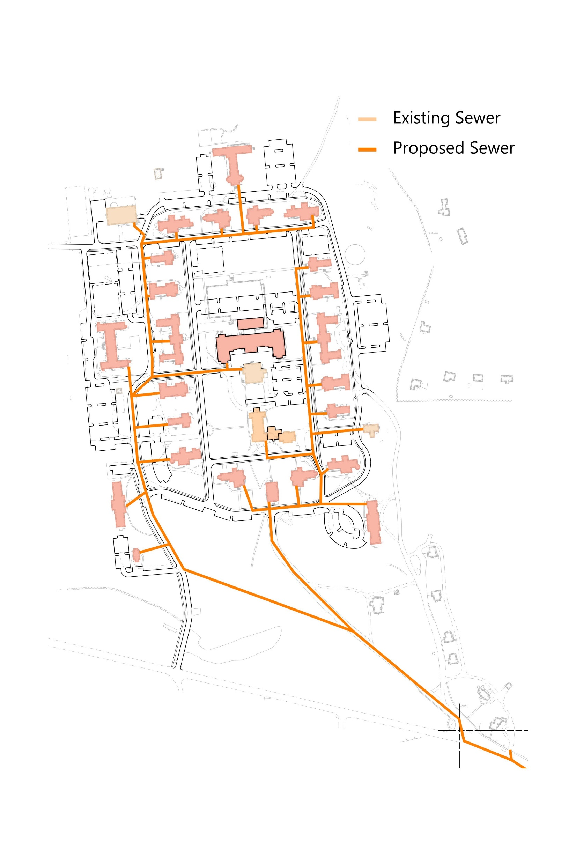
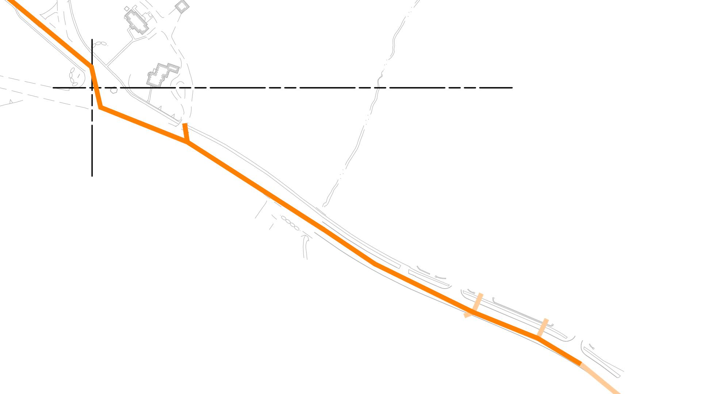
Sewer Infrastructure
Previously Estimated Wastewater Generation from Master Plan: 96,910 GPD
Current Estimated Wastewater Generation: 63,153 GPD
±1,250 LF of offsite sewer improvements down Hospital Rd towards Copperwood
Cleanouts at all building services
Notes:
Previous analysis of the wastewater generation was performed by Pare Engineering Corporation based on the redevelopment program as specified in the Medfield State Hospital Strategic Reuse Master Plan, dated 2018, which estimated the wastewater generation to be 96,910 gallons per day (GPD). This analysis, including a peer review performed by Environmental Partners, noted that the additional wastewater generated by the Project could be accommodated by the downstream municipal system with the improvements as identified in the Proposed Sewer Plan. The proposed redevelopment, CAM Buildings, and future Town-retained buildings identified in the Master Plan are anticipated to generate 63,153 GPD of wastewater based on MassDEP rates per 310 CMR 15: System Sewage Flow Design Criteria for peak estimated sewer generation. Due primarily to the reduction in proposed residential units from the original Master Plan to the proposed redevelopment, the wastewater generation associated with the redevelopment is held well within the capacity identified in the original analysis and therefore still sufficient capacity in the municipal system to accommodate. An updated full program summary of both the initial Master Plan program and redevelopment programs, with associated wastewater generation is included as Exhibit D4 in Appendix D.
Sanitary sewer utility improvements associated with the Project will be generally consistent with the recommendations of the 2018-2020 analysis. Due to concerns with combined sewer systems, aged infrastructure/clay pipe, and sources of inflow and infiltration (I&I) and illicit connections, the Project will provide a network of new PVC sanitary sewer mains/services and precast sanitary sewer manholes to support the redevelopment, all installed to the Medfield Water & Sewer Department standards. New infrastructure will be installed within the Site and extended down to Hospital Road. The Project will also include a sewer extension/replacement from Cottage Street, down Hospital Road to Stoneridge Way as shown on the Schematic Design Utility Plans. Sanitary sewer mains throughout the Site are anticipated to be proposed as 8” SDR 35 polyvinyl-chloride (PVC) pipe, with 4” and 6” service laterals to the renovated buildings as sized by the MEP Engineer. Sanitary sewer cleanouts will be provided on each building service lateral approximately 5-10 feet from the footprint prior to connecting to the sanitary sewer mains.
As a result of the new sanitary utility network, the Project is anticipated to provide a near total reduction of inflow and infiltration (I&I) into the sanitary sewer system as the existing sewer system is being replaced, removing any sources of inflow/infiltration or illicit connections.

Slide 38
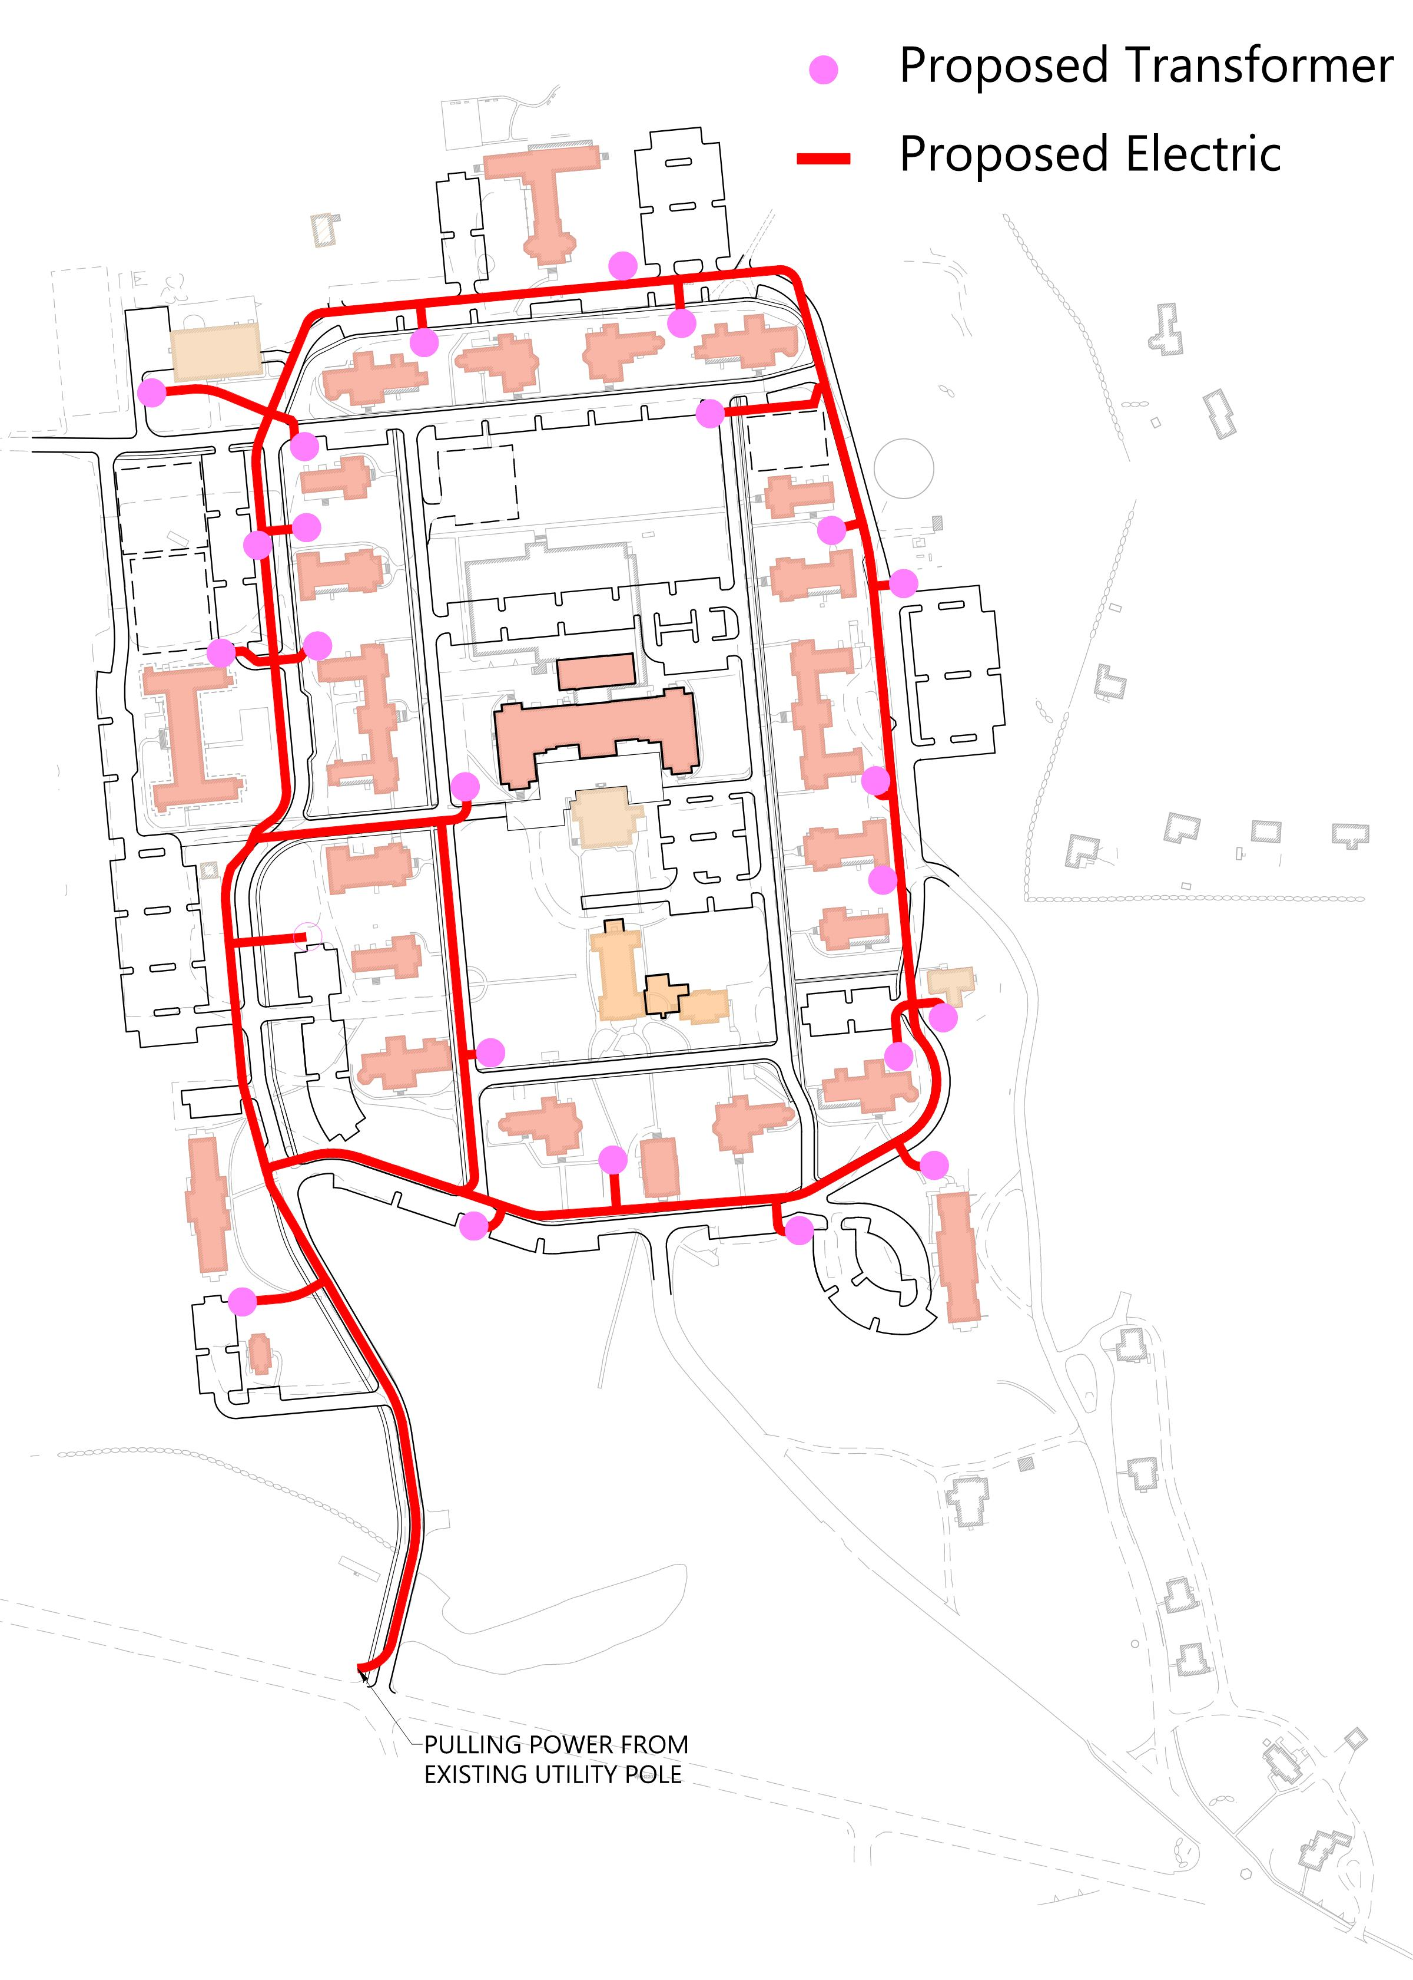
Electric Infrastructure
All new electrical infrastructure (ductbanks/manholes) shall be installed underground
Removal of existing utility poles and overhead wires within the Hospital Site
Transformers located to support proposed redevelopment program and future EV ready parking

Slide 39
Infrastructure | TFI

Slide 40


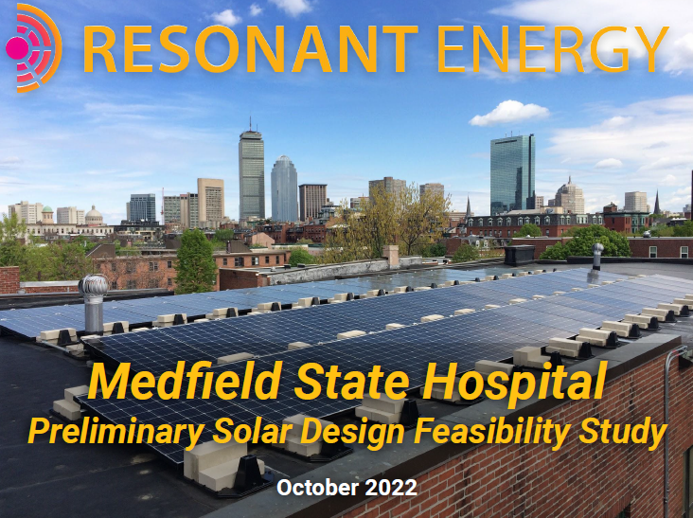
Solar Feasibility Study
Significant Historic Tax Credit Constraints
NPS/MHC may allow solar arrays on flat roofed buildings ~ Buildings 7, 10 & 13
Proposed in TFI Part II Submission for 7 & 13
Subject to structural integrity of existing roofs
Parking canopy solar arrays are currently not allowed per Zoning of the MSH Site
Planning Board continued Zoning Bylaw Amendment on solar array parking canopies to Town Meeting 2024
Subject to approval by NPS, MHC, Town of Medfield, Planning Board, Medfield Historic Districts Commission, project lender, and project investor
Notes:
Including potential for rooftop on 7 & 13 in Part II;
No longer proposing canopy on WTP;
Building 7 canopy - per zoning, would have to return to PB for approval after zoning was voted on at Town Meeting 2024.

Slide 41
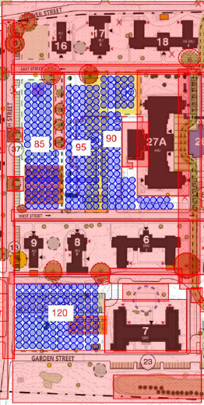

District Energy Feasibility Study
Study produced in consultation with ICON Architecture, R.W. Sullivan, and McPhail Associates
Environmental Constraints – Reuse of steam tunnels and proximity to Laundry Parcel AUL Area presents risk of hazardous material exposure and remediation
Cost Restraints – $50M for wells, piping, and central plant on top of the project’s other extraordinary costs
Site Restrictions – MSH Site cannot accommodate the 300 wells needed for anticipated energy load
Notes:
Geothermal District Energy Approach
The team believes the use of geothermal energy is a forward-thinking and sustainable energy alternative
if appropriately designed and financially feasible. In order to determine if geothermal technology at
MSH renders further study, Trinity engaged the design and engineering team of ICON Architecture, R.W.
Sullivan (Mechanical Engineer) and McPhail Associates (Geotechnical Engineer) to provide guidance and
consultation.
The team’s initial study was to determine if a district energy system would be appropriate for the site. It
was suggested that MSH’s former steam tunnels could serve as potential conduits for a district-wide
geothermal system; however further examinations concluded this was not a viable path. Given the unit
mix and square footage, the design team made reasonable assumptions about anticipated energy loads.
The design team estimated that approximately 300 wells would be needed to adequately serve the site.
While the number of wells may suffice, the distribution is hindered by site restrictions described below.
Please refer to Exhibit B Well Field Layout Site Plans from ICON Architecture.
Site Restrictions
The design team reviewed the preliminary MSH Site Plan to see if it could accommodate the number of
geothermal wells needed to accommodate district energy. Site constraints included, but were not
limited to, the required spacing between wells, utility pathways and road infrastructure, building
footprints and required setbacks, tree canopies, and locations for future potential plantings to enhance
views and open space. Please see attached Exhibit C Study from McPhail Associates and RW Sullivan.
Environmental Concerns
Given the site’s Phase I Environmental Site Assessment, and the neighboring remediation of the Laundry
Parcel and its associated Activity and Use Limitation (AUL) the reuse of existing steam tunnels presents a
risk of remediation and an exponential risk of cost overruns that would not be supported by the project.
Cost Restraints
Preliminary estimates for a geothermal district energy system include cost of wells, piping, and central
plant. These expected costs, notwithstanding any risks associated with remediation and of the existing
tunnels, on top of the project’s expected extraordinary site costs surpassing $50 million, are prohibitive
to geothermal development.

Slide 42
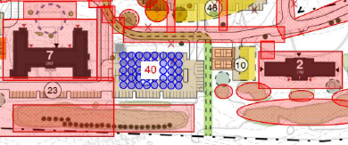

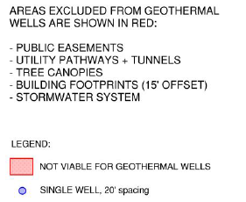
Select Geothermal Loop Feasibility Study
Explored vertical, closed-loop geothermal well systems serving ground source heat pumps for select buildings
Small scale, by-building approach hindered by limited site area near buildings
$2M cost increase compared to the currently proposed all-electric, air-source heat pump system
Operational Concerns – Management concerned by inefficiencies created by multiple utility systems
Site constraints, capital costs, operational challenges, environmental risks, and the inherent complexity of the project as proposed rule out this approach.
Notes:
Select Geothermal Loops
The design team explored the feasibility of vertical closed loop geothermal wells serving ground source
heat pumps for select buildings at the MSH campus. Please refer to Exhibit B Well Field Layout Site
Plans from ICON Architecture. For this exercise, the design team considered three centralized well fields
for larger buildings serving buildings with a larger number of units for efficiency. These included one well
field servicing Buildings 13 and 10 together; another well field servicing Building 27A; and a final well
field servicing Buildings 2 and 7 together. Finally, the team explored a well field servicing one of the smaller buildings,
the 9-unit Building 15. The small scale, or by-building approach for well fields is hindered by the limited site area near buildings.
Preliminary cost differential between an electric air-source heat pump system and a geothermal HVAC
system, as summarized in R. W. Sullivan Geothermal HVAC Systems Narrative, constitutes approximately
a $2,000,000 cost increase for the Select Well Field approach.
Operational Concerns
Concerns were raised about the operational inefficiencies created by multiple utility systems at the site.
In consultation with management, it was determined that operations would be best served with
consistent systems across the property.
Conclusion
While geothermal energy would be a feasible alternative energy source for the site, the site constraints,
capital costs, operational challenges and potential environmental risks, coupled with the inherent
complexity already associated with the 27-building, certified historic rehabilitation render it an energy
source the development team is not prepared to pursue at this time.
Trinity’s priority for the Medfield State Hospital redevelopment continues to be the salvaging of the 27
historic buildings. The development team is engaging on multiple fronts to advance the project. This
includes detailed conversations with the National Park Service and Massachusetts Historic Commission
regarding acceptable treatment of the buildings’ historic features; advancing site plan development for
Planning Board Review and strategies to secure funding for the extraordinary site costs for hazardous
materials and infrastructure. Finally, in our effort to attract institutional capital to the redevelopment,
we remain focused on mitigating the percussive noise from the adjacent gun range training field that we
have consistently represented will preclude any private investment on the site.

Slide 43
Planning Board Q&A

Slide 44
Public Comment Opportunity

Slide 45
THANK YOU!

